Slide 1
NORM in Produced Waters: Basics of Problem Avoidance
Presentation to the SPE Water and Waste Water Management Study Group.
19 May 2014
George E. King, P.E.

Slide 2
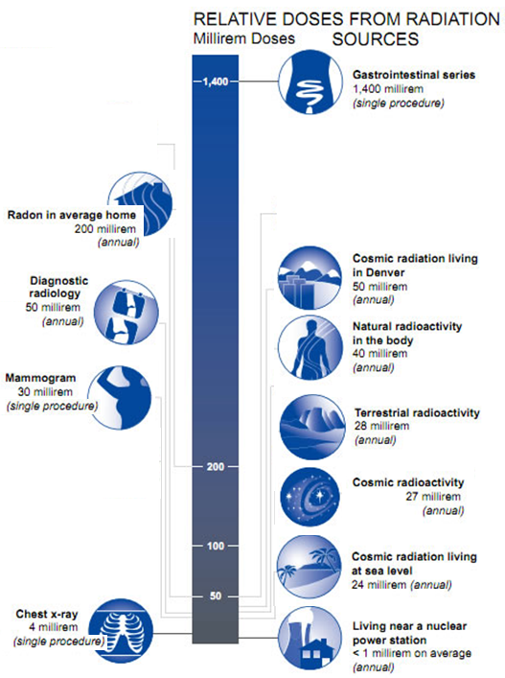
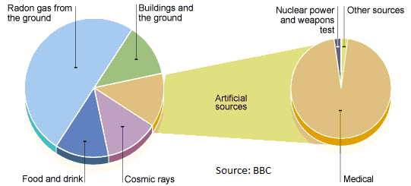
Comparison Doses
EPA
BBC
Total background is about 620 mrem/yr and OSHA occupational limit is 5,000 mrem/yr.

Slide 3
Some US Background Levels
Location | ²²⁶Ra | ²²⁸Ra | Units | Source
Air | 1.5x10⁻⁵ | 2.3x10⁻³ | pCi/m³ | Radium-226 and 228 in Drinking Water California Public Health Goal, March 2006
Dust (over NYC) | 8x10⁻⁵ | 1.5x10⁻⁴ | pCi/m³ | Radium-226 and 228 in Drinking Water California Public Health Goal, March 2006
Soil (356 samples from 33 states) | 1.1 |  | pCi/g | Radium-226 and 228 in Drinking Water California Public Health Goal, March 2006
Rock | 0.42 to 1.3 |  | pCi/g | Radium-226 and 228 in Drinking Water California Public Health Goal, March 2006
Water (990 samples) | 0.4 (mean) | 0.5 (mean) | pCi/L | USGS 1998
Contaminated Soil | 1 to 37,000 |  | pCi/g | From coal burning & mining/milling
Extremes from limited areas in the North Sea – 2000 to 27,000 pCi/g for scale and 130 to 1300 pCi/g in sludge.
Rule of thumb: if on-site readings background readings are about twice the normal background levels of 10 to 15 μR/hr., NORM may be present in equipment, soil, water or air.

Slide 4
Radiation types
alpha and beta particles are the most damaging to humans. Gamma rays are much less damaging.
Alpha (α) particles – cannot penetrate a layer of dead skin
Beta (β) particles – stopped by thin metal
Gamma (γ) waves – penetrates steel and stopped by lead
The principal hazard from alpha and beta energy is from inhalation and ingestion.
Marcellus Shale • Issue Number 4 • August 2011

Slide 5
Particle or wave?
gamma or (γ) – small ray or wave, not a particle, travels far, very penetrating and can pass through most shielding except lead. When not highly concentrated, it is not felt to be damaging to humans (in small concentration).
beta or (β) – small particles, size of an electron, travels short distances (30 to 90 ft), can be carried further by wid. Not very penetrating and can be stopped by thin metal shielding (even aluminum). Route of contamination is ingestion and inhalation. Damage is from breaking bonds, tissue damage in humans and forms toxins. Attracted to calcium in bones.
alpha (α) – larger particles (2 protons and 2 neutrons), positive charge. Not transported by wind, but can pass through air for short distances. Cannot penetrate a layer of dead skin or a piece of paper. Causes 20 times more damage than beta particles. Route of contamination is ingestion and inhalation. Attracted to chloride in bones.

Slide 6
Unit descriptions
Roentgen (R) - pronounced Ranken in the US
A unit of exposure – the amount of gamma radiation to which a body is subjected (or that is emitted from an object).
Rem (Roentgen equivalent man) (Rem describes potential biological damage).
A unit of radiation dose equivalence.
Rad (radiation absorbed dose) – the amount of any type of radiation which will deposit 100 ergs of energy per gram in any material.
Curie (Ci) – the Curie is a unit of measurement for activity (expressed as per gram for soil, per m³ for air and per liter for water.

Slide 7
Units for Radioactivity
“SI” Unit | What does it mean? | US Unit | Conversion
Gray or Gy | Amount of radiation adsorbed by a material | rad (radiation absorbed dose) | 1Gy = 100 rad
Sievert or Sv | Exposure level or dose equivalent (& effect) | Rem | 1Sv=100Rem
Becquerel or Bq | Activity Level or Total energy from radioactivity | Curie (Ci) | 1Bq = 2.7x10⁻¹¹ Ci
Coulomb/kilogram or C/kg | Exposure | Roentgen (R) | 1 C/kg = 3876 R
Common multiplier: kilo (k) = 10⁺³; mega = 10⁺⁶; giga = 10⁺⁹; tera = 10⁺¹²
Common sub-unit:
Milli- (m) = 1/1,000th or 10⁻³; micro- (μ) = 10⁻⁶; nano (n) = 10⁻⁹; pico (p) = 10⁻¹²

Slide 8
Naturally Occurring Radioactive Material NORM in the General Environment
Texas definition: Anything that constitutes, is contained in, or has contaminated oil and gas waste and exceeds the TDSHS of 50μR/hr. emanation rate or has a concentration of greater than 30 pCi/g. (TRC Ch 4, Subchapter F).
If NORM accumulates as result of technological (human) activity, such as oil & gas production, it is called Technologically Enhanced NORM or TENORM.
If TENORM accumulates to levels above natural background levels, it may present a human health risk and require removal.
The best way to treat NORM is to prevent its occurrence.
Inspection and removal must be done by a specialist.

Slide 9
What are the Radionuclides? (Most important are Radium-226, Radium-228 and Radon-222)
U-238
Th-232
U-234
Th-228
α
4.5 x 10⁹ yrs
β
α
14 x 10⁹ yrs
β
1.2 mins
α
240,000 yrs
Uranium-238
Decay Series
6.1 hrs
α
1.9 yrs
Thorium-232
Decay Series
Pa-234
Ac-228
β
Th-230
β
Ra-224
24 days
5.8 yrs
Th-234
α
77,000 yrs
Ra-228
α
3.6 days
Ra-226
Rn-220
α
1,600 yrs
Po-212
α
55 sec
Rn-222
Po-214
Po-210
β
Po-216
61 mins
α
α
3.8 days
β
β
300 nsec
20 mins
5 days
Bi-212
Po-218
α
160 μsec
α
0.15 sec
Bi-214
Bi-210
β
Pb-208
(stable)
α
3.1 mins
β
11 hrs
α
61 mins
β
α
140 days
β
27 mins
22 yrs
Pb-212
Pb-214
3.1 mins
Pb-210
Pb-206
Tl-208
(stable)
Source: US DOE Office of Science, K.P. Smith

Slide 10
TENORM
Technically enhanced NORM
Concentrated downhole or at surface by:
Evaporation
Scales
Filtration
Precipitation
Sludge (silt stabilized emulsions)
Flocculation
Scale mill cuttings
Prevention? - keep it in the water.

Slide 11
NORM in the Oil and Gas Field
Know which wells & waters have higher NORM potential. Low concentration NORM is present everywhere.
The level of radioactivity in produced water is normally very low and is safe to handle. NORM is usually only a danger if it is concentrated.
Source | What is Affected? | Cause | Prevention
Scale (BaSO₄ or SrSO₄) | Water tanks, separators, downhole or surface pipe, wellheads, valves. | Substitution of radionuclide ions into the structure of specific scales | Scale inhibitor application.
Sludge or sediment | Tanks, separators, filter bags or cartridges, flocculation waste. | Concentration of debris, scale crystals & solids to which radionuclides attach. | Avoid concentrating this waste.
Treatment reject streams | Reject fluids from heat exchangers, centrifuges and evaporators. | Concentration of a stream of fluid when NORM condenses or is trapped. | Avoid concentrating this waste.
Debris in pipe yards | Soil contamination | Pipe cleaning. | No accumulation – clean & dispose.

Slide 12
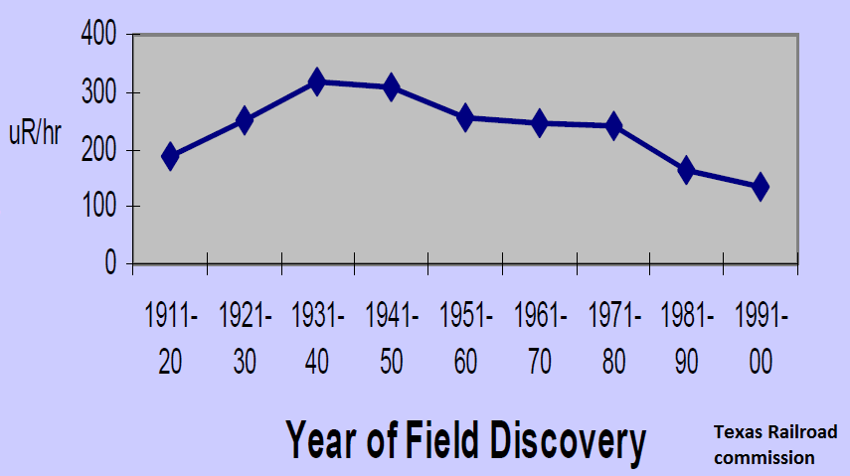
Older Fields Had Higher NORM – Longer Time to Accumulate?

Slide 13
NORM Pathway into Oil & Gas Waste
NORM primarily accumulates in O & G waste when radium is dissolved and carried to surface by produced water.
Radium is concentrated in scale and sludge when precipitated with Ba-, Sr-, or Ca-SO₄.
NORM also accumulates in gas processing facilities when radon decays to lead²¹⁰.
Radon decay elements accumulate on inner surface of gas processing piping (propane-ethane processing)

Slide 14
What is the hazard?
Direct exposure to alpha particles through ingestion and inhalation.
Direct exposure to beta particles by contact of materials from inside tanks.
Breathing Radon gas for extended periods.
How?
Breathing dust.
Eating or drink fluids that have contacted alpha particles.
Removing beta contamination.
There are no documented chronic cases of solid NORM (non-Radon) induced cancer.

Slide 15
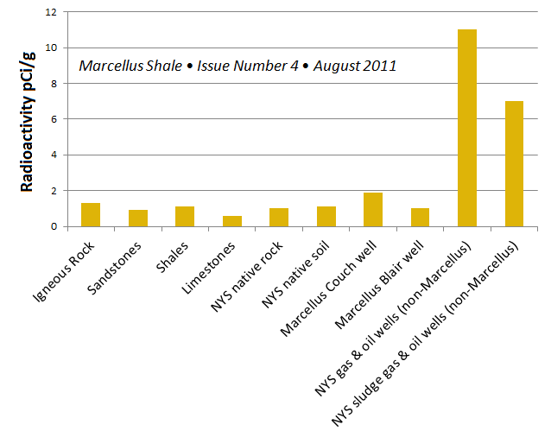
²²⁶Ra measurements from various formations

Slide 16
TX norm Inspection – Case History
In 2000, the Texas Railroad Commission surveyed >600 leases.
59 leases had surface equipment >59 μR/hr.
Of 6000 measurements, 3.4% were above 50 μR/hr.
Max reading was >1000 μR/hr.
Water tanks, gun barrels and flow lines had highest readings.

Slide 17
Why Do Produced Waters have Low Activity (Comments from TBEG, 1995)
The isotopes 226Ra and 228Ra produce most of the radioactivity in oil and gas facilities.
Because the half-lives of 226Ra and 228Ra are geologically short (1,622 yr. and 6.7 yr., respectively), Ra incorporated with sediments and original pore water does not survive to be produced.
(Isotopes in water migrating out of high RA activity rocks decay quickly) – shale an exception?

Slide 18
Where should you Expect NORM?
Older surface equipment and used pipe with barium or strontium scales are prime candidates, HOWEVER:
Only a few areas are affected by NORM,
Some areas start with higher than normal radioactivity,
Even moderate to low radionuclide levels can be inadvertently concentrated to values above acceptable limits.
Evaporation, settling of solids, centrifuges, filtration, sludge formation, flocculation and precipitation all concentrate NORM.
Some produced waters (and even some virgin drinking waters) have higher than acceptable radioactivity values. The best approach for produced waters is not to concentrate the waters or solids from such waters.

Slide 19
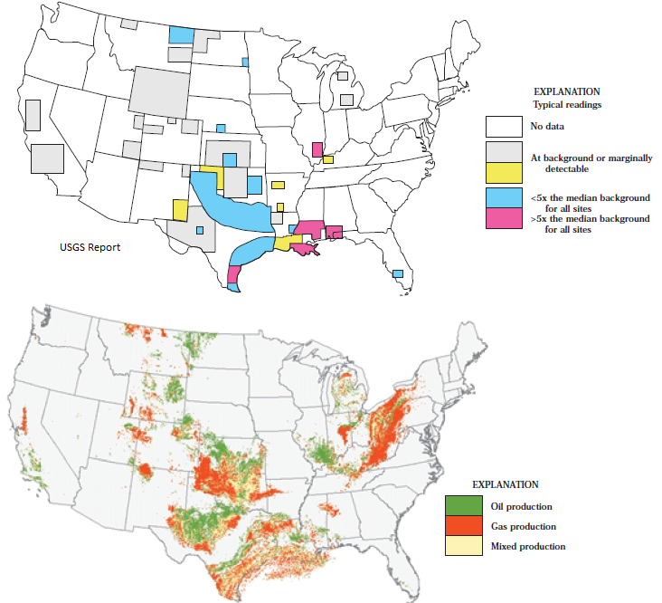
TOP – O&G NORM Levels
Bottom – O&G Well Locations
Gamma-ray radiation levels exceeded natural background radiation levels at 42% of surface sites.
Radium, Uranium, Thorium and Potassium isotopes are problems when the isotopes are concentrated in scale, sludge and/or sediment.
Markedly higher RA was found in Gulf Coast, northeast Texas, southeast Illinois and south-central Kansas.

Slide 20
What does NORM Look like?
Solid NORM can be:
Crystalline, brittle & thin, may flake, mostly in pipes and tanks.
NORM scales are white to brown, and are typically calcium, barium or strontium sulfates.
NORM-rich sludge (tank bottoms) may have any appearance – can only identify with inspection instruments.
Evaporites and pipe cleaning residues (usually in pipe yards) may be higher than background NORM.
Radon-222 gas is colorless, but is short half life (3.8 days) and can form lead-210 films (gray or black) on inside of pipe, valves, etc. in gas processing equipment.

Slide 21
Norm in the Air
Largest source is airborne Radon
Emanates from ground (decay product of uranium)
Short half-life, avoid areas where Radon can concentrate and not disperse.
Unevenly distributed – some areas much higher – e.g. -Colorado.
Avg inhaled dose is 1.26 mSv/yr. or 126 mRem/yr.
Second leading cause of lung cancer after smoking.

Slide 22
How do you identify NORM?
A trained person (8 hr...... NORM surveyor course) surveys the area:
Soil readings taken while walking slowly holding the probe a half-inch off the ground.
Readings of the background, generally taken with the probe at waist high.
Readings of tanks and mid level and at bottom at several points around the tank with the probe about a half-inch from the tank wall. Also check pipes, valves, pumps. Water knockouts, etc.
Compare readings with background to determine hazard level.
There is NORM everywhere and all materials have some level of radioactivity.

Slide 23
What do you do if the NORM readings are over the limit?
Tag or mark the equipment with the reading and avoid maintenance that would disturb the materials.
Do not have to take the equipment out of service immediately in most cases.
At a time when maintenance is scheduled, a licensed NORM remediation company must decontaminate the equipment.
After the equipment is decontaminated, the equipment may be returned to service, sold or reused at another location (Texas rules)

Slide 24
Measurement Devices
Geiger-counter; NORM survey Instrument
Scintillation probe- Sodium Iodide crystal
Pancake or Geiger-Mueller probe- mylar plastic cover
Scintillation probe- (µR/hr) Measures Gamma
Pancake or Geiger-Mueller probe- (cpm) measures Alpha and Beta particles

Slide 25
Limits from Texas Regulations (limits are above background)
Texas Limits (From RRC Website)
For Protection of the Public | 100 milliRem/yr
For Radium in Drinking Water | 5 pCi/liter
EPA suggested action level for Radon in residences | 4 pCi/liter
Examples of radiation exposure levels
Terrestrial background TX Gulf Coast | 60 milliRem/yr
Terrestrial background for Texas Panhandle | 120 milliRem/yr
Medical X-ray | 40 milliRem
Cosmic (sea level exposure) | 35 milliRem/yr
Cosmic (10,000 ft elevation) | 85 milliRems/yr

Slide 26
PPE and best practices for routine Work
Standard PPE is usually adequate for operations outside of confined areas or areas marked as high NORM readings.
There is no relationship between radiation sources and H₂S or CO₂.
NORM readings in shale frac flowback water may be slightly higher.
Concentrated sediments (cuttings?) from shale flowback may be higher in NORM.
Avoid inhalation and ingestion routes of fluids, dust, smoke and vapors from produced water tanks.
Wash hands and face before eating.

Slide 27
Conclusions
Don’t be afraid of NORM but do be aware of:
places where elevated NORM might occur,
route of contamination- inhalation & ingestion of NORM dusts, &
how to prevent problems from NORM when it is present.
NORM damage potential is sharply reduced by
Limiting time of exposure near NORM
Increasing distance between you and NORM
Any effective shielding (a tank or pipe wall will stop alpha and beta particles completely).
Diluting and not concentrating the source (as in produced water)
Avoiding ingesting or inhaling NORM particles.

Slide 28
Survey instruments for NORM
Common Isotope | Type of radiation | Probe Type | Energy Level | Common Location
Radium-226 | 96% α, 4% γ | scintillation for γ, pancake for α & β |  | Pipes, tanks, etc. from produced water concentration
Radium-228 | 100% β | pancake for α & β |  | Pipes, tanks, etc. from produced water concentration
Radon-222 |  | pancake for α & β |  | Builds up in areas of gas stripping.
Lead-210 | 100% β | pancake for α & β | very low | Dry gas processing
Bismuth-214 | 100% β | pancake for α & β
Polonium-210 | 100% β | pancake for α & β | very low
Thorium-228 | 100% α | pancake for α & β
Anytime you see gamma radiation, you also have α and β.

Slide 29
 | Avg effec dose.
Sources (NCRP, 2006) | (µSv)/yr | (mrem)/yr
Inhaled (Radon & Decay prod.) | 2290 | 229
Internally Depos. Radionuclides | 310 | 31
Terrestrial Radiation | 190 | 19
Cosmic Radiation | 270 | 27
natural source | 3100 | 310
Medical, industrial, etc. | 3100 | 310
Total | 6200 | 620
And…………………………
If you smoke, add 1300 mrem/yr (from radon decay products)

Slide 30
Uranium, Thorium, Potassium and Lead radionuclides are resident in sediment
Uranium²³⁸, Thorium²³², Potassium⁴⁰ nuclides (unstable isotopes = radioactivity) are present in rocks. (This is what the gamma-ray log measures)
Isotopes decay into other elements and eventually into stable (non-radioactive) materials.
Uranium²³⁸ is a long-lived isotope that continuously produces Radium²²⁶ – a comparatively short-lived (1660 year half-life) element that may migrate in produced water and plug itself into the structure of forming scales or associate with other materials.
Low concentration is typical, but if concentrated, can gradually increase background radioactivity.

