Slide 1
Kick off Meeting 2024-2025
Abhi Kohli, Section Chair
Subsurface & Area Development Lead, Shell
Presentation starts at 10:30 am
August 30, 2024

Slide 2
Agenda
Welcome
Safety and DEI Moment
Gulf Coast Section Overview
Event Metrics
Membership Update
Thank you Sponsors
Meet the Team
2024-25 GCS Section Goals
Scholarship Endowment Fund (SEF)
August Lookback and September Events
Available Resources and Media Guide

Slide 3
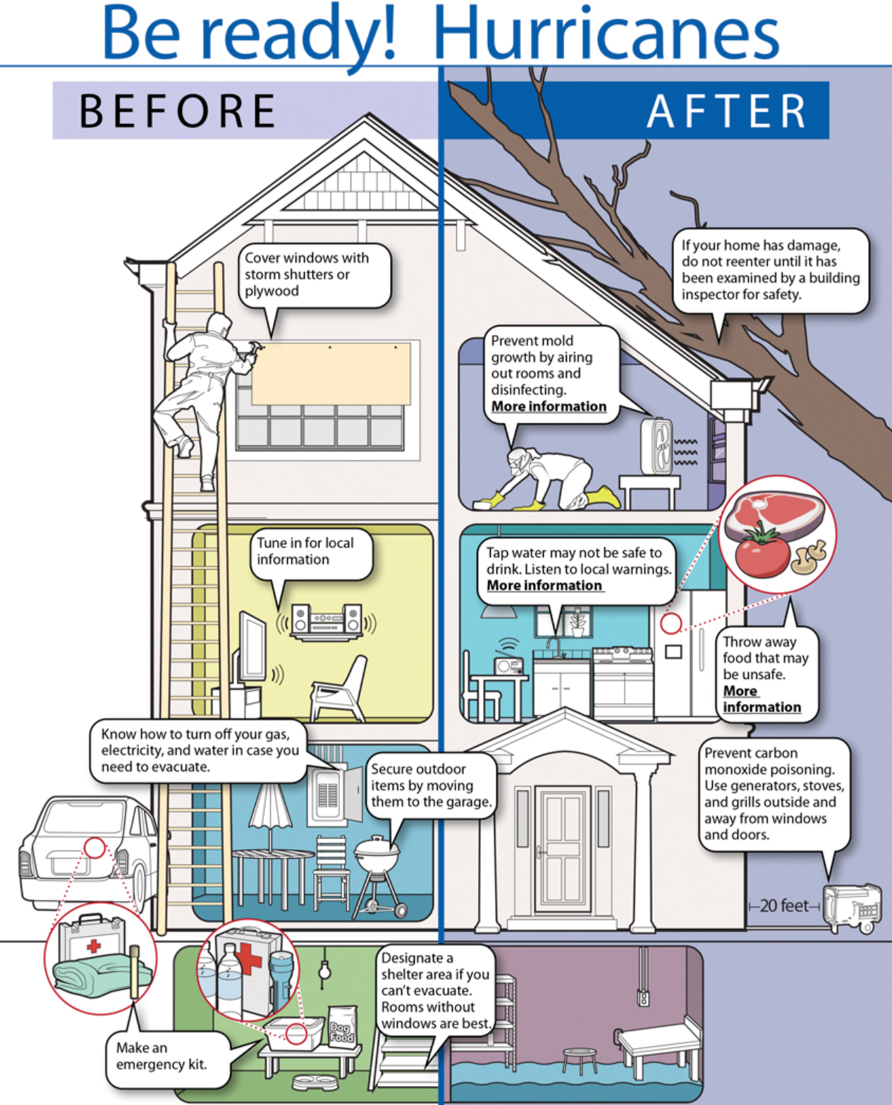
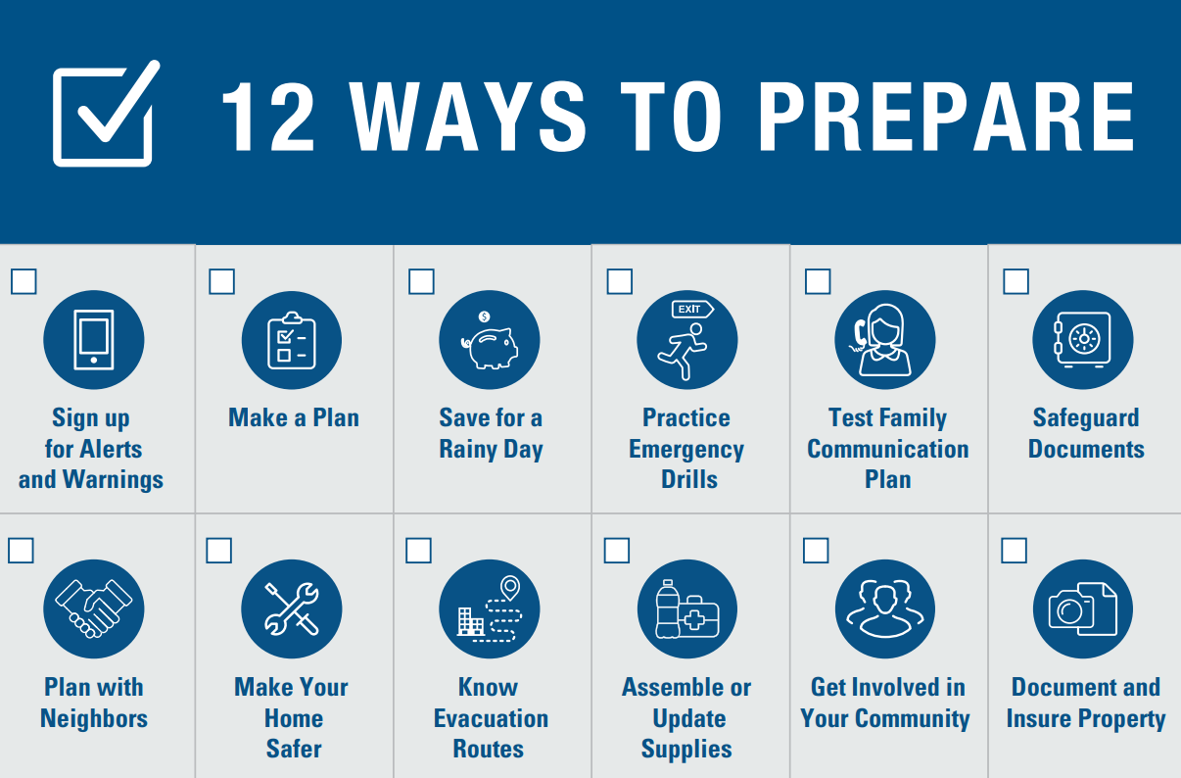
Hurricanes
The hurricane season in Texas is from June 1 to November 30 every year, with peak tropical storm from Aug through mid-September.
FEMA - Federal Emergency Management Agency FEMA.gov
US Dept. of Homeland Security www.ready.gov
National Hurricane Center www.nhc.noaa.gov/
Notes:
Source National Hurricane center

Slide 4
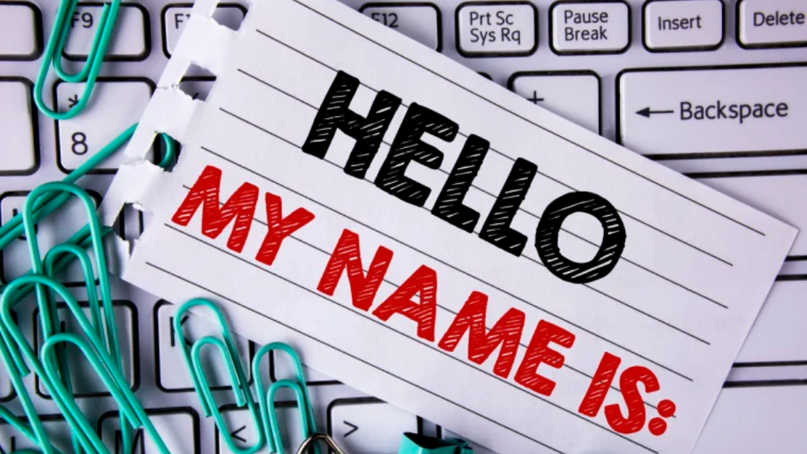
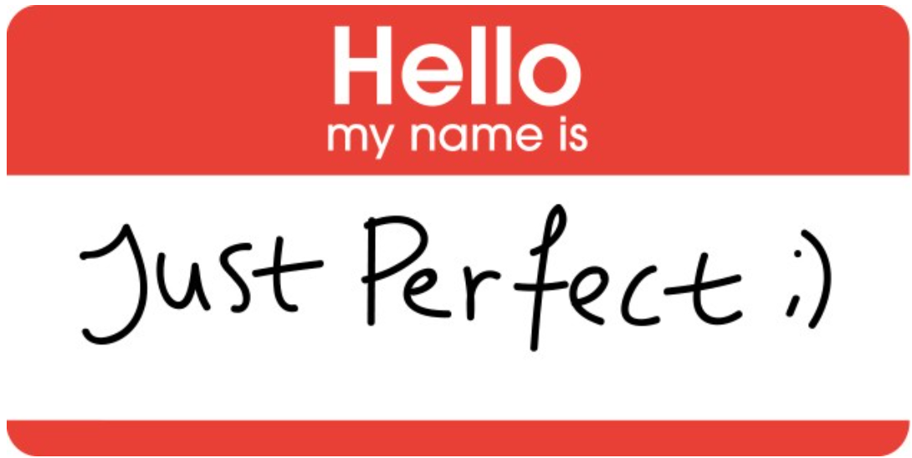
Diversity, Equity and Inclusion : What's in a Name ?
Name-based discrimination is deep rooted and persisting in the job market.
Few Actions that can help increase Inclusion:
Do clarify: Ask for help directly. “Can you help me say your name correctly?”
Do practice: Before proceeding, say it in your mind 2-3 times (like memorizing). It helps.
Do double-check: When writing emails, slides or documents, double-check names. There is no excuse to get someone’s name wrong in written form when you have seen it.
Be curious: Use social settings as a safe space to practice names (with respect). Genuinely ask people about their name and try to get it right.
Do not judge: Please do not judge someone’s name for being too hard, too long, too masculine, or too feminine, or what it sounds like.
Respect choices: If a colleague chooses to use an alternate or a nickname or uses a short name, then it’s fine but otherwise use their full name.

Slide 5
SPE Gulf Coast Section Overview
2024-2025

Slide 6
SPE GCS MEMBERSHIP

Slide 7
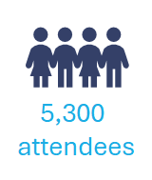
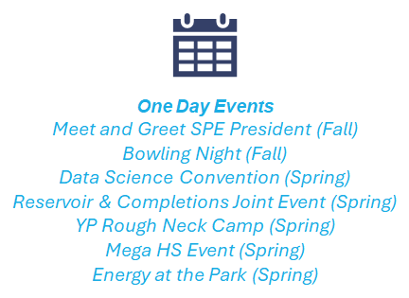
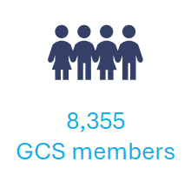
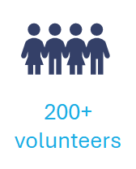
2023 - 2024 Recap

Slide 8
Thank you Sponsors and Venue Partners
Venue Partners

Slide 9
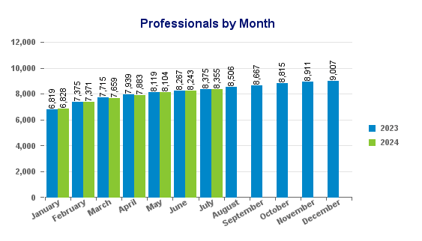
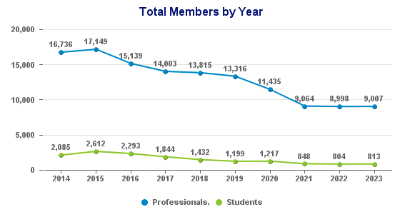
Membership Status
8375 8355
Number of members increased consistently each month throughout 2024, almost same number of members in July 2024 compared to July 2023
Total members number flat YOY

Slide 10
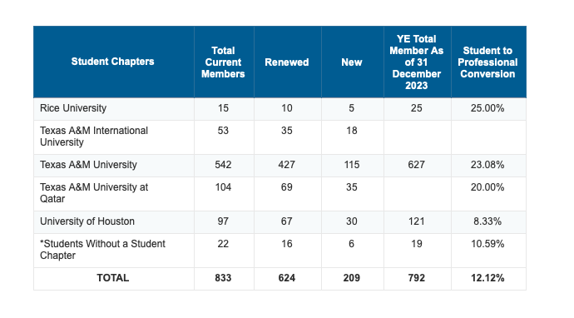
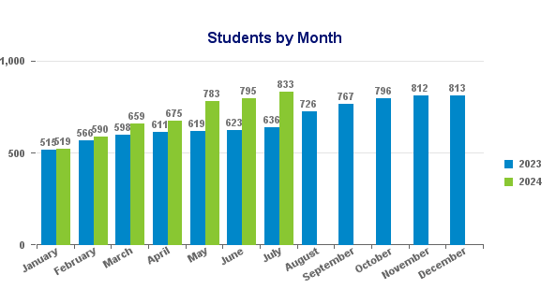
Student Membership Status
636 833
Big increase in number of students compared to previous month. Higher student to professional conversion compared to previous months (Jan 5.05%, Feb 8.13%, March 10.16%, April 10.83%, May 11.29%, July 12.12%) .

Slide 11
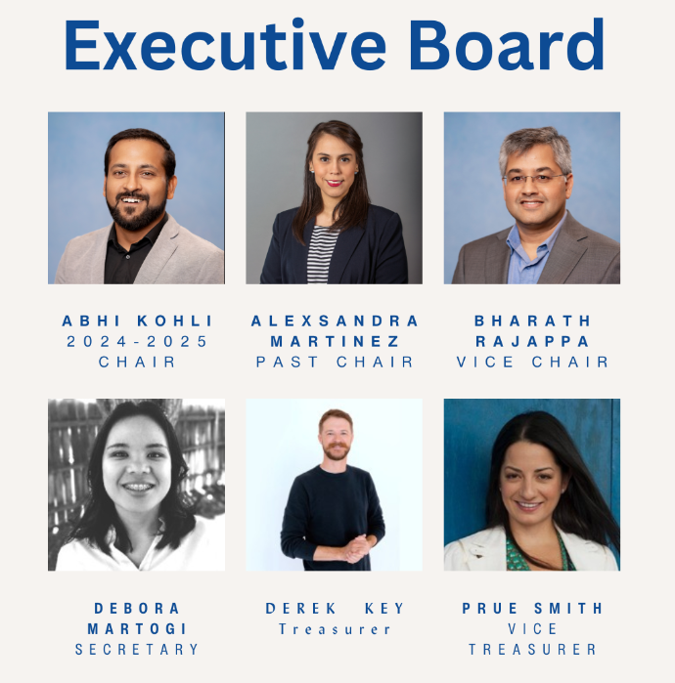
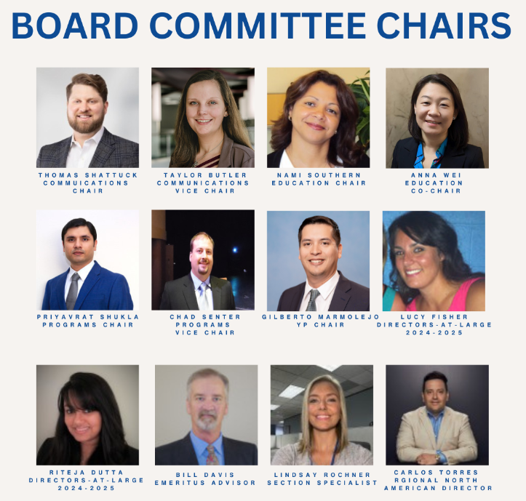
Meet the team

Slide 12
2024-2025 Board
 | Position | 2024-2025 BOD | Email
Board of Directors | Chair | Abhi Kohli | Abhinandan.Kohli@shell.com
 | Vice Chair | Bharath Rajappa | Bharath.Rajappa@conocophillips.com
 | Past Chair | Alex Martinez | amartinez@demac.com
 | Treasurer | Derek Key | Derek.Key@corelab.com
 | Vice Treasurer | Prue Smith | pruee.smith@bp.com
 | Secretary | Debora Martogi | Debora.Martogi@Geosyntec.com
 | Communications Chair | Thomas Shattuck | Thomas.Shattuck@cliffordchance.com
 | Communications V-Chair | Taylor Butler | TButler@sabineoil.com
 | Education | Nami Southern | namisouthern@yahoo.com
 | Education- VC | Anna Wei | XWei7@slb.com
 | Programs Chair | Priyavrat Shukhla | pshukla5@slb.com
 | Programs Vice Chair | Chad Senters | chad.senters@corelab.com
 | Young Professionals | Gilberto Marmolejo | marmolejog1@gmail.com
 | Director at Large 1 | Lucy Fisher | Lucy.Fisher@bpx.com
 | Director at Large 2 | Riteja Dutta | riteja.dutta@enverus.com
 | Emeritus Advisor | Bill Davis | bdavis0819@gmail.com
 | Position | 2024-2025 BOD | Email
Committees | AWARDS BANQUET | Bharath Rajappa | Bharath.Rajappa@conocophillips.com
 | CAREER ADVANCEMENT NETWORK (CAN) | Jennifer Calderin | Jennifer.Calderin@wsp.com
 | COMMUNITY SERVICES | Alvaro Gomez | Alvaro.Gomez@bakerhughes.com
 | CONTINUING EDUCATION CHAIR | Amer Hanif | Amer.Hanif@bakerhughes.com
 | ESP SYMPOSIUM | Shauna Noonan | Shauna_Noonan@oxy.com
 | GOLF CHAIR | Juan Grimaldi | JGrimaldi@petro-amigos.com
 | MEMBERSHIP | Nelly De Nicolais | nazuaje@hotmail.com
 | MEMBERSHIP VICE CHAIR | Laura Santos | laura.santos@cmgl.ca
 | SCHOLARSHIP | Rita Okoroafor | ritaok@exchange.tamu.edu
 | SPONSORSHIP SOCIAL CHAIR | Jeannie Chung | jchung1727@gmail.com
 | SPORTING CLAYS | Prue Smith | pruee.smith@bp.com
Study Groups | BUSINESS DEVELOPMENT | Megan Jones | mjones@gepllc.com
 | COMPLETIONS & PRODUCTION | Mohsen Babazadeh | Mohsen.Babazadeh@conocophillips.com
 | COMPUTATIONAL FLUID DYNAMICS (CFD) | Madhusuden Agrawal | Madhusuden.Agrawal@bp.com
 | DATA ANALYTICS | Prithvi Chauhan | prithvi.chauhan@xecta.com
 | DRILLING | James Barry | jbarry1970@gmail.com
 | GENERAL MEETING | Roberto Saucedo | robertsaucedo@gmail.com
 | INNOVATE | Tim Stephens | ceramist@att.net
 | NORTHSIDE | Holli Cramm | hcramm@stokesandspiehler.net
 | RESEARCH & DEVELOPMENT | Amit Patil | APatil14@onesubsea.slb.com
 | RESERVOIR | Steve Schubarth | steve@schubarthinc.com
 | WESTSIDE | Darby Witt | darbykwitt@gmail.com
 | Position | 2024-2025 BOD | Email
SEF | SEF Committee | Alexsandra Martinez | amartinez@demac.com
 | SEF Committee | open
 | SEF Committee | Jeannie Chung | jchung1727@gmail.com
 | SEF Committee | Abhi Kohli | Abhinandan.Kohli@shell.com
 | SEF Advisor | Richard Murphy | stancal@windstream.net

Slide 13
Congratulations!!!
MANIFESTING
OUTSTANDING
SECTION - 2025

Slide 14
SPE-GCS Goals : BoD
2024-2025

Slide 15
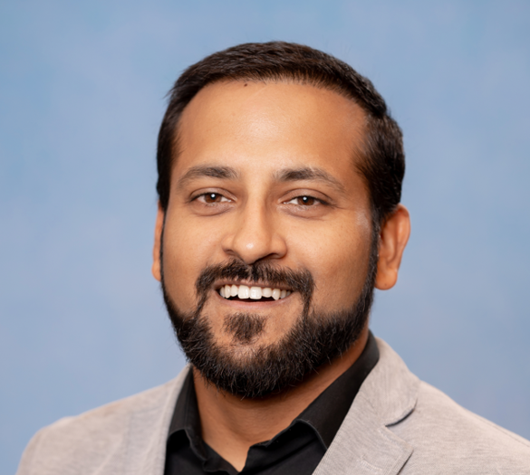
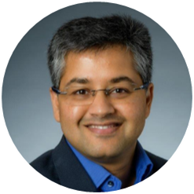
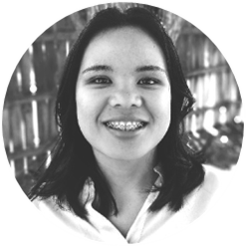
Gulf Coast Section 2024-2025 Goals
Abhi Kohli
Section Chair
Shell
Bharath Rajappa
Vice Chair
ConocoPhillips
Debora Martogi
Secretary
Geosyntec
Chair
Vice-Chair
Secretary
Strong Focus on membership
Young Professionals
High schools and college
Membership appreciation events
Engagement with BoD and Chairs
BoD presence at different events
Quarterly Chair’s corner
Mid Year Review of Goals
Board meeting attendance
Promote the SEF
New award categories for top-performing groups
Chair role for Awards banquet delivering another successful event in 2025
Support section chair in day-to-day activities and functioning of the board.
Support SEF and membership committee to recruit new members.
BoD meeting agenda
Schedule/Arrange with SG/Committee/Event to present in Monthly BoD
Monitoring event registrations
Post-event look back and compilation
Complete SPE-GCS Roster for submission

Slide 16
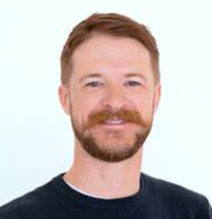
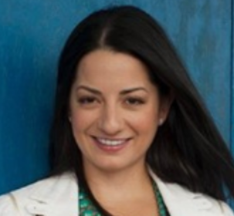
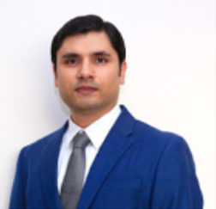
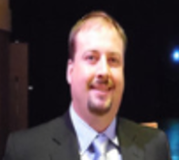
Gulf Coast Section 2024-2025 Goals
Derek Key
Treasury Chair
CoreLab
Prue Smith
Treasury Vice Chair
BP
Priyavrat (PV) Shukla
Programs Chair
SLB
Chad Senters
Programs Vice Chair
Corelab
Treasury
Programs
Maintain Financial Reporting: Continue to provide clear, accurate, and timely financial reports to support informed decision-making.
Optimize Investment Management: Regularly review and manage the investment portfolio to balance risk and maximize returns.
Ensure Compliance and Timely Payments: Adhere to financial guidelines for all expenses and ensure timely payment processing to support smooth operations.
Financial forecasting: Comparison of beginning budgets vs actuals?
Continue the strong relationship with the free venues that we have and provide them publicity.
Nudge other groups to look for free venues. This can have a big impact on the financial performance of these groups
Attend the internal kick off meetings of the SG’s and understand their plans. Attend their events and focus on quality.
Promote joint events. The original event host who brings the speakers keeps the revenue.
Continue working with teams to ensure that events are not concentrated within just a few days.
Try to have one SG represented at the board meeting every month.

Slide 17
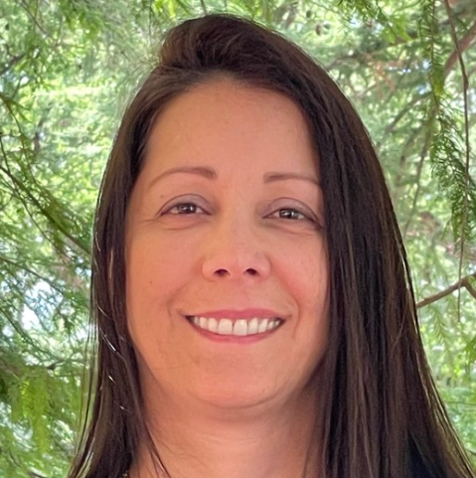
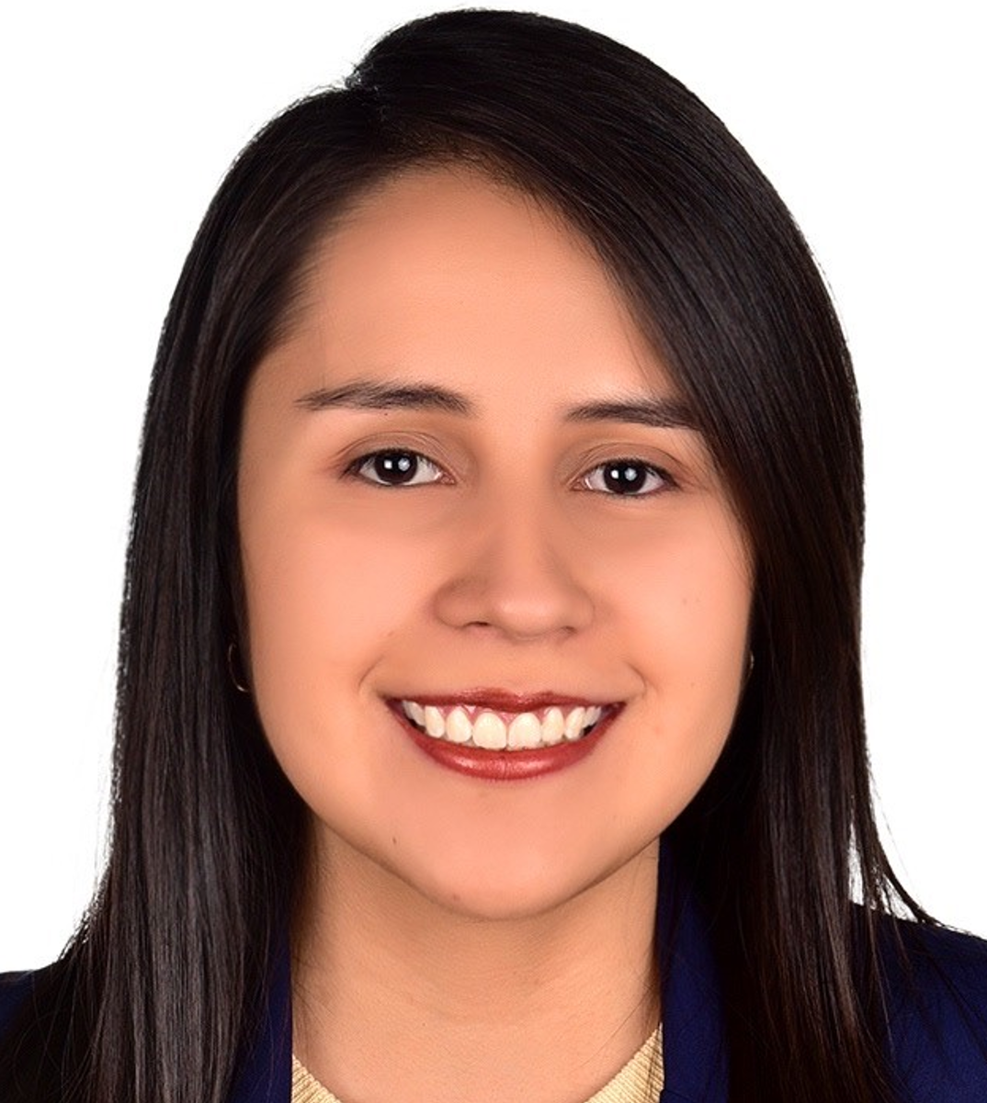
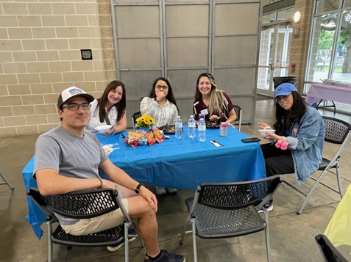
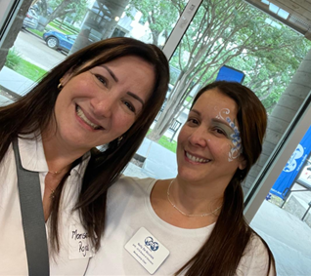
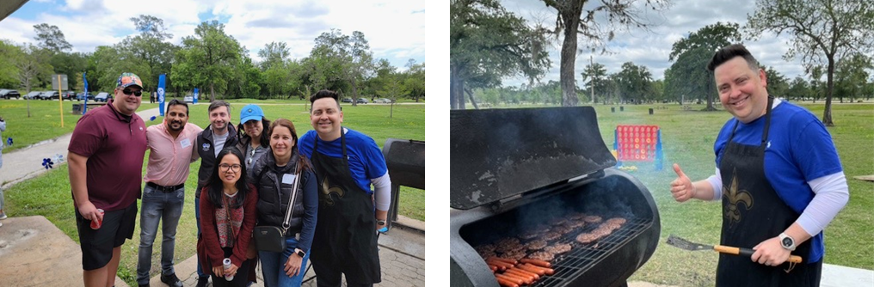
Gulf Coast Section 2024-2025 Goals
Nelly DeNicolais
Membership Chair
Enovate Upstream
Laura Santos
Membership Vice Chair
CMG
Membership
Support student chapters at universities (Rice, University of Houston, Texas A&M)
Organize and host membership appreciation events
Promote SPE through internal communications within companies
Emphasize student benefits to encourage a higher conversion rate from student to professional members
Participate at the major GCS events (Sporting Clays, Golf Tournament, Awards ceremonies, etc.)
Network with other professional organizations at their events SPWLA, OTC, ATCE, URTeC, AAPG, AADE
Communicate the Membership Anniversary Recognition program each year

Slide 18
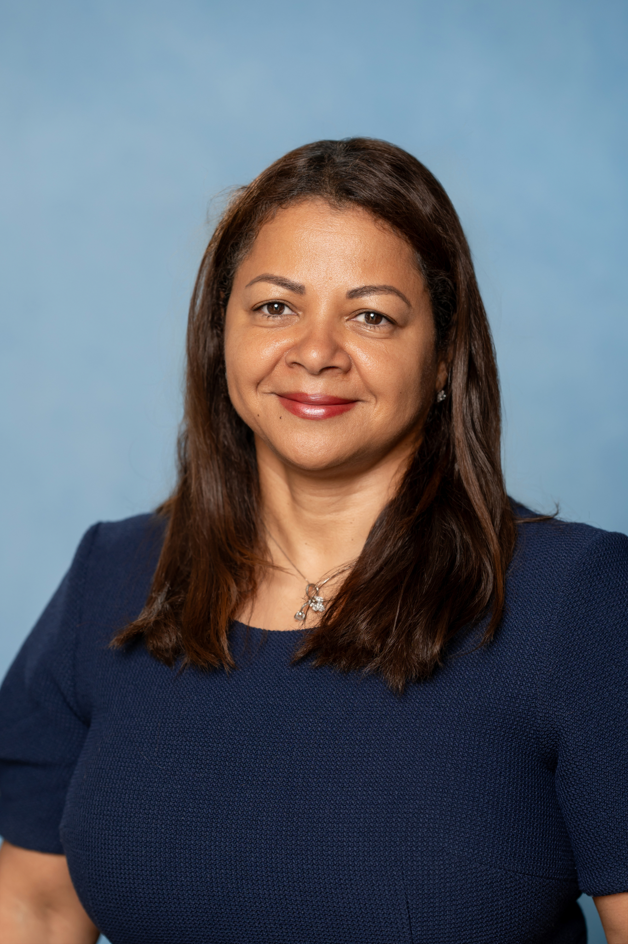
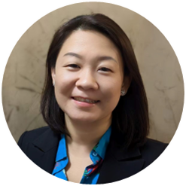
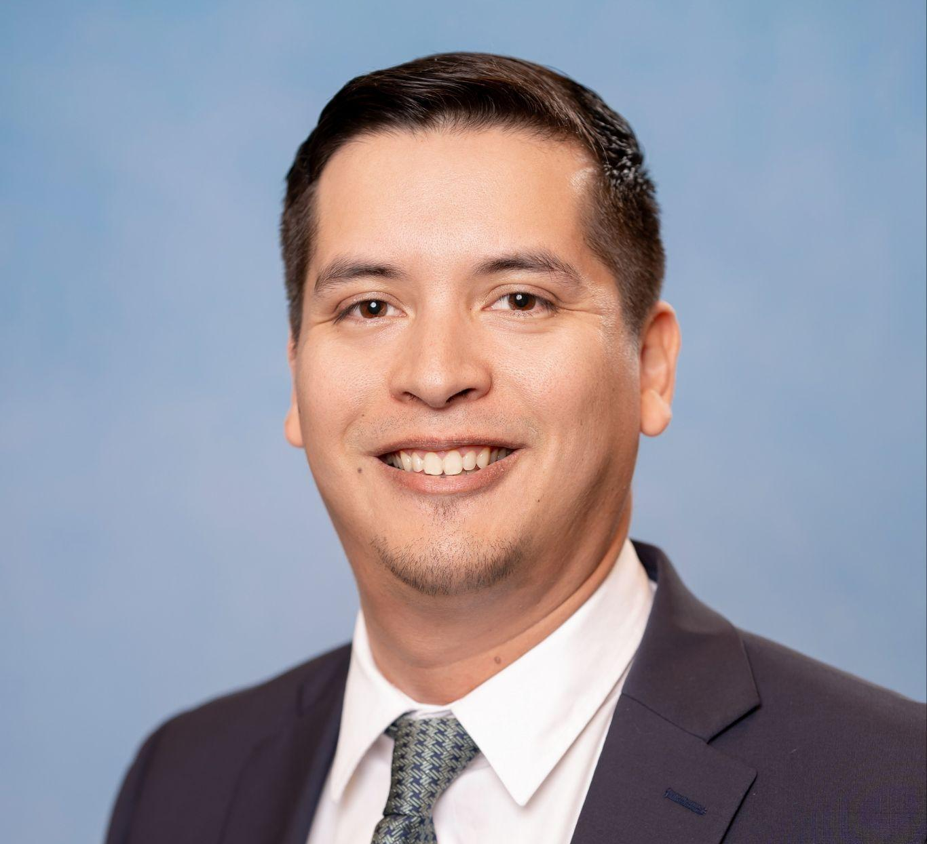
Gulf Coast Section 2024-2025 Goals
Nami Southern
Education Chair
Gilberto Marmolejo
Chair
NexMile
Education
Anna Wei
Education Vice Chair
SLB
Young professionals
Achieve a 100% graduation rate for our scholarship programs and attain a higher retention rate for scholars pursuing careers in the energy industry
Scholarship applications Improve scholarship application process and the past scholar database
Internship Program Restart internship program, recruit internship chair and secure at least 6 internships for summer 2025
Mentoring Program Build and pilot a mentoring program and recruit volunteers to commit to mentoring scholarship students
CISH - Communities in School of Houston Strengthen collaboration between CISH and SPE-GCS and increase the number of scholarship applicants.
STEM Tutoring Grow the HS STEM Tutoring program (4 schools & 10 volunteers)
Educational Events HS College recruiting events & collaboration with Community Services
Increase membership base by attracting members from diverse backgrounds within O&G companies.
Enhance member engagement by promoting opportunities for members to participate in leadership roles.
Increase professional events attendance by securing high-profile speakers and industry experts:
Panelist
Workshops
Develop and execute a post-event marketing strategy to maintain engagement and leverage event content

Slide 19
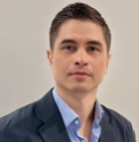
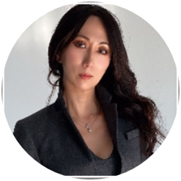
Gulf Coast Section 2024-2025 Goals
Alvaro Gomez
Community Services Chair
Baker Hughes
Jeannie Chung
Sponsorship Social Chair
Increase High School Attendees & Events participation
Conduct the following events
STEM Mega Event
Strake - St. Agnus STEM Event
Katy ISD Robotics Event
ICOTA committee collaboration
Collaboration with the Education Committee
SMEs Talks for HS Students
Sponsorship Social Chair
Sponsorship Acquisition:
Identify and approach potential sponsors, both individuals and businesses, that align with the nonprofit’s mission.
Share media guide and raise sponsorship for advertising on GCS website and e-newsletter.
Create a Sponsorship Pitch-deck with tailored packages that offer value to sponsors.
Relationship Management:
Build and maintain long-term relationships with sponsors with regular updates of the impact of their contribution
Builds a contact list to categorize Tier 1, 2 and 3 and Ensure sponsor recognition in marketing materials, events etc.
Compliance and Ethics:
Ensure all sponsorship activities comply with relevant laws, regulations, and ethical standards.
Plan, organize, and oversee social events and activities that align with the nonprofit's mission.
Target Sponsorship amount 100K to 500K for 1st year
Organize Decarbonization Congress at UoH (Feb 2025)
Community Services

Slide 20
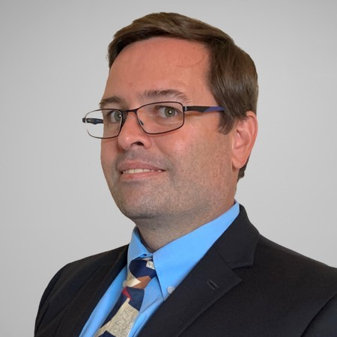
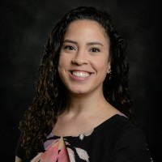
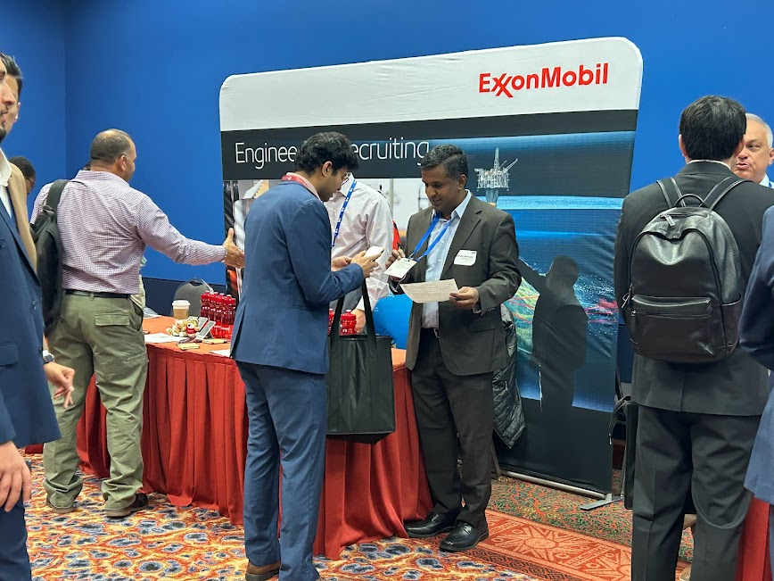
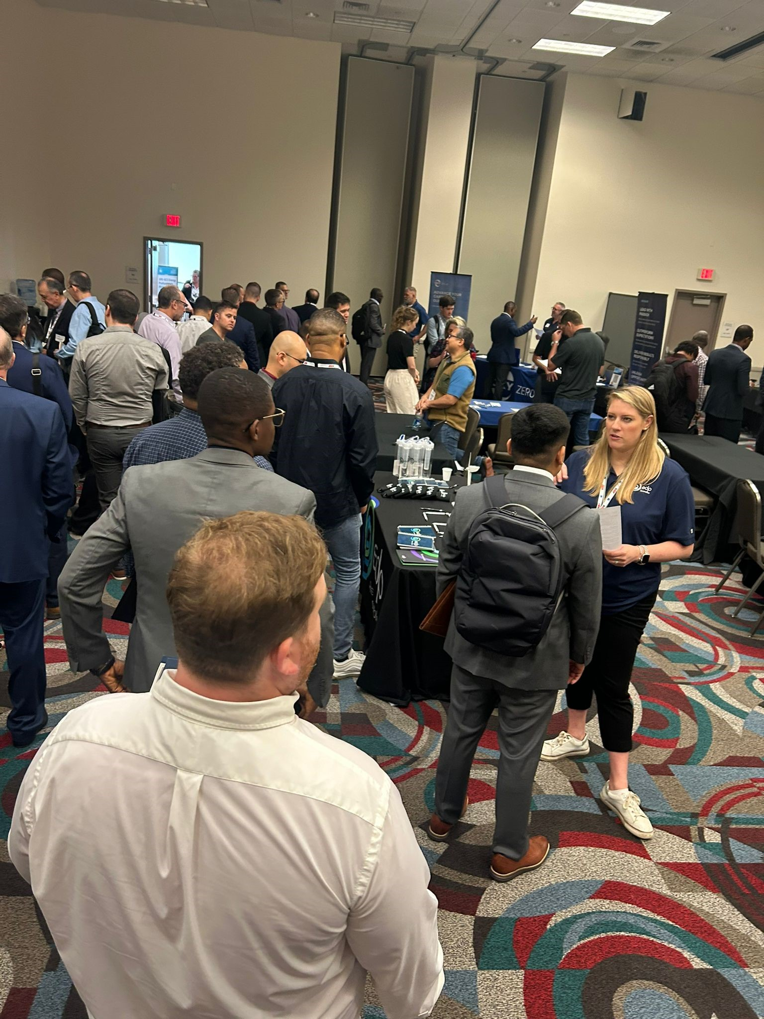
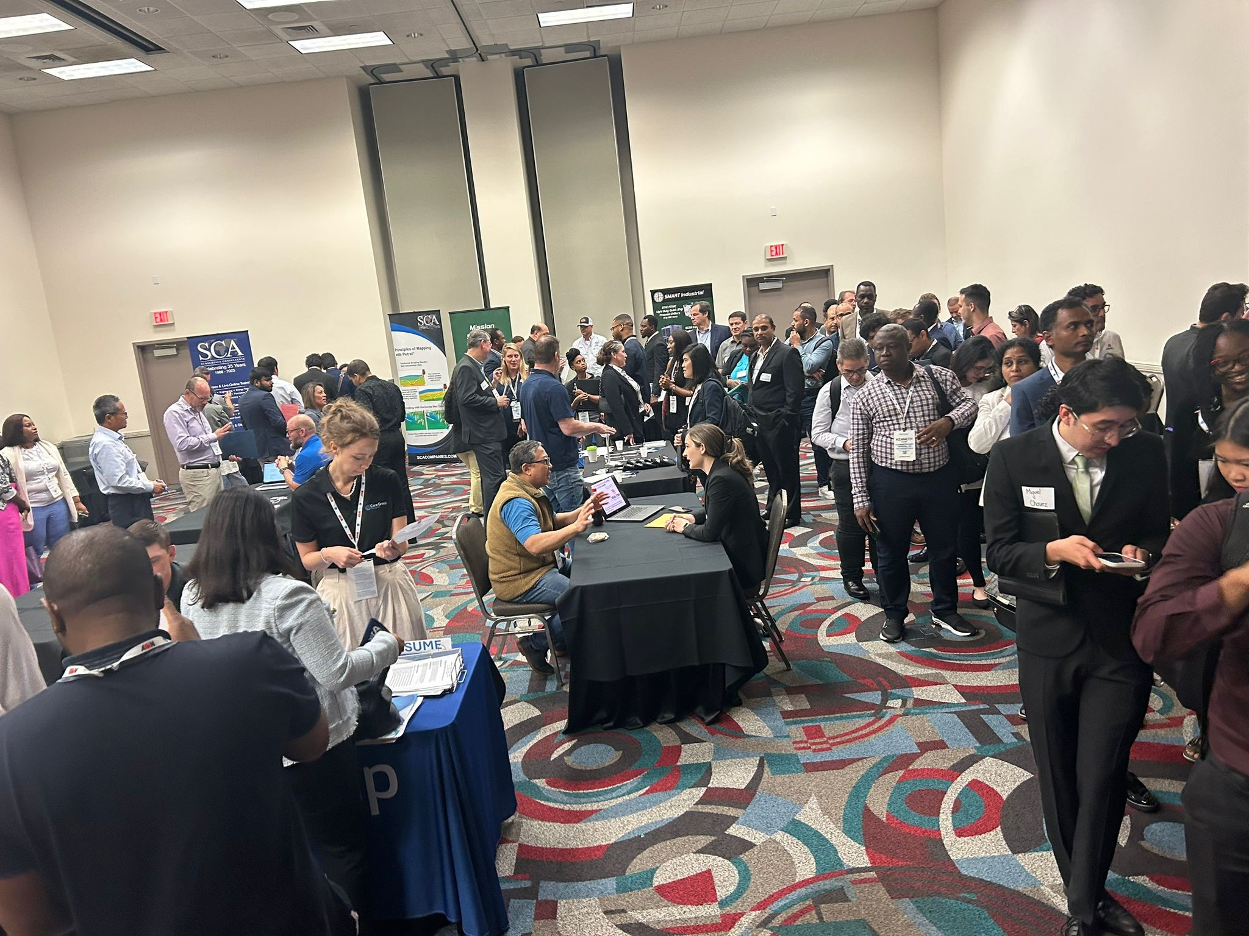
Gulf Coast Section 2024-2025 Goals
Jamie S. Marzonie
Career Advancement Network (CAN) Chair
Integrated Project Services
Jennifer Calderín
CAN Hiring Event Chair
WSP Underground Storage
CAN – Career Advancement Network
2024 – 2025 SPE-GCS Energy Professional Hiring Events
Sept. 25, 2024, ATCE SPE Energy Professionals Hiring Event
New Orleans, LA
ATCE attendees only
Oct. 10, 2024, CAN Energy Professionals Hiring Event
Houston, TX - Trini Mendenhall Community Center
Open to all experienced Job Seekers
Spring 2025, OTC CAN Energy Professionals Hiring Event
Houston, TX – NRG Park
Open to all experienced Job Seekers
2024 – 2025 Committee Goals
Lead and support ongoing career help sessions
Expand diversity in Employer positions
Boost Employer participation
Increase cross-committee & Study Group awareness and support
Promote greater volunteer agility in event planning
Foster collaboration opportunities with other committees

Slide 21
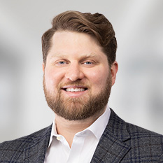
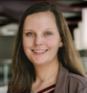
Gulf Coast Section 2023-2024 Goals
Communications
Thomas Shattuck
Communications Chair
Clifford Chance
Taylor Butler
Communications Vice Chair
Sabine Oil
Social Media Engagement
Event Promotion
Website Improvements
Focus on increasing social media engagement through regularly posting on LinkedIn and Instagram.
Work to continue establishing and publicizing "Quizzing the Oilfield".
Identify new opportunities for social media platforms and posts.
Engage study groups and committees to better promote their events.
Better communicate with study groups about available platforms and mediums including email blasts, LinkedIn, and Instagram.
Identify new ways to promote events outside of existing platforms.
Engage study groups to make sure the website is fresh, functional, and responsive to their needs.
Provide study groups and committees updates on ongoing website build-out.
Identify new or improved functionality for the website.

Slide 22
Communications, Advertising and Event Promotion
Thomas Shattuck and Taylor Butler

Slide 23
Who to Contact to Promote Your Event
General Communications Inquiries: Thomas Shattuck (thomas.shattuck@cliffordchance.com)
Taylor Butler (tbutler@sabineoil.com)
Website Inquiries: Lindsey Newsome (webmaster@spegcs.org)
Social Media: Annie Shen (communications.spegcs@gmail.com)
 | Submission Contact | Posting Frequency | Submission Deadline | Submission Details
Weekly Email Blast | Lindsey Newsome (webmaster@spegcs.org) | Weekly on Mondays | A week prior | Event Description Time/Place Registration Link Flyer/Graphic Sponsor
Email Blast | Lindsey Newsome (webmaster@spegcs.org) | As Requested | A week prior | Event Description Time/Place Registration Link Flyer/Graphic Sponsor
Social Media | Annie Shen & Pranav Mutt (communications.spegcs@gmail.com) CC: Debora and Thomas | As Requested | A week prior | Event Description Time/Place Registration Link Flyer/Graphic Sponsor Tags

Slide 24
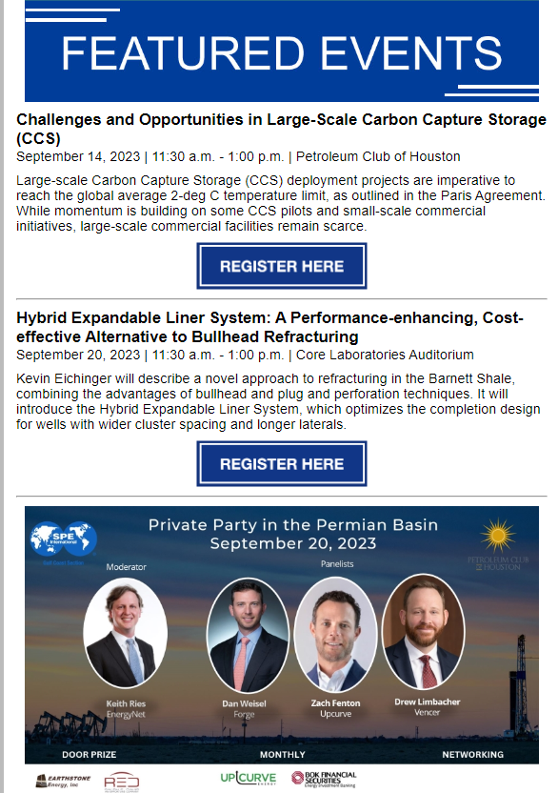
Weekly Email Blast
Received by ~9,800 members each Monday morning.
Events show up in the SPE-GCS weekly email under “Featured Events” section.
Priority given to near-term upcoming events with lower registration.
Please reach out to Lindsey, Thomas, and Taylor early to make sure your event is in the newsletter.

Slide 25
Individual Event Email Blast
Only sent to select email recipients based on study group or committee.
Limited spots per week to avoid spamming SPE-GCS mail recipients.
Priority given to near-term upcoming events with lower registration.
Please reach out to Lindsey, Thomas, and Taylor if you need to promote your event via email.

Slide 26
Social Media Posts
SPE-GCS has over 21,000 LinkedIn and 1,300 Instagram followers. We average 11 LinkedIn posts per month with 1,700 impressions per post.
If you provide posting materials early, we can make multiple posts and re-share ahead of your event for maximum visibility.
Event flyer and tagging speakers, sponsors, and committees are highly recommended.
Please reach out to Annie, Thomas, and Taylor if you need to promote your event via LinkedIn or Instagram.

Slide 27
Requesting Social Media Posts
When requesting a social media post, please provide the following to communications.spegcs@gmail.com and copy both Thomas and Taylor:
Description - includes at least:
Brief Text Description
Date, Time, Location
Tags of speakers, sponsors, and committees (Let us know who you want to tag with @_name_). Please share full LinkedIn name of user to facilitate their finding.
Any Hashtags
Feel free to look at the Society Petroleum Engineers – Gulf Coast Section LinkedIn Page for inspiration.
Graphic
If you do not provide a graphic, we can make one for you following a standard template. However, we'd like for you to contact us at least 1 week prior to when you want to start posting in order to allow for proper feedback to make sure all info is correct.
Please send your request at 1 week in advance. If you would like to have the post on a certain date, please specify in your email and we will accommodate if possible.
The best way to get exposure is to have members share and comment on the post throughout the week. This will keep the post alive and circulating.
We try to space out most of the postings so they get enough exposure, but there are many posts that go through the page, so it is easy for a certain ad to get “lost”. Please keep that in mind.
Pleases send Annie, Thomas, and Taylor a reminder if you don’t hear back or see the event posted within a few days after sending in your request.

Slide 28
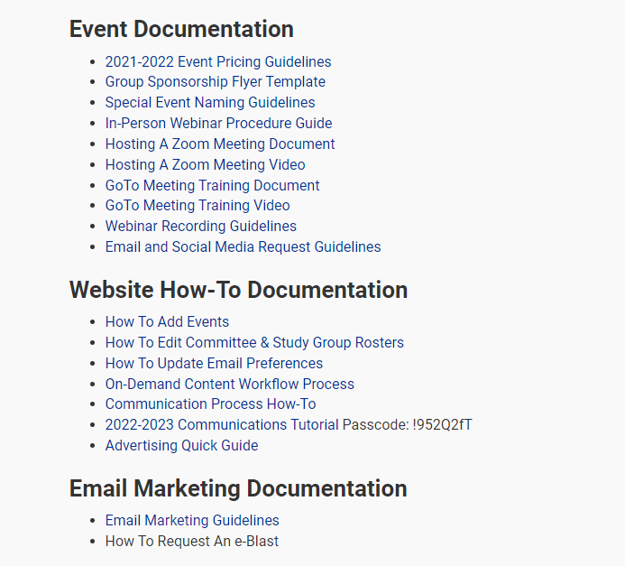
Additional Communications Resources
The SPE website contains additional information at spegcs.org/member-resources/.
If you have any questions, please reach out to Thomas and Taylor.

Slide 29
Available Resources
On demand library
Ad Opportunities
Membership Appreciation Events
Podcast Episodes
Monthly Volunteer Spotlight
Monthly & One-Day Technical Events

Slide 30
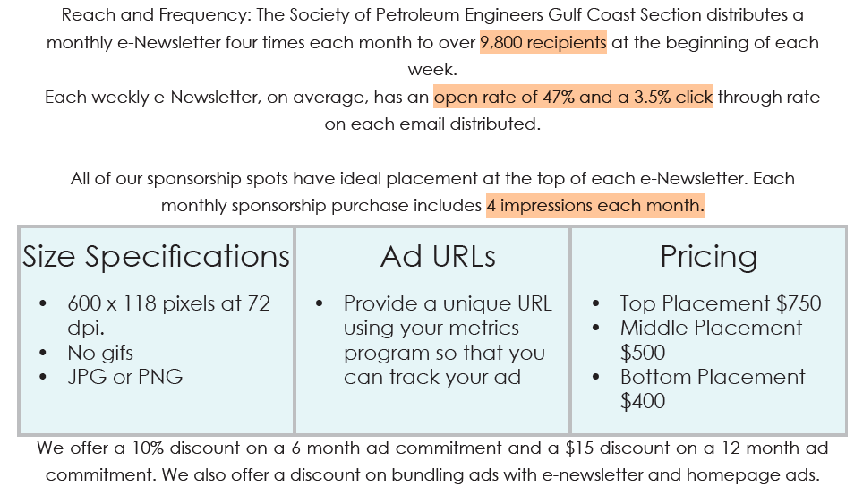
Advertise with SPE-GCS : E-Newsletter

Slide 31
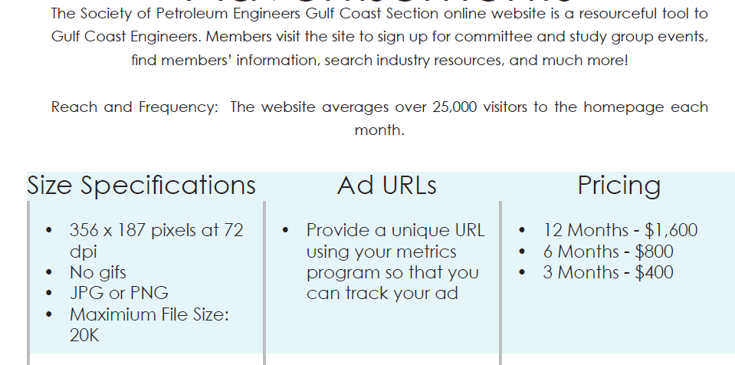
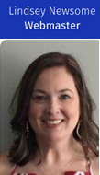
Advertise with SPE-GCS Website

Slide 32
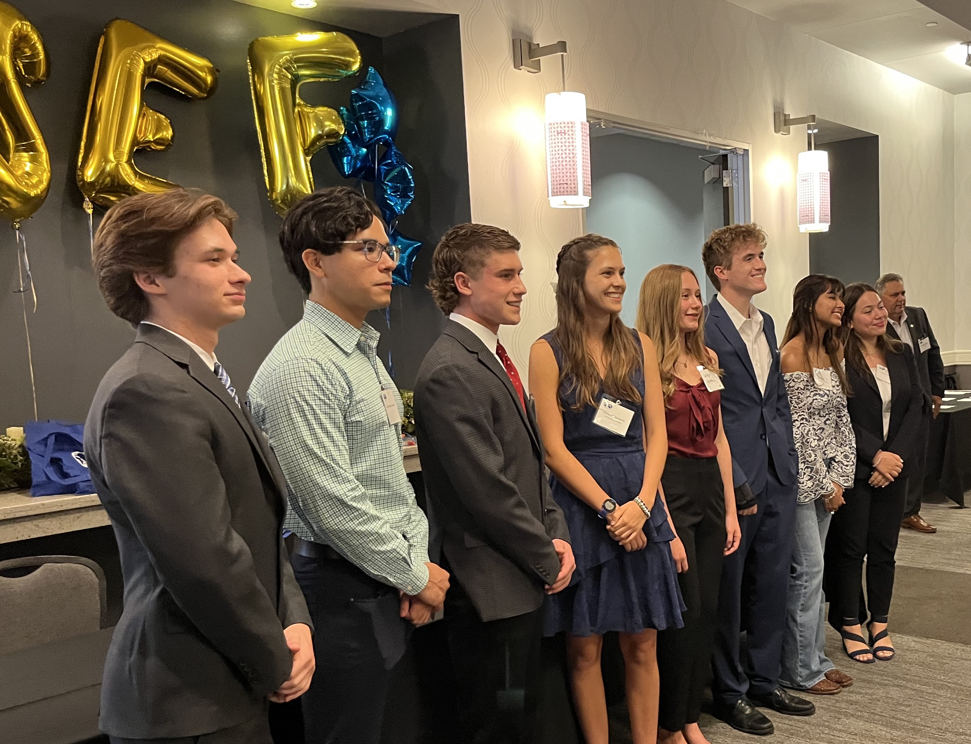
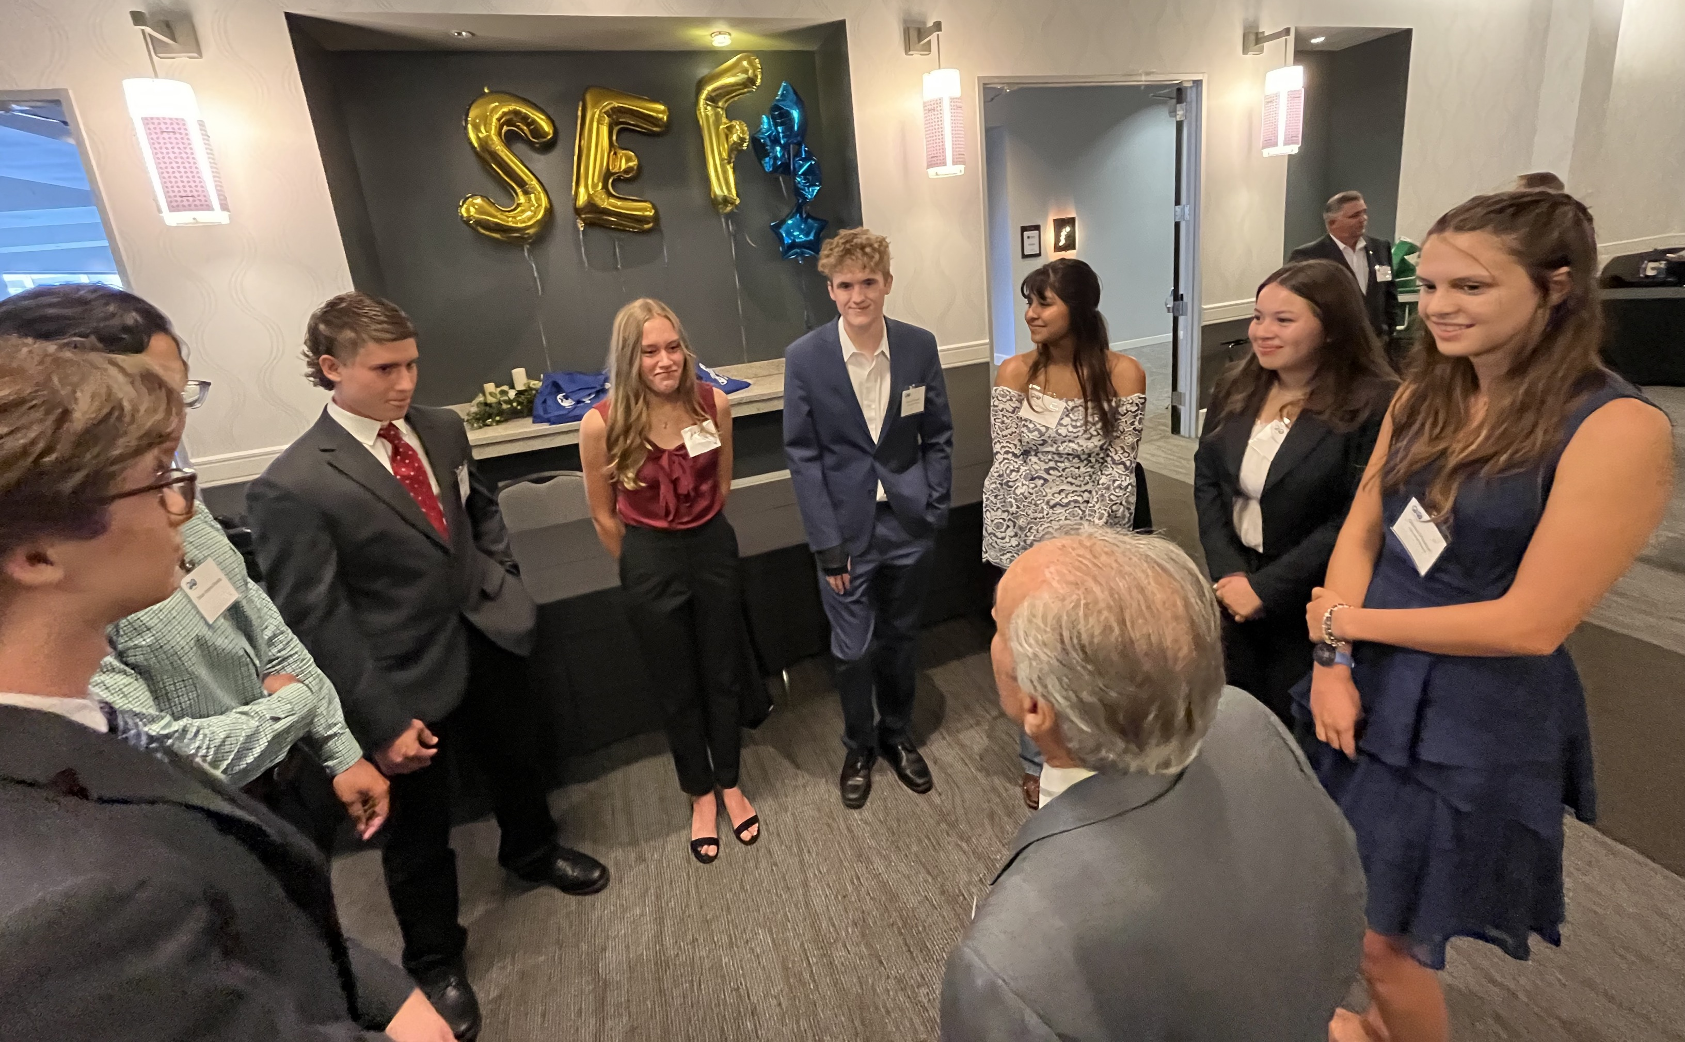
Scholarship Endowment Fund
Local Effort – Lead entirely by the Gulf Coast Section
Scholarship Program started in 1963
The Fund started in 2015; focused on our industry’s future
Goals
Promote and make awareness of the SEF
Continue building relationship with operators and service companies about the SEF
Campaign Donation during certain months
Increase number of freshman scholarship recipients (from 9 to 11 for 2024)
11
freshman
scholarships
Dr. Aly Daneshy giving advice to freshman scholarship recipients
Notes:
Recognition to Dick Murphy to leading this and for his advisor role

Slide 33
SPE-GCS : August’24 Lookback

Slide 34
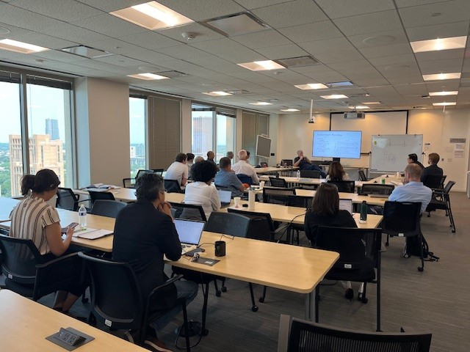
9 Aug 2024 – Continuing Education Committee
Speaker: | Steve Schubarth
Event Title: | Completion and Well Spacing Optimization through Reservoir Characterization
Location: | Galleria II Building - 18th Floor (sponsored by Cap Gemini)
Sponsors: | Cap Gemini Schubarth Inc & Schubarth Software Systems
Registrants: | 33
Attendees: | 22
Registration page: | https://www.spegcs.org/events/6884/

Slide 35
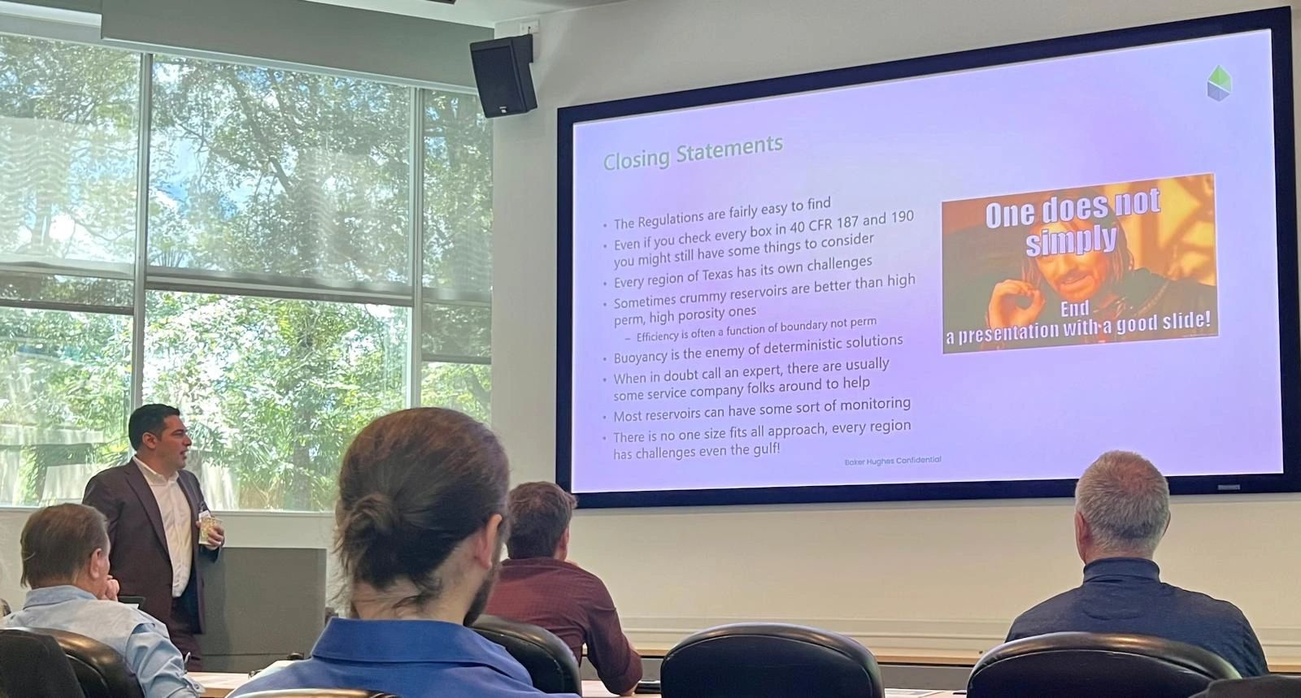
15 Aug 2024 – Northside Study Group
Speaker: | Adam Haecker (Milestone Carbon)
Event Title: | Data Gathering Requirements for Class VI Permit Applications, from a Lone Star Point of View
Location: | Baker Hughes 9110 Grogan's Mill Road The Woodlands, TX 77380
Sponsors: | Baker Hughes WS Calfrac
Registrants: | 24
Attendees: | 20
Registration page: | https://www.spegcs.org/events/6928/

Slide 36
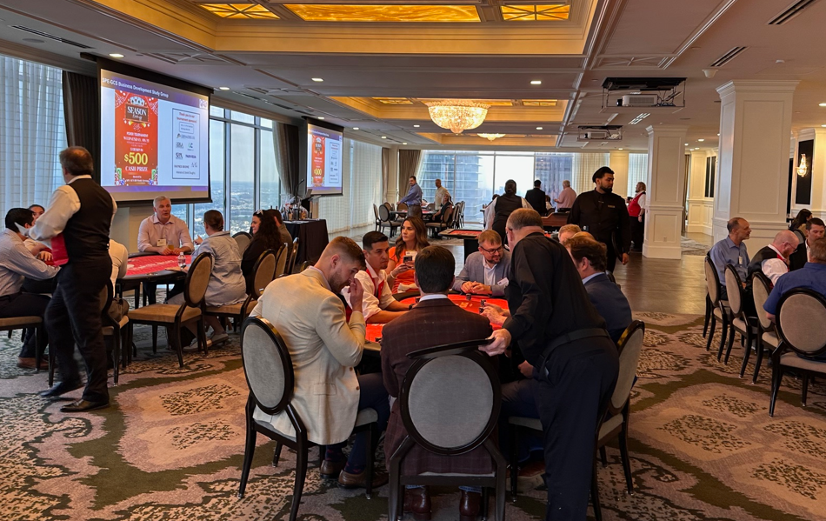
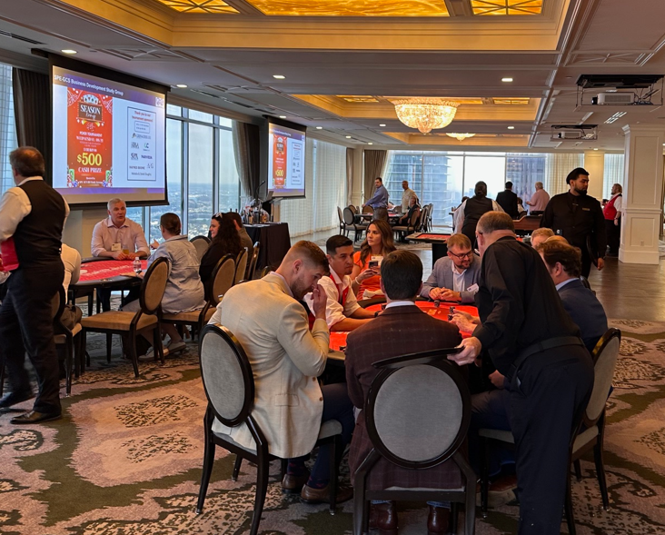
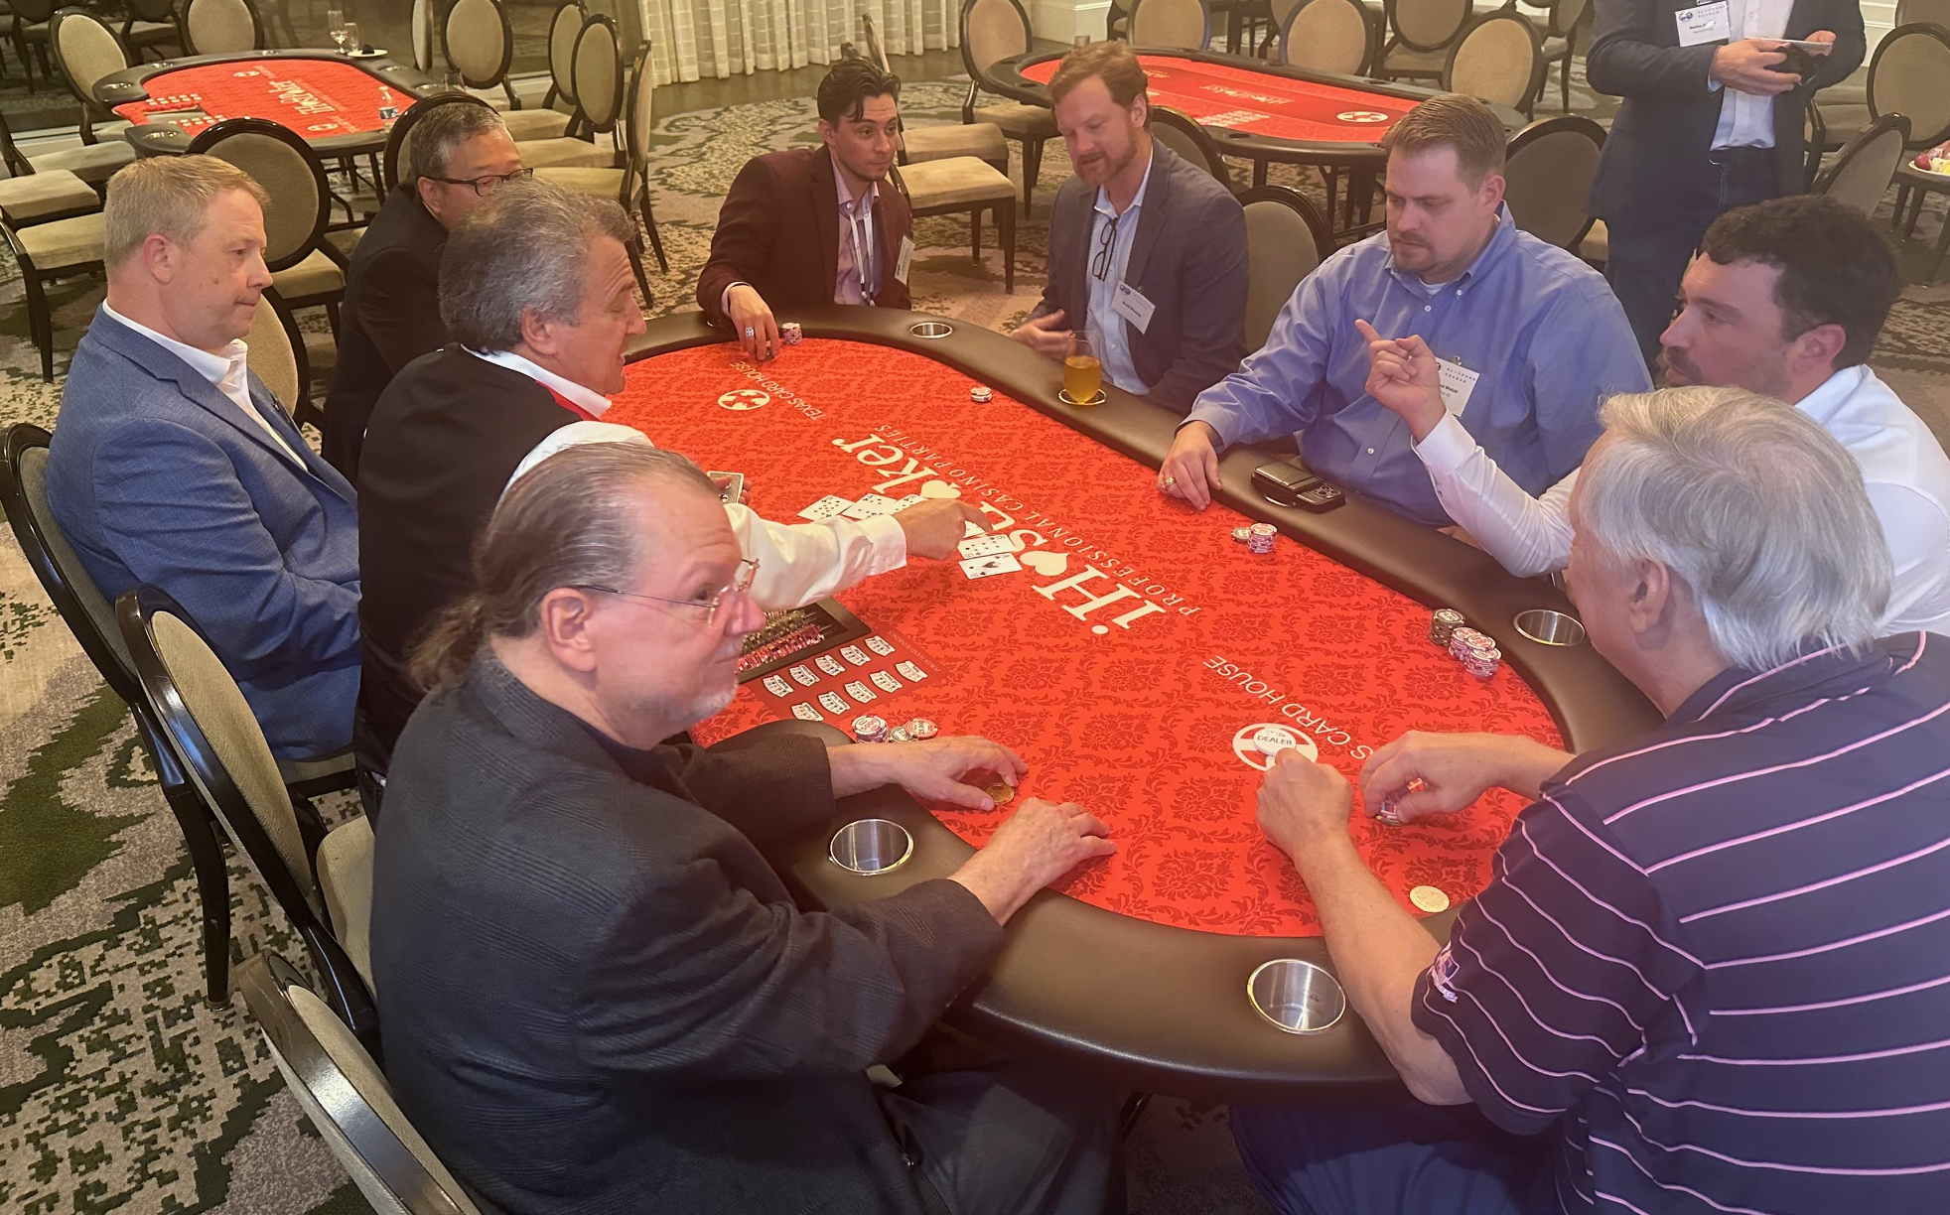
21 Aug 2024 – Poker Tournament BD Kick Off
Speaker: | Multiple Speakers
Event Title: | Poker Tournament BD Kick Off
Location: | Petroleum Club of Houston
Sponsors: | Clifford Chance, Grenadier III, Combo Curve, Haynes Boone, RR&A, Pariveda, SCA, the Arias Group
Registrants: | 85
Attendees: | 80
Registration page: | https://www.spegcs.org/events/6890/

Slide 37
22 Aug 2024 – Computational Fluid Dynamics Annual Symposium
Speaker: | Multiple Speakers
Event Title: | Annual Symposium: AI Accelerated Physics Based Modelling and its Role in Energy Industry
Location: | SLB Q-Auditorium 10001 Richmond Ave Houston, TX
Sponsors: | Platinum: Rescale Silver: Ansys, CPFD, ESSS O&G, ESTECO, Wood, Altair Bronze: Convergence CFD Software, DS Simulia, Tridiagonal Software
Registrants: | 50
Attendees: | 60 in-person, 20 online Total = 80
Registration page: | https://www.spegcs.org/events/6876/

Slide 38
Upcoming Events : September 2024
Event ID | Event Title | Event Date | Group Name
6934 | Chevron Technical Center - Comprehensive Understanding of Proppant Transport for Slickwater Fracturing via CFD Modeling | Sept. 6, 2024, 11:30 a.m. | Completions & Production
6891 | Northside - DFIT Best Practices and Interpretation Update with Focus on DFIT-Flowback | Sept. 11, 2024, 11:30 a.m. | Northside
6902 | General Meeting : Future Sources of Domestic Gas to Meet LNG Demand | Sept. 12, 2024, 11:30 a.m. | General Meeting
6930 | Transforming Energy Systems: Advanced Integrated Approaches for a Green Future [IN-PERSON] | Sept. 12, 2024, noon | Special Interest Group
6936 | Westside: How Operators and Service Companies Are Weathering a Challenging North American Market | Sept. 18, 2024, 11:30 a.m. | Westside
6953 | Permian Panel | Sept. 18, 2024, 5 p.m. | Business Development
6951 | Section-Based Data Analytics to Optimize Unconventional Development and Completions | Sept. 19, 2024, 11 a.m. | Reservoir
6916 | SPE-GCS Monthly Board of Directors Meeting | Sept. 20, 2024, 10 a.m. | Board of Directors
Notes:
Mention schedule meetings in September via Conference Call 30 min to 1 hour refresh Comms & Programs on how to’s? same for Treasury

Slide 39
Scan Me
https://www.spegcs.org/forms/volunteer-spe-gcs/

Slide 40
Thank you
Abhi Kohli
Shell
Abhinandan.Kohli@shell.com

