Slide 1

SPE Gulf Coast Section
Communications Refresher
August 19, 2022
SPE-GCS Communications
Alex Martinez, 2019-22 Comms Chair | Lindsey Newsome, Webmaster

Slide 2

Agenda
Overview of SPE-GCS Communications Team
Website page – www.spegcs.org
  Committee/Study Group Pages
Connect Newsletter
e-mail Marketing
  E-blasts & e-Newsletter
E-mails – Privacy Policy/Guidelines
Social Media Marketing
Communications Template – Starter Pack
FAQs

Slide 3
Why Is This Important?
Boost Attendance – In person and Online Events
Abide by SPE(I) Cybersecurity Protocol
Visibility to your Study Group/Committees Future Events
Notes:
in virtual and hybrid events as we transition to in-person events

Slide 4
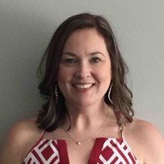
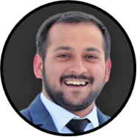

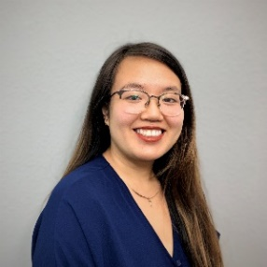

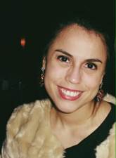
Communications Team
Lindsey Newsome
Abhinandan "Abhi“
Kohli
Debora Martogi
Tram Nguyen
Jaemin Jang
Webmaster
Communications
Chair
Vice Communications
Chair
YP - Communications
Alex Martinez
2019 – 22 Communications
Chair

Slide 5
Overview of Communications
Study Groups / Committees are responsible for creating and advertising their events
We highly recommend having dedicated officer(s) for communications and publicity within your Study Group / Committees
Study Group / Committees Roles & Responsibilities
Update your dedicated web page
  Mission, members, contact information, etc.
  Maintain officer positions
  Post presentations, photos, webinars, etc. (if needed)
Create events on the website & setup registration
Request e-mail blasts for your group / event
Request social media posts for your group
Submit content for Connect Newsletter

Slide 6
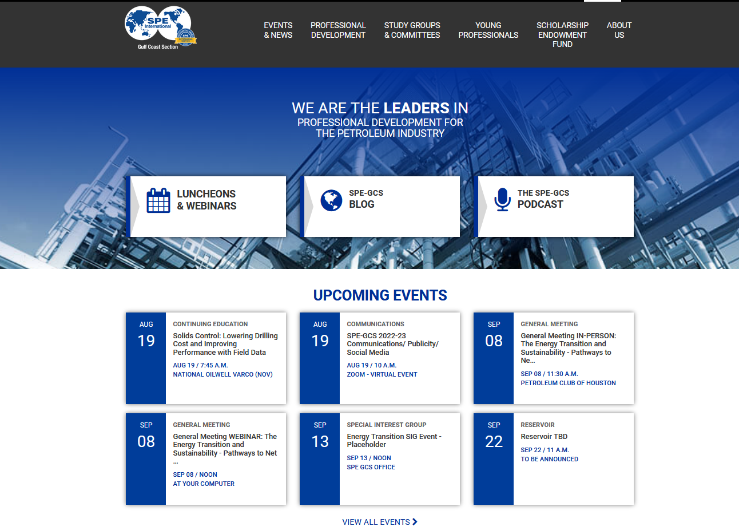
SPE-GCS Website
www.spegcs.org

Slide 7
SPE-GCS Website
Each Study Group / Committee has a dedicated page. It is the SG/Committee responsibility to maintain with relevant information
  Include your officers, sponsors, etc.
  Post presentations, photos, etc.
Registration for events is done through the website. To fully utilize the website, you need to know how to:
  Update Study Group/Committee Pages
  Add/Edit An Event
  Update Officer Positions

Slide 8
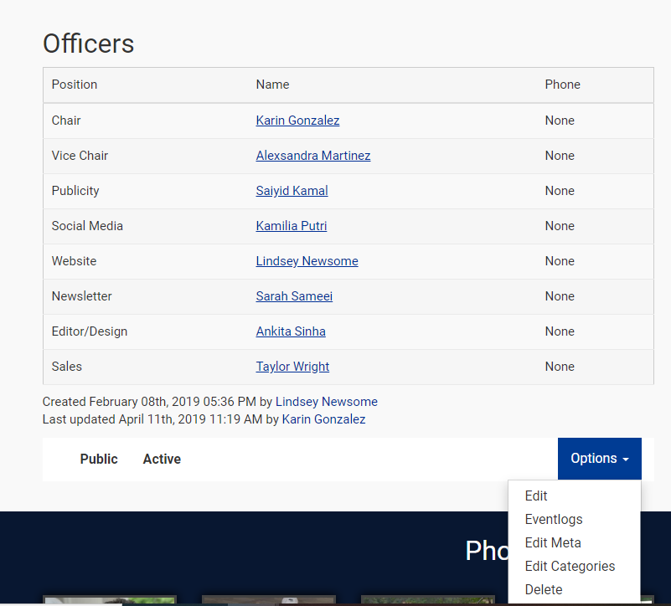
How To: Update Committee/SG Pages
Log onto the site
Go to your Committee/SG page
Scroll to the bottom and click Options > Edit
Change the information as needed
Make sure to include information on upcoming webinars/events
Click Save
Notes:
We have a set of specific positions. Due to the large variety of positions offered within each group you may have to customize the title by writing it into the phone field.
Make sure you get people’s permissions to add their phone number on the website. Some people don’t want it publicized.

Slide 9
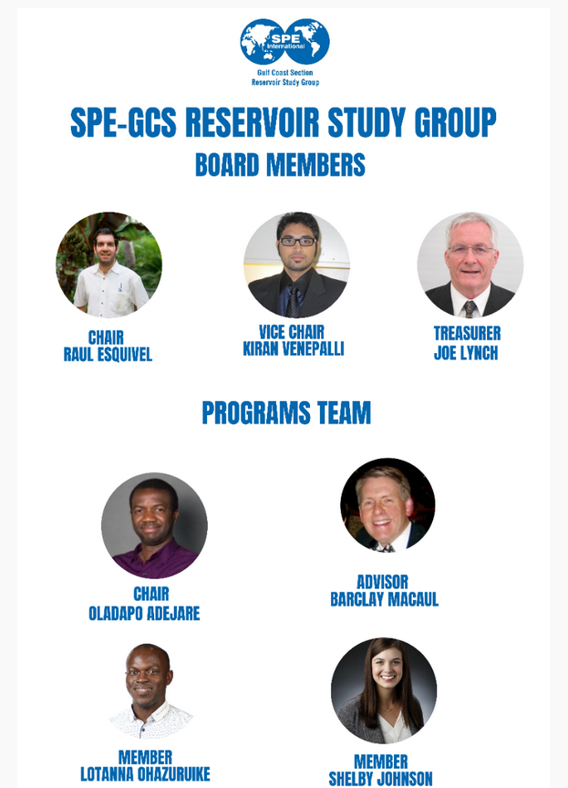
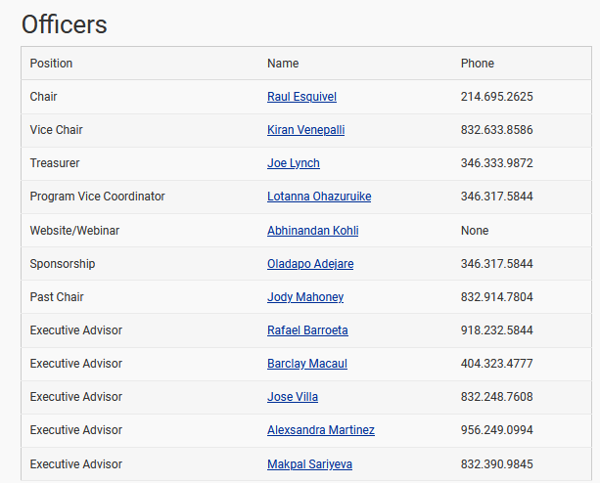
How To: Update Committee/SG Pages
Notes:
Examples of committee and study group pages – make sure all officers are okay with you posting their phone number on the committee/study group page before posting.

Slide 10
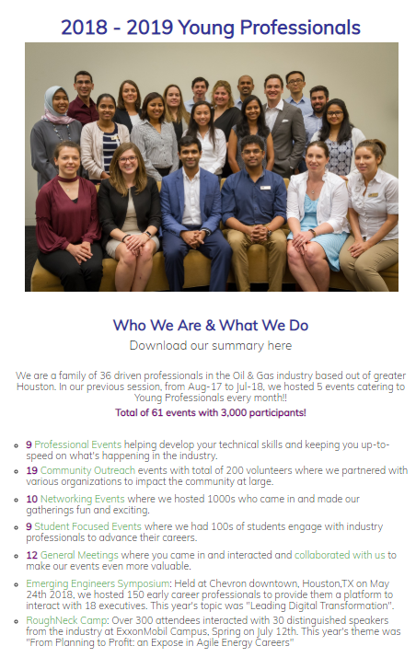
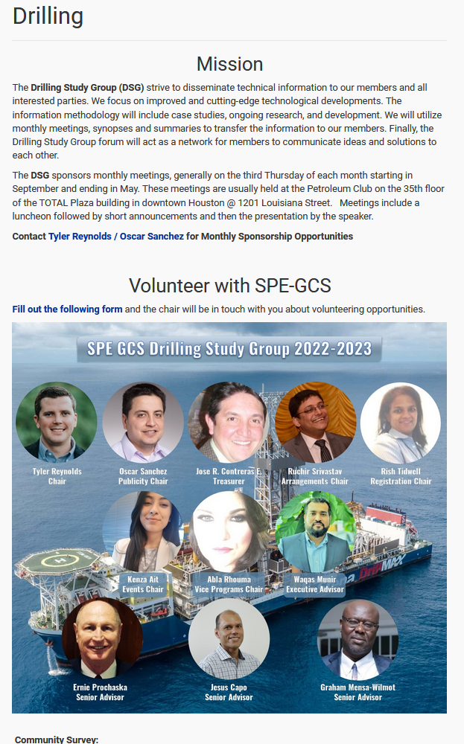
How To: Update Committee/SG Pages
Committee Page Example 2

Slide 11

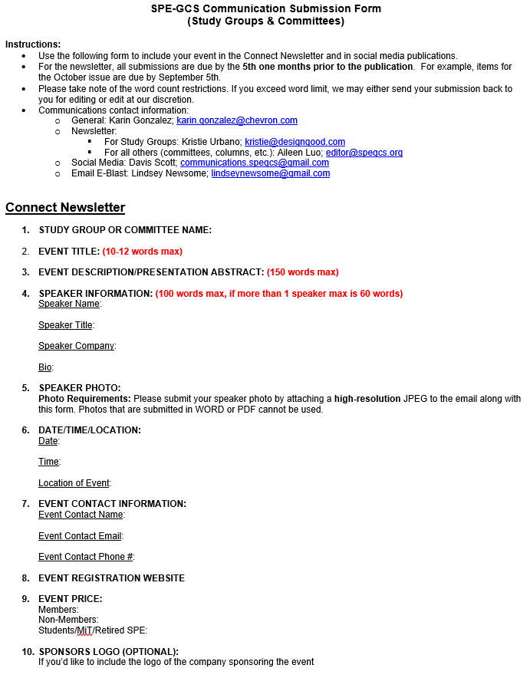
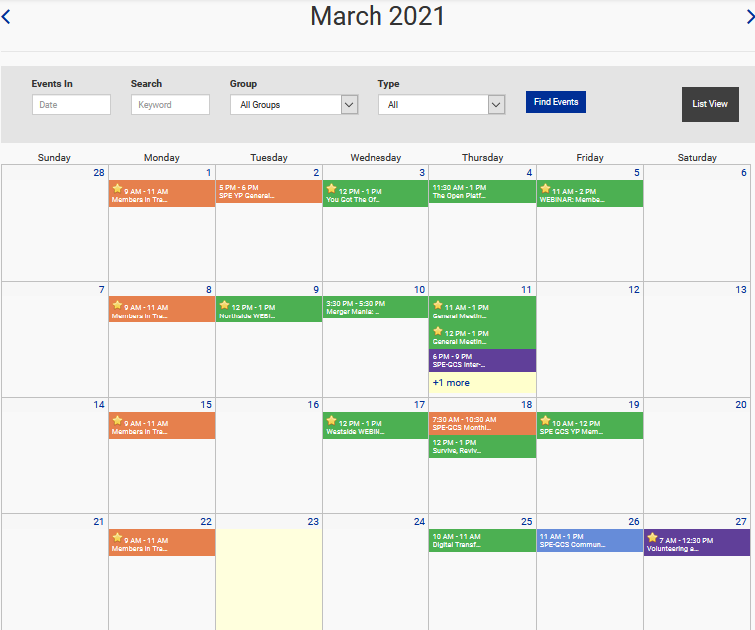
Event Timeline Example - Webinar Friday April 16
Create event on SPE-GCS Website by adding to calendar
Fill out Submission Event (you’ll need the URL from the event)
Review 1st CONNECT Draft
Submit to CONNECT
e-Newsletter is out with CONNECT
April 1st
March 1-5
March 19 -23
Week of April 5
Week of April 12
Request e-blast for reservoir SG/committee
Request Social Media Post
Monitor attendance
Make sure to share/link/comment
If attendance is low, request an e-blast for the following week
Advertise/Spread the word out

Slide 12
How To: Publish in CONNECT
Submit Connect Magazine Content
Distribution
Send electronically to all SPE-GCS members in our directory
Advertised through our social media platforms
Submissions
Events must be submitted by the 5th of each month to editor@spegcs.org
Reminder email will be sent to Study Group and Committee chairs. We can add other members to the distribution list if needed

Slide 13
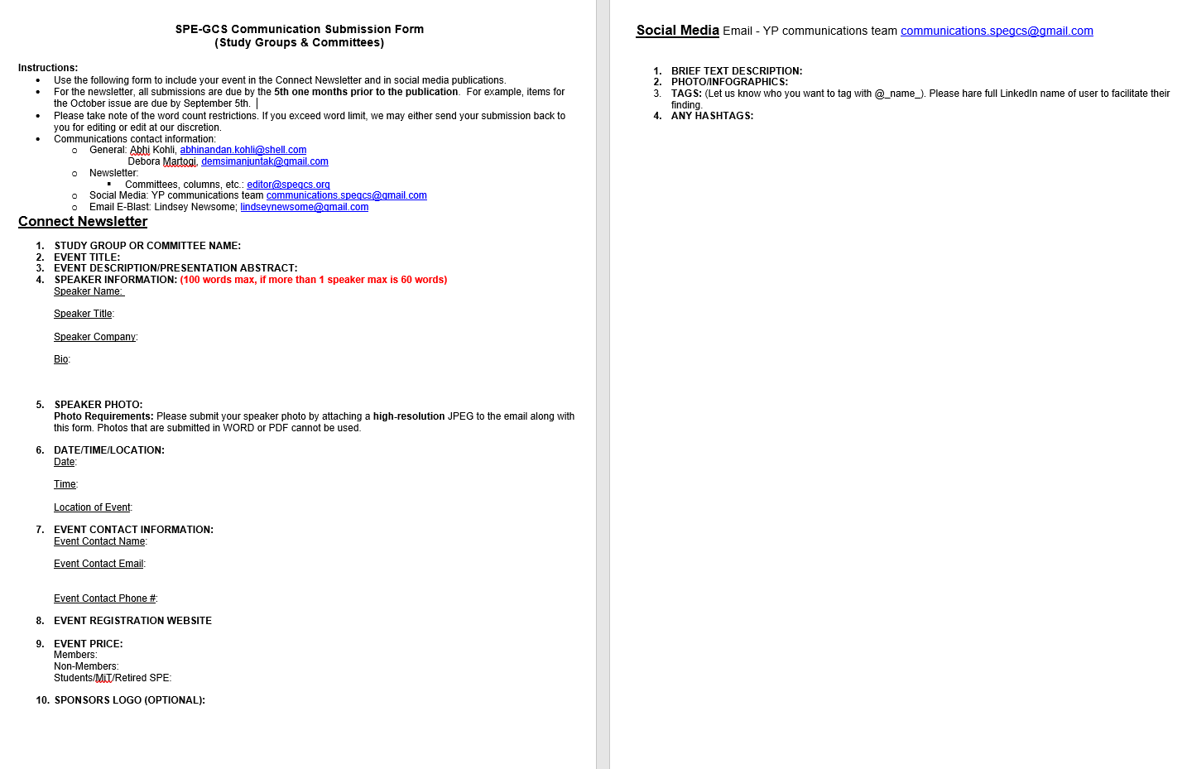
Connect Magazine – Submission Template

Slide 14
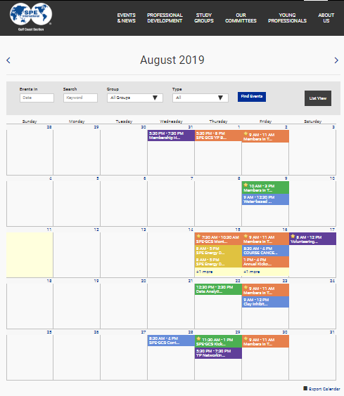
How To: Add An Event to the Calendar
It is the Chair’s responsibility to update the Officers Positions.
For user rights/permissions, make sure you email webmaster@spegcs.org and CC’d your chair OR have them send a request to give you access.
DO NOT DELETE EVENTS, EVER!

Slide 15
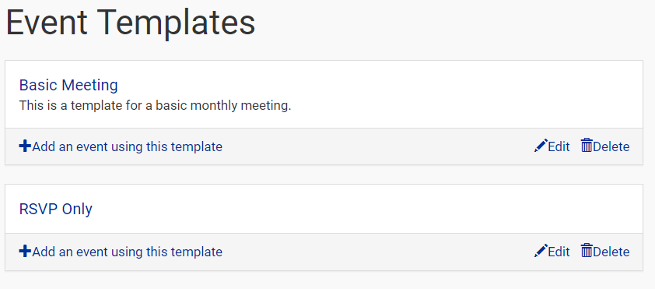
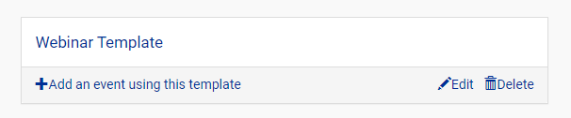
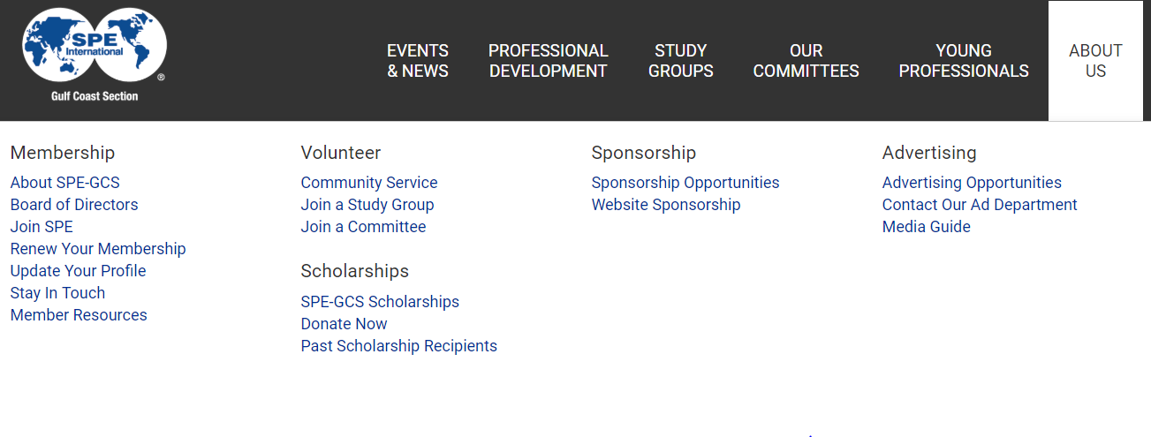
How To: Add An Event
Logged In > Events > Event Templates
Add an event using this template
Update the fields according to your event details
All How-To Instructions can be found
online under About Us > Membership > Member Resources
All events need to be added to the calendar at least one month in
advance to ensure promotion via
e-Newsletters

Slide 16
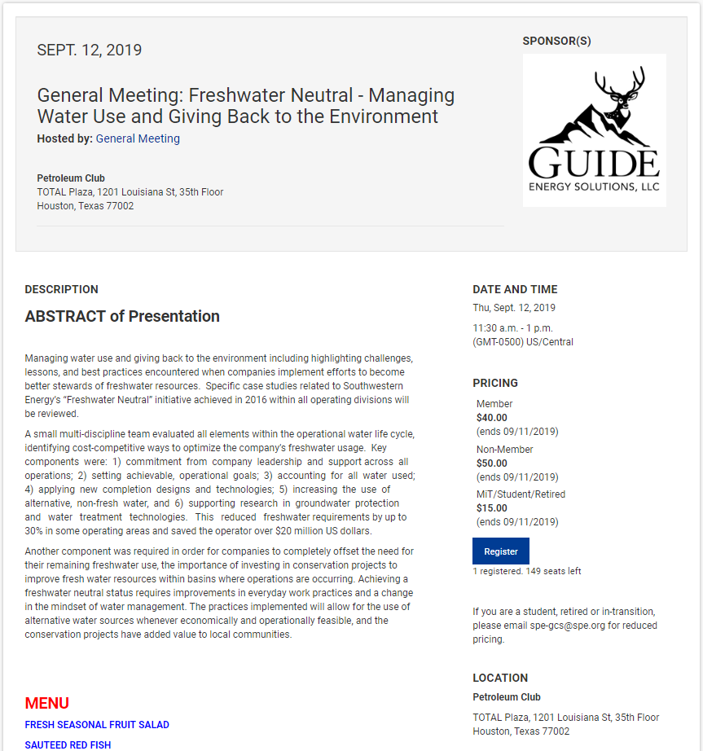
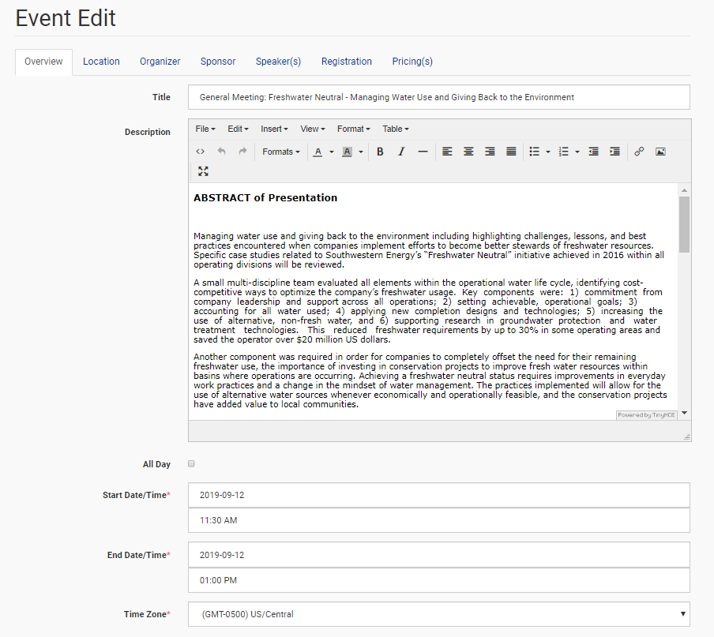
How To: Add An Event
Simple wizard will guide you on
information needed

Slide 17
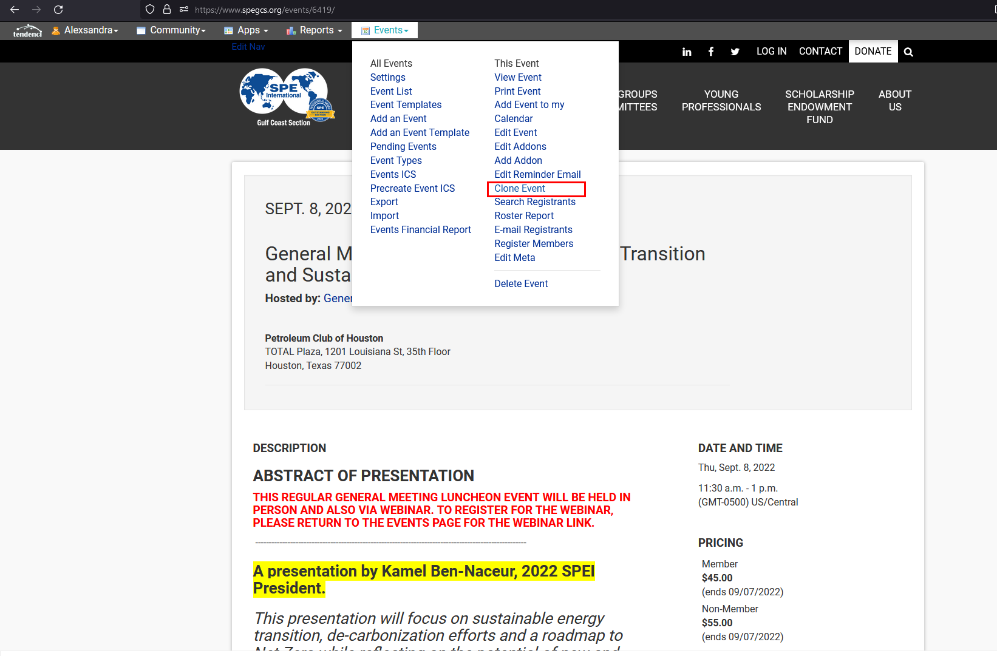
How To: Clone An Event
Simple wizard will guide you on information
needed

Slide 18
How To: Edit An Event
If you need to delete the event for some reason,
email webmaster@spegcs.org to make the event inactive
PLEASE DO NOT DELETE ANY EVENT ON THE CALENDAR OR THE EVENT PAGE (EVEN AFTER THE EVENT IS OVER)

Slide 19
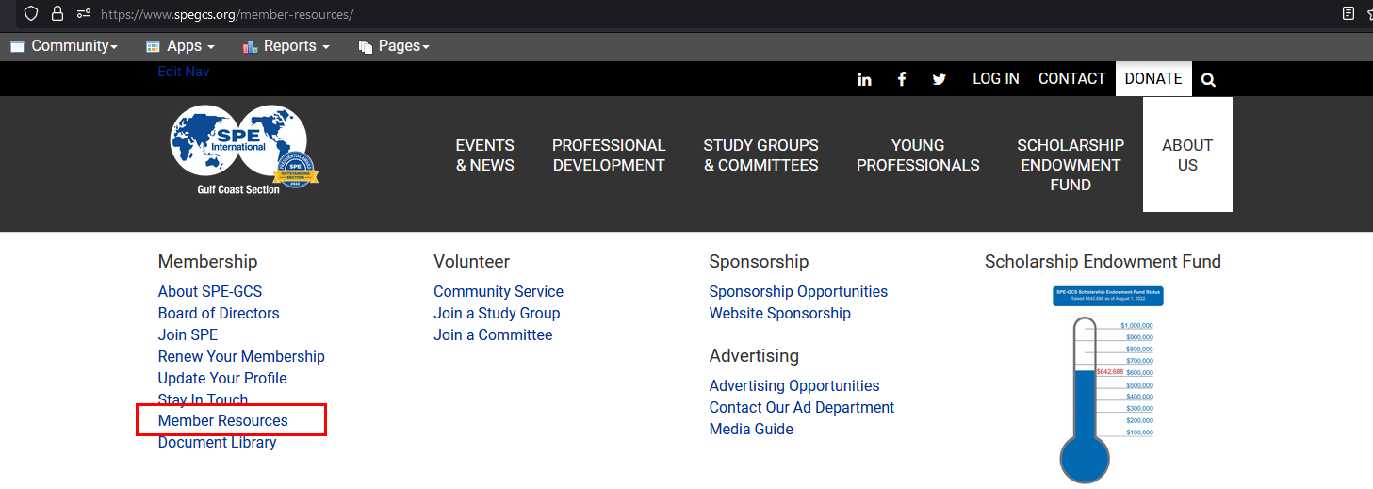
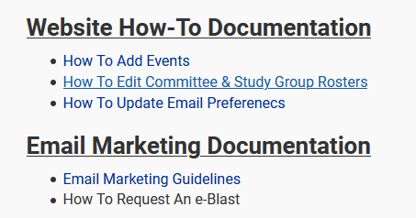
How To: Update Officer Positions
It is the Chair’s responsibility to
update the Officer’s Positions
All How-To Instructions can be found online under About Us >
Membership > Member Resources
Notes:
We have a set of specific positions. Due to the large variety of positions offered within each group you may have to customize the title by writing it into the phone field.
Make sure you get people’s permissions to add their phone number on the website. Some people don’t want it publicized.

Slide 20

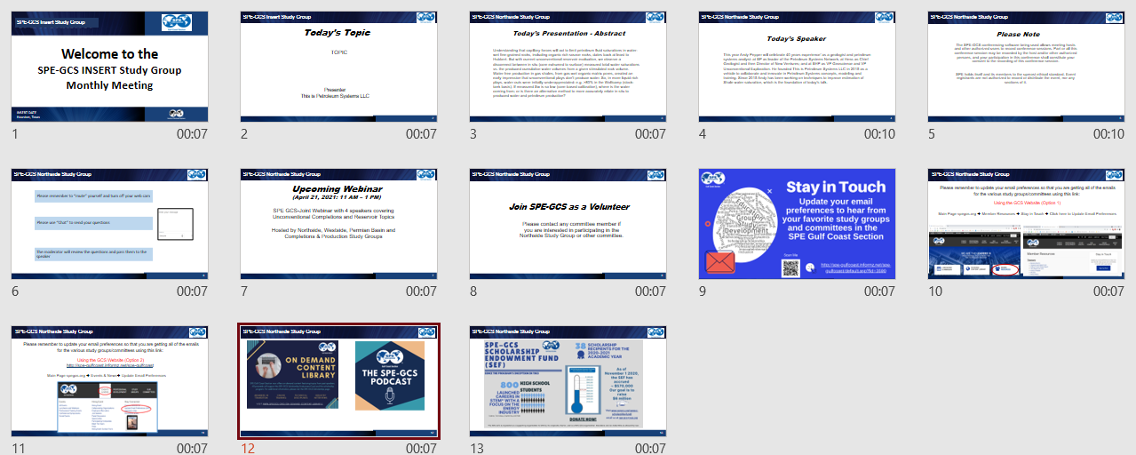




Communications Template – Starter Pack
Make sure to let your attendees know
about the on-demand content library, how to update their email preferences,
The SPE-GCS podcast

Slide 21
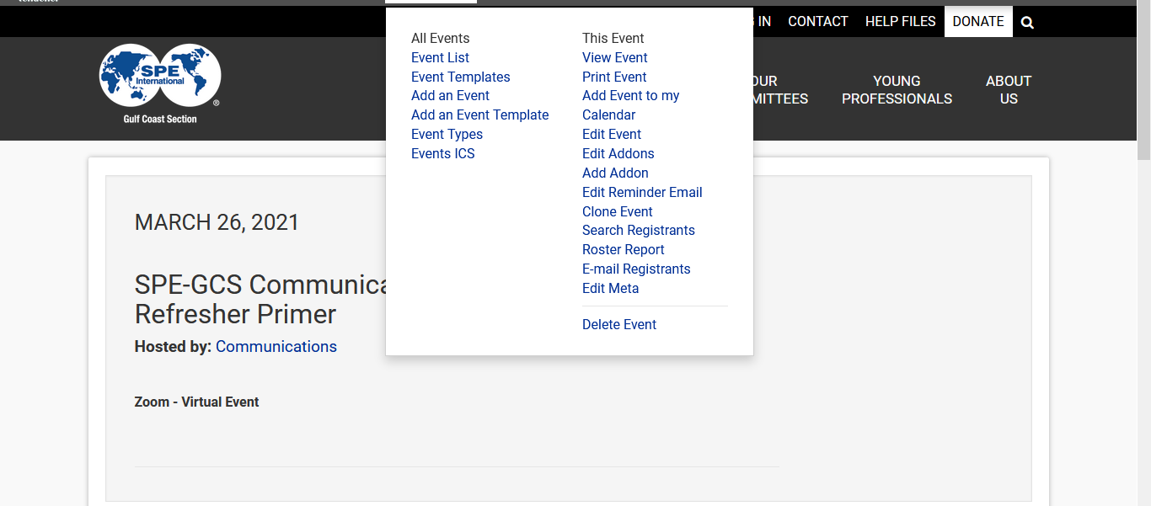
How To: Emailing Registrants

Slide 22
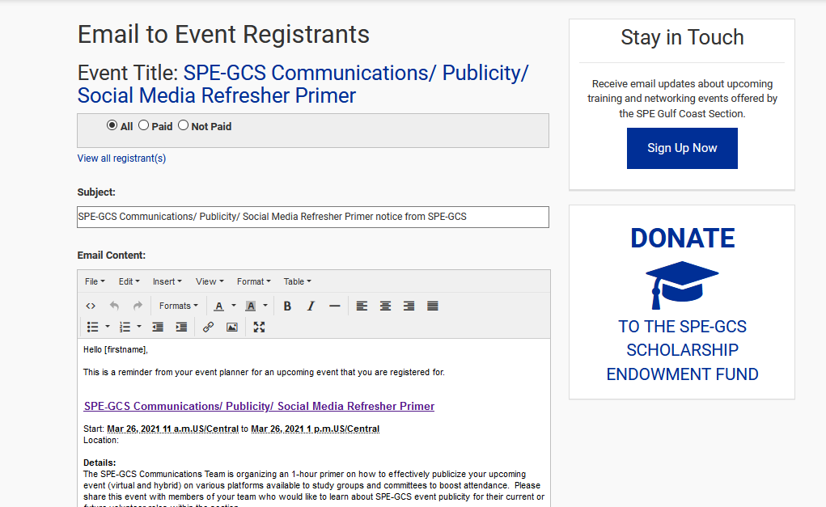
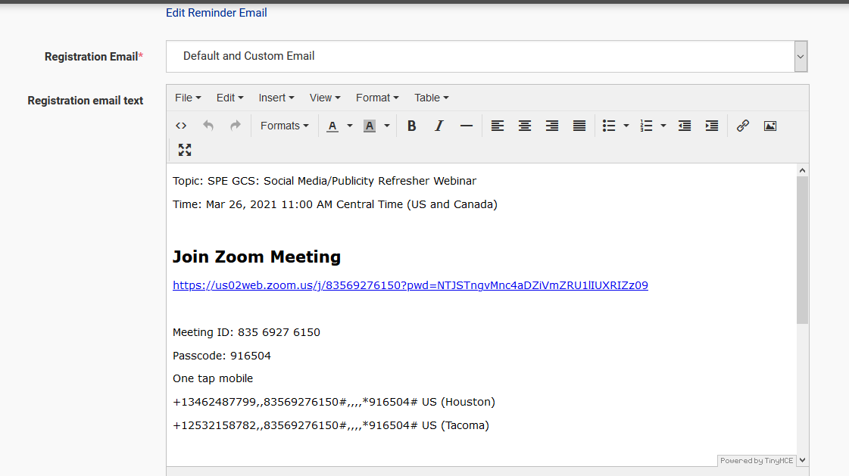
How To: Emailing Registrants & Setting up an Event Webinar
Need to reach out to attendees? E-mail slides?
Send Virtual Meeting link?
Events > E-mail Registrants
Add Virtual Meeting Link (GoTo Meeting or Zoom) by using the Default and Custom E-mail

Slide 23
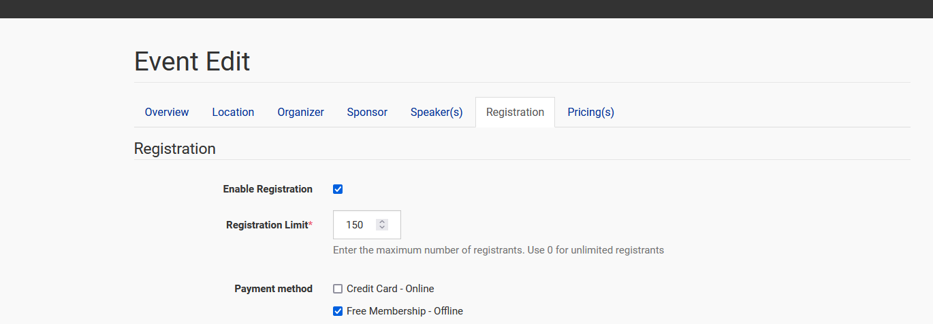
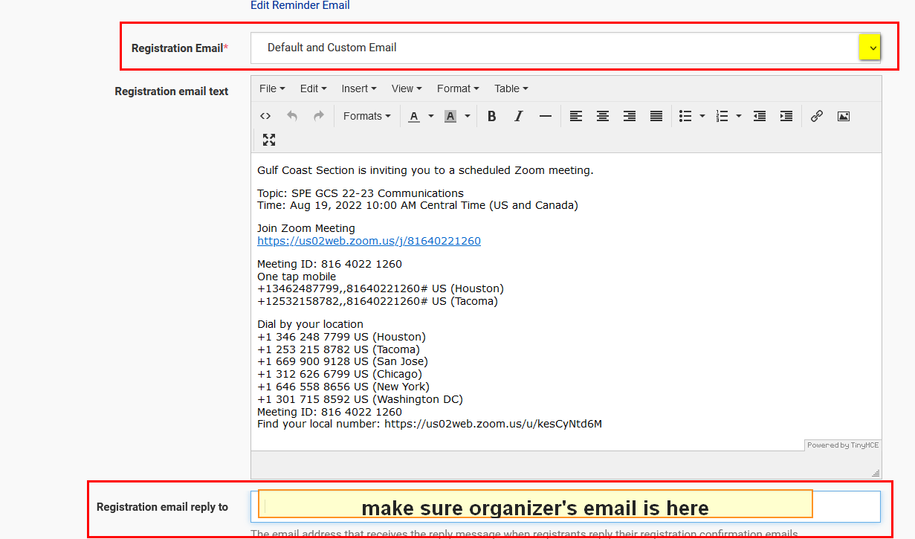
How To: Emailing Registrants & Setting up an Event Webinar

Slide 24
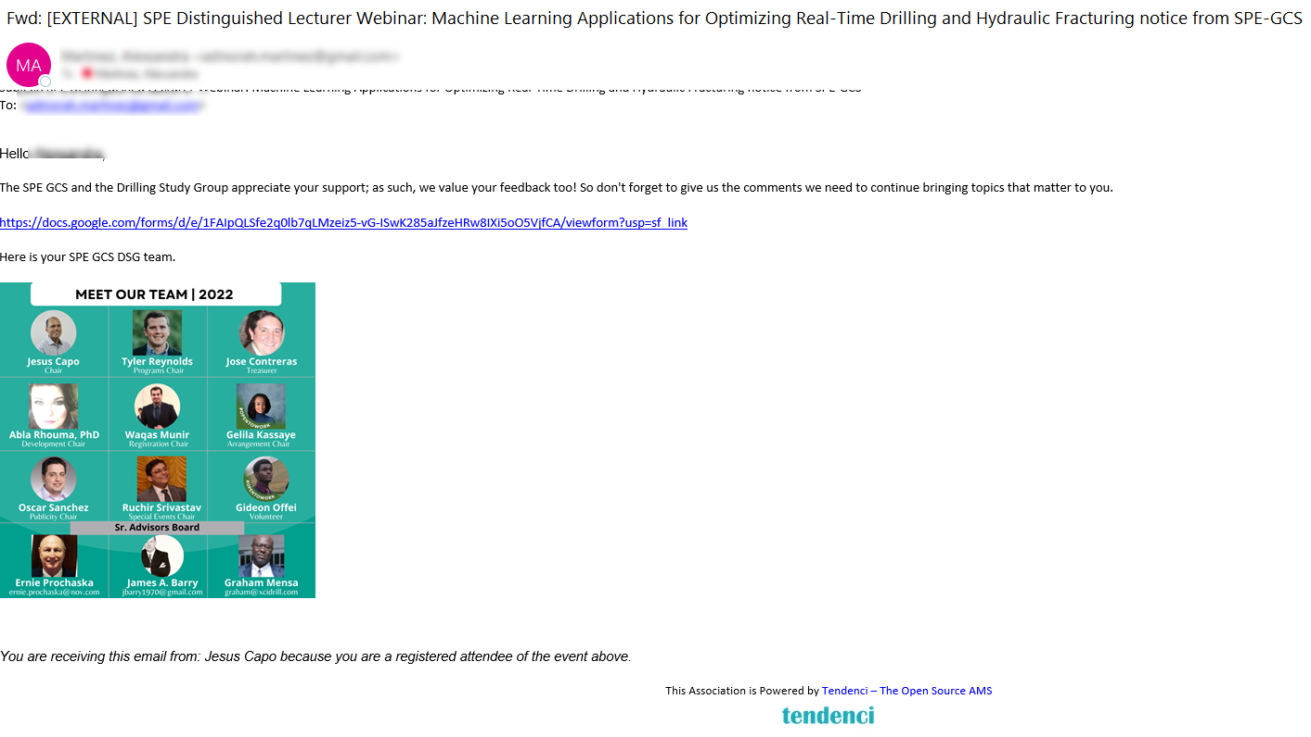
How To: Emailing Registrants
Example 1
Send Thank You Email Note to
your attendees (post event), you could include:
Presentation approved by the speaker
Link to the on-demand library
or any upcoming events for
your study group/committee,
Etc.
Link to your next event

Slide 25
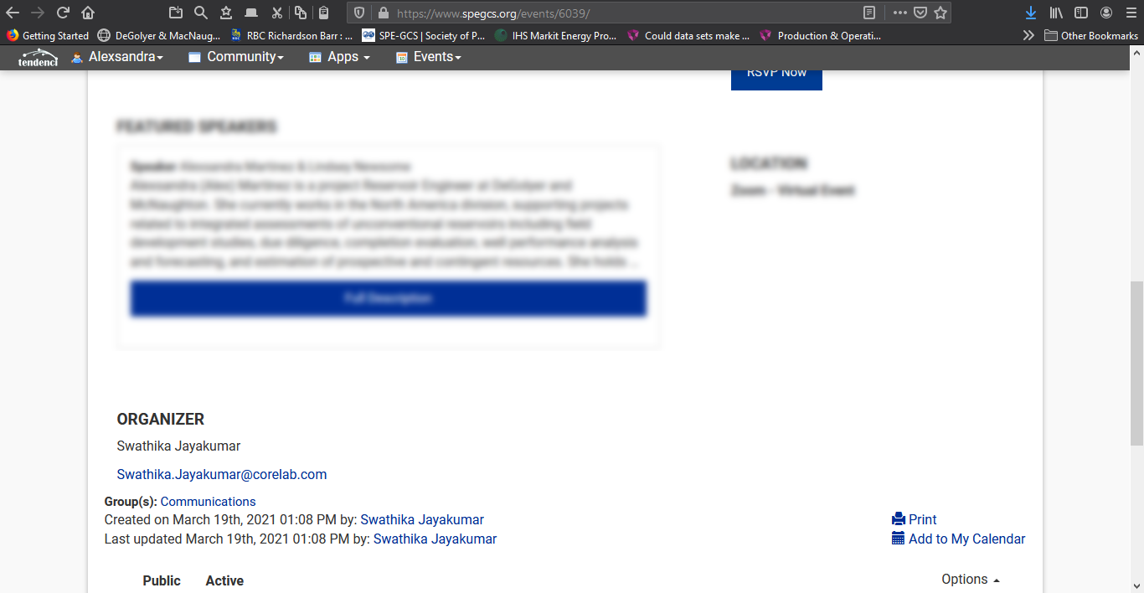

How To: Setting up an Event Webinar
Recommend SG/Committee to add to virtual events “If you do not receive the link to meeting within 24 hours, please e-mail organizer”
Make sure event lists organizer’s contact e-mail and phone (if available)

Slide 26
How To: Setting up an Event Webinar
Guidelines for Distributing Webinar Information
E-mail registrants from the event webpage
Include organizer contact information (e-mail and phone number) on all e-mails and events so people reach out to organizer and not webmaster for login information
Insert zoom/go to meeting info in the custom email on the registration tab
DO NOT E-MAIL REGISTRANTS FROM PERSONAL OR WORK E-MAIL
Who should we ask for the zoom/go to meeting links for each event?
  Answer: Programs Chair – Aaron Burton
Encourage participants to check SPAM/JUNK folder if they did not receive the webinar login details

Slide 27
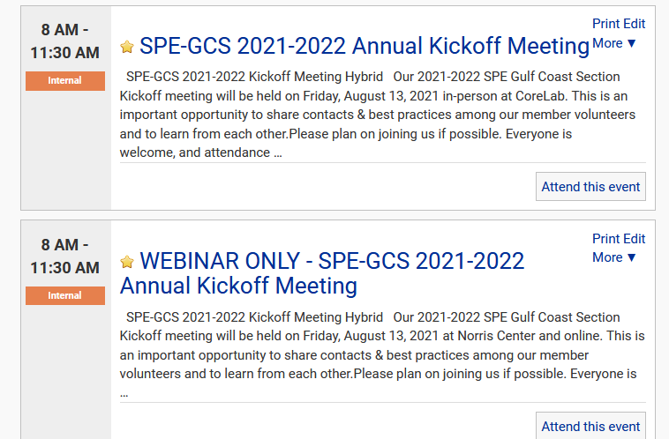
How To: Setting up Hybrid – In person and Online
For hybrid events i.e. hosting an in-person luncheon and a webinar, make sure to set two separate registration pages
  IN-PERSON
    Member, Non-Member and MIT prices
  WEBINAR
    Online price

Slide 28
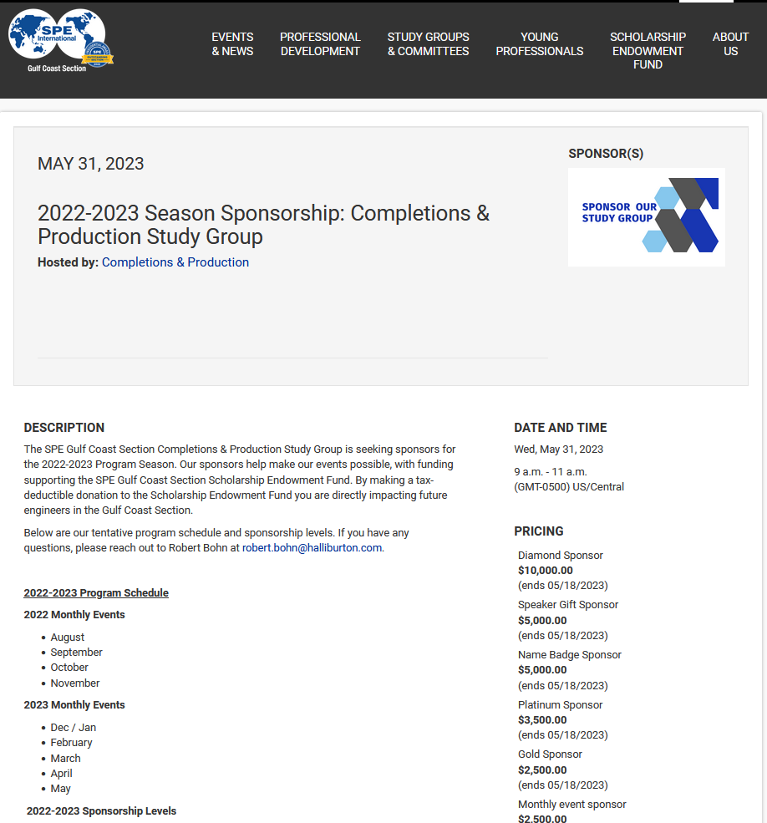
How To: Sponsorship Page
**NEW**
Sponsorship pages created for all SG/committees

Slide 29
How To: e-mail Marketing
Publicity
Update e-mail Preferences
e-mail Options
Request e-Blasts

Slide 30
e-Mail Publicity
There are two types of communications by e-mail:
e-Newsletter
E-Blast
Point-of-contact: Lindsey Newsome webmaster@spegcs.org

Slide 31
e-Newsletter
Frequency
    e-Newsletters sent out every Monday morning
    All events on the website are automatically added to the e-Newsletter
    Important! Create your event on the website early to make sure it is included
Who receives these e-mails?
    E-mails are sent to SPEI members assigned automatically to SPE-GCS that
    have joined the group
    MUST BE AN ACTIVE/PAID SPEI MEMBER to receive e-mails from SPE-GCS
Notes:
Notify webmaster@spegcs.org of any edits to events that are made one week prior to an e-Newsletter going out to ensure proper information distributed.

Slide 32
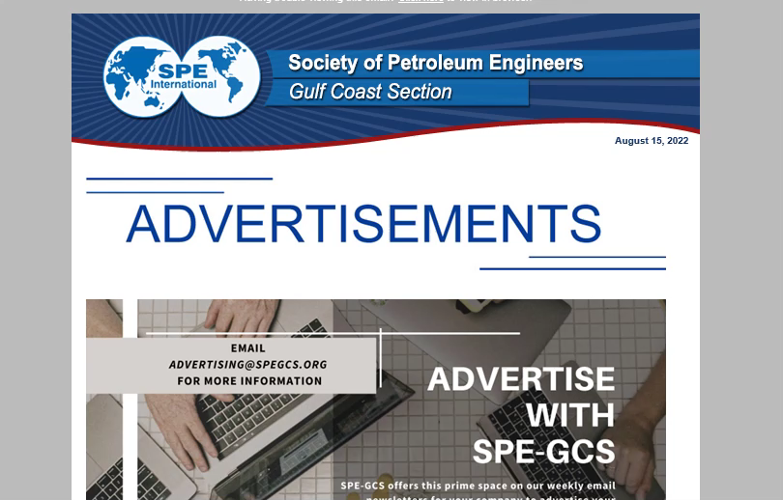
E-Newsletter
Frequency
    e-Newsletters sent out every Monday morning
    Important! Create your event on the website early to make sure it is
    included
Who receives these e-mails?
    E-mails are sent to SPEI members
    assigned automatically to SPE-GCS
    that have joined the group
    MUST BE AN ACTIVE/PAID SPEI
    MEMBER to receive e-mails from
    SPE-GCS

Slide 33
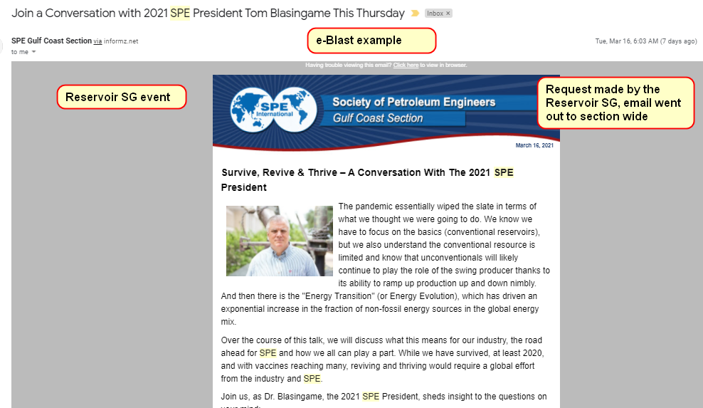
e-Blast
Frequency
    Sent only to specific groups, e.g.,
    Reservoir Study Group subscribers
    We will only send one e-blast per group per
    week to avoid spamming inboxes
    Exceptions can be made if attendance low
Who receives these e-mails?
    E-mails are sent to SPEI members assigned
    automatically to SPE-GCS that have joined the
    group
  MUST BE AN ACTIVE/PAID SPEI MEMBER to receive e-mails from SPE-GCS
  MUST HAVE OPTED-IN to specific groups to receive their e-mail
  REMIND YOUR MEMBERSHIP in December, Jan and Feb. to pay membership dues

Slide 34
How To Request An e-Blast
Chair/Co-Chair or Publicity Chair can request targeted e-blasts sent to your group
Download the E-mail Guidelines on the website
Requirements to send e-blasts:
Only one point of contact to request e-blast to avoid confusion
48 hours notice to send e-blast
Which study group(s) to send to
Link to website event with title of the event and details required in email - If
content on website exceeds 6-7 lines, must provide revised text
Date/time to send email
Send e-Blast to multiple groups:
Must get permission from other study group chairs EVERYTIME one wants to send an email blast to multiple study groups

Slide 35
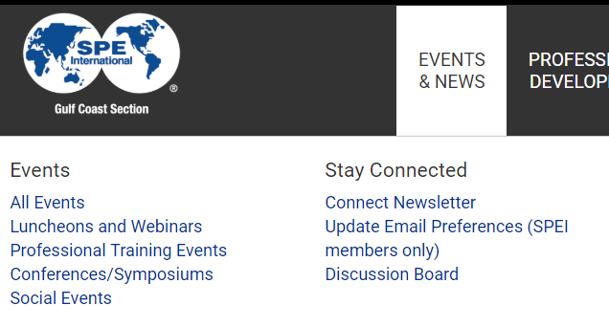
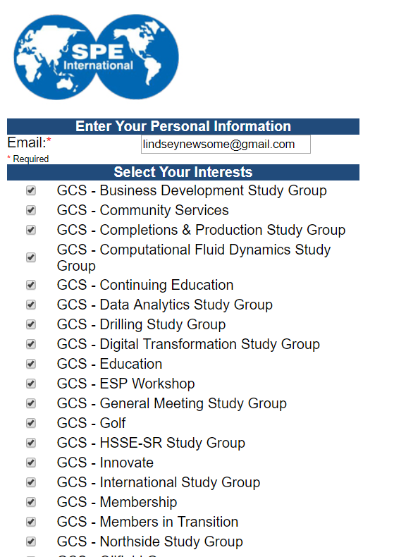
Update e-Mail Preferences for e-Blast
e-Blasts are sent to SPEI members assigned to SPE-GCS that have opted into the group
How to Update your Preferences
Click Events & News > Update e-Mail Preferences (SPEI members only)
  Use SPEI e-mail to update
  Select groups to receive e-mail updates
  Save

Slide 36
E-mails – Privacy Policy/Guidelines
IMPORTANT
All e-mails advertising SPE-GCS events MUST be sent by SPE-GCS official e-mail system (Informz) to comply with SPEI Privacy Policy guidelines
Any distribution of e-mails promoting SPE-GCS events through channels other
than Informz (i.e. – your work e-mail or private account) is strictly prohibited
  E-mail privileges will be revoked by the study groups or committees
  that violate SPEI email policy

Slide 37



How To: Social Media Marketing
All events are promoted via social media through the official SPE-GCS LinkedIn, Twitter and Facebook pages
For all events listed on the website, events are automatically advertised using our standard template using the following timeline:
  Event reminder two weeks before the event
  Another event reminder one week before the event
  Newsletter post at the beginning of the month with a link to all events
You are encouraged to share/like your event post to improve visibility
If Study Groups would like to post additional event reminder on social media, email
communications.spegcs@gmail.com (Tram Nguyen and Jaemin Jang)

Slide 38
How To: Social Media Post
Protocol to request a social media post
When requesting a social media post, please provide the following to communications.spegcs@gmail.com:
Description - includes at least:
  Brief Text Description
  Date, Time, Location
  Tags (Let us know who you want to tag with @_name_). Please hare full LinkedIn name of user to facilitate their finding.
  Any Hashtags
  Feel free to look at the Society Petroleum Engineers – Gulf Coast Section LinkedIn Page for inspiration
Graphic
  If you do not provide a graphic, we can make one for you following a standard template. However, we'd like for you to contact us at least 1 week prior to when you want to start posting in order to allow for proper feedback to make sure all info is correct.
Please send your request at least 2 days in advance. Most posts will be posted the day of or after. If you would like to have the post on a certain date, please specify in your email. Most times we can accommodate.
The best way to get exposure is to have members share and comment on the post throughout the week. This will keep the post alive and circulating.
  We try to space out most of the postings so they get enough exposure, but there are many posts that go through the page, so it is easy for a certain ad to get 'lost'. Please keep that in mind.
Feel free to send me a reminder if you don't see it posted in a few days after sending in your request

Slide 39


Advertise on Social Media
Standard Templates
If you have a specific picture to use, contact communications.spegcs@gmail.com

Slide 40
Key Resources - Contacts
General Communications
Abhi Kohli
abhinandan.kohli@shell.com
Debora Martogi
demsimanjuntak@gmail.com
Website
Lindsey Newsome
webmaster@spegcs.org
Connect
editor@spegcs.org
Social Media
SPE GCS YP Communications Team
communications.spegcs@gmail.com

Slide 41
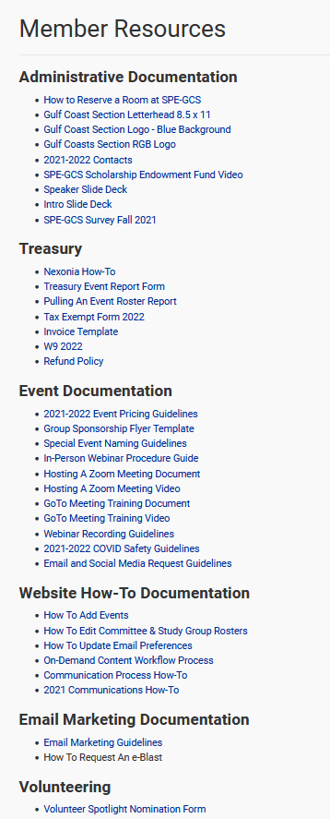
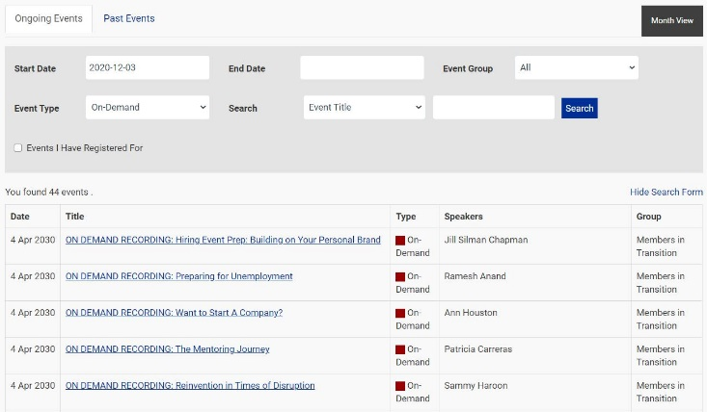
Key Resources - Online Member Resources
https://www.spegcs.org/on-demand-content-library/
Watch webinars on-demand with our new
library of videos
https://www.spegcs.org/member-resources/
Find how-to videos, templates and guidelines

Slide 42
Frequently Asked Questions by Category
What sources SPE-GCS provides to advertise events?
e-Blast, e-newsletter, CONNECT, social media post (LinkedIn)
Webpage
CONNECT Magazine
Who is responsible to update the study group/committee’s website?
  Study Groups / Committees are responsible for creating and advertising events. We highly recommend having a dedicated officer for communications in your Study Group/ Committees
Can ANYONE create an event?
  Communications/Publicity/Arrangement chairs can create/add events. See slide 18 for how to add event to website.
  You need to be given permission to create events. Ask your chair to contact the webmaster if you need rights
Can I directly email event attendees from my work or personal email about event updates and link to join?
  No, personal or work email cannot be used to email registrants
  What’s CONNECT?
    Digital magazine of SPE-GCS, send electronically to all SPE-GCS members in our directory
When is the deadline to submit to CONNECT?
    Events must be submitted by the 5th of each month to editor@spegcs.org

Slide 43
Frequent Q&A
Email Blasts
What’s an e-blast?
  Sent only to specific groups, e.g. Reservoir Study Group subscribers
Can a study group/committee request multiple e-blasts?
  We will only send one e-blast per group per week to avoid spamming inboxes (exceptions can be made if attendance low)
Can a study group/committee request an e-blast the morning the day of the event?
  Love the enthusiasm, unfortunately due to the short notice you cannot
  48 hours notice to send e-blast
How can I be added to email distribution list for CONNECT submissions?
  Reminder email will be sent to Study Group and Committee chairs. We can add other members to the distribution list if needed (Communications or Publicity chairs can be included to)
Where can I go to update my email preferences?
  Go http://spe-gulfcoast.informz.net/spe-gulfcoast/default.asp?fid=3590
  Remind your audience before the start of every event
Can I send email blasts about my event to those signed to other groups?
  Yes, for certain events (one-day) and if you have low attendance
  Need approval from the chair of the other study group before requesting Lindsey for e-blast

Slide 44
Frequent Q&A
Monthly e-Newsletter and Social Media
What’s the e-Newsletter?
  All events on the website are automatically added to the e-Newsletter
I need a social media post to advertise my event, who should I contact?
  For all events listed on the website, events are automatically advertise using our standard template using the following timeline:
    Event reminder two weeks before the event
    Another event reminder one week before the event
    If you need your event to be posted outside the timeline, please email communications team (Tram Nguyen and Jaemin Jang) communications.spegcs@gmail.com

