Slide 1
SPE-GCS Insert Study Group
Welcome to the
SPE-GCS INSERT Study Group
Monthly Meeting

Slide 2
Today's Topic
TOPIC
Presenter
This is Petroleum Systems LLC
SPE-GCS Insert Study Group

Slide 3
Today’s Presentation - Abstract
Understanding that capillary forces will act to limit petroleum fluid saturations in water-wet fine-grained rocks, including organic rich source rocks, dates back at least to Hubbert. But with current unconventional reservoir evaluation, we observe a disconnect between in situ (core exhumed to surface) measured total water saturations vs. the produced cumulative water volumes from a given stimulated rock volume. Water-free production in gas shales, from gas-wet organic matrix pores, created an early impression that unconventional plays don’t produce water. So, in more liquid-rich plays, water cuts were initially underappreciated: e.g. >80% in the Wolfcamp (stock-tank basis). If measured Sw is so low (core-based calibration), where is the water coming from; or is there an alternative method to more accurately relate in situ to produced water and petroleum production?
SPE-GCS Insert Study Group

Slide 4
Thank you Sponsor
INSERT SPONSOR LOGO HERE
SPE-GCS Insert Study Group

Slide 5
Today’s Speaker
Insert speaker’s bio
SPE-GCS Insert Study Group

Slide 6
Please Note
The SPE-GCS conferencing software being used allows meeting hosts and other authorized users to record conference sessions. Part or all this conference session may be recorded by the host and/or other authorized persons, and your participation in this conference shall constitute your consent to the recording of this conference session.
SPE holds itself and its members to the upmost ethical standard. Event registrants are not authorized to record or distribute the event, nor any sections of it.
SPE-GCS Insert Study Group

Slide 7
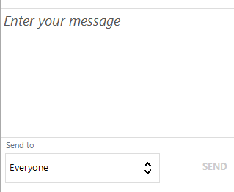
Webinar Etiquette
Please remember to “mute” yourself and turn off your web cam
Please use “Chat” to send your questions
Type Question Here
The moderator will review the questions and pass them to the speaker
SPE-GCS Insert Study Group

Slide 8
Upcoming Webinar
(April 21, 2021: 11 AM – 1 PM)
SPE GCS-Joint Webinar with 4 speakers covering Unconventional Completions and Reservoir Topics
Hosted by Northside, Westside, Permian Basin and Completions & Production Study Groups
SPE-GCS Insert Study Group

Slide 9
Join SPE-GCS as a Volunteer
Please contact any committee member if you are interested in participating in the Northside Study Group or other committee.
SPE-GCS Insert Study Group

Slide 13
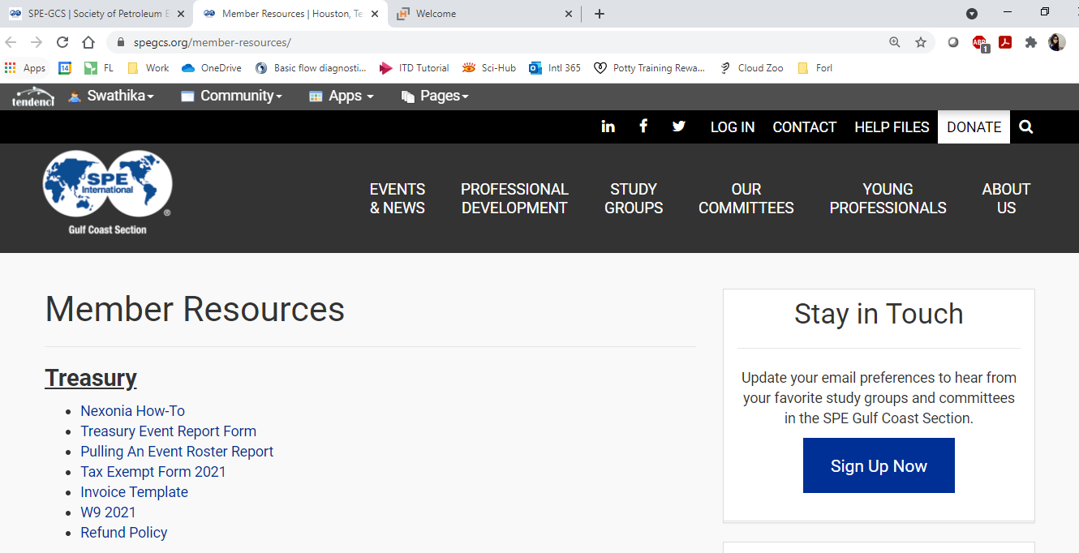
Update Email Preferences
Please remember to update your email preferences so that you are getting all of the emails for the various study groups/committees using this link:
Using the GCS Website (Option 1)
Main Page spegcs.org → Member Resources → Stay in Touch → Click here to Update Email Preferences

Slide 14
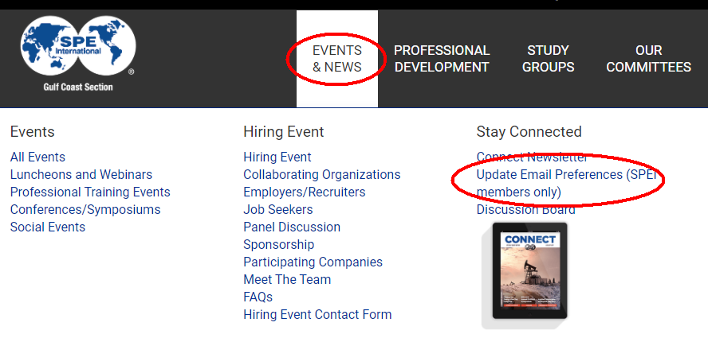
Update Email Preferences
Please remember to update your email preferences so that you are getting all of the emails for the various study groups/committees using this link:
http://spe-gulfcoast.informz.net/spe-gulfcoast
Using the GCS Website (Option 2)
Main Page spegcs.org → Events & News→ Update Email Preferences

