Slide 1
Digital Transformation Study Group Blockchain in Oil & Gas Observations and Trends
Claude Baudoin – 3 May 2018

Slide 2
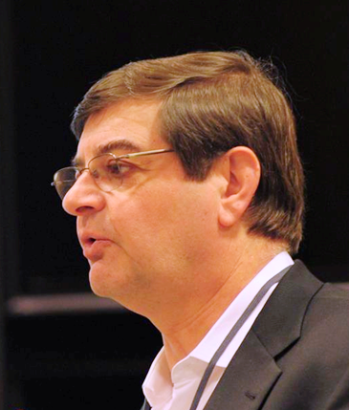
Background
Expertise in IT strategy and Knowledge Management
Co-chair, OMG (Object Management Group) Business Modeling & Integration Task Force
Leader, OMG Data Residency Working Group
Steering Committee member, Cloud Standards Customer Council
Energy Domain Consultant, Industrial Internet Consortium (IIC)
26 years at Schlumberger
Owner and Principal of a boutique consulting company
Chaired the “Blockchain, IoT and Machine Learning in O&G – Canada” conference on Feb. 13-14 in Calgary

Slide 3
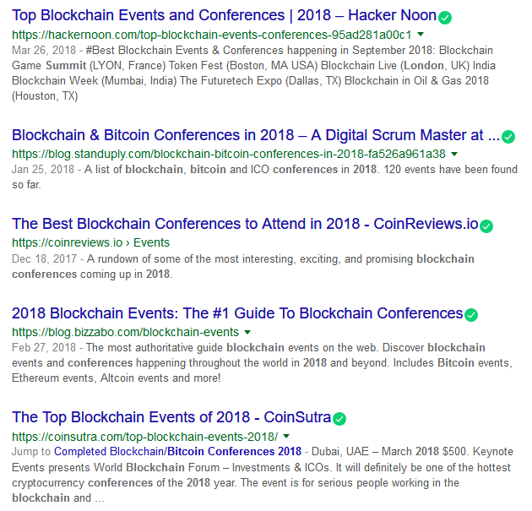
Explosion of Interest
This year, we almost need a “guide to the guides of blockchain conferences” →
Peak of Inflated Expectations?
Will it be followed by a Trough of Disillusionment?
Not if you educate yourself and place the business value first, not the technology

Slide 4
Gartner on Blockchain… FWIW
“The recent rapid rise and fall in the value of Bitcoin has thrust blockchain into our everyday vocabulary and into the minds of CEOs, IT leaders and Boards.”
“Blockchain has captured the interest of leaders across the spectrum as a technology that can radically transform business and society. But for most, the technology remains an enigma, and it is hard to find real enterprise projects where this promise has turned into reality.”
“Blockchain has transcended its bitcoin-related origins to reveal itself as a disruptive collection of technologies that can have an enormous impact on business and society. IT leaders in organizations (private and public sector) must cut through the hype and apply blockchain for maximum benefit.”

Slide 5
General Observations
In most blockchain conferences, much time is spent “demystifying” blockchain
For most people, blockchain = Bitcoin, Ethereum, and perhaps ICOs
You have to clarify when blockchain is useful vs. overkill
You can secure data with simpler solutions if you trust the custodian
Blockchain is helpful when you have simultaneous requirements for:
Encryption
Distribution
Non-repudiation
Implementation is not simple…
… but there are now several positive case studies
Assess business value, define process, before selecting technology

Slide 6
Use Cases
“Distributed energy business ledgers are coming rapidly”
Contracts and orders
Establish trust and confidentiality in the order-to-cash process
Eliminate paper
Royalty transactions
Royalty asset entitlement recording
NAL Resources eliminated their A/P department, handles 5,000 royalty invoices with just 4 person-days of work per month
Logistics
Water hauling (Amalto)
Recording of shipments

Slide 7
Key Actors
Some Technology Suppliers
GuildOne
CG Blockchain
BCT (The Blockchain Terminal)
Fast Access Blockchain
ShipChain
Others
Blockchain Association of Canada
University of Calgary
York University (Toronto)
Government Blockchain Association

Slide 8
Concluding Thoughts
Blockchain is here to stay, and has legitimate uses
The key focus is trust
Some applications require cryptography-based security, but not necessarily blockchain
Look into Hashgraph
Educate yourself and people around you
Especially executives who read the airline magazines too much
Start small, prove the business value, iterate
Don’t stop after a single failure – Don’t stop after a single success
Don’t roll your own – partner with technology providers

