Slide 1


with Michelle Peavy

Slide 2








Introducing
Michelle Peavy

Slide 3

Today’s
Program

Slide 4


Society of
Petroleum Engineers
Thank
You!

Slide 5
Agenda
How to ASK for what YOU want
Obstacles / Rejection
Linkedin Statistics
Linkedin Subscriptions
Top 3 Linkedin Components
Letting Executive Recruiters Know You are Open
Call to ACTION
Stay Connected with Michelle

Slide 6

ASK
What Do You Want?

Slide 7

Answer
OPI
OPM
OPN
OPK
OPT

Slide 8

Rejection
Biggest Obstacle

Slide 9

Overcome
Rejection
www.FearBuster.com

Slide 10




467M Global | 228M in USA
Females 44% Males 56%
Statistics
$26.2 Billion | June 2016
98% of Recruiters use
Linkedin to vet candidates
Avg Monthly Time = 17 mins

Slide 11
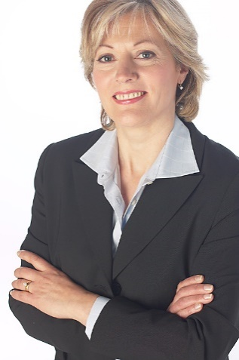

Add a Professional Picture
= 36 X times more likely
to receive a message
Increase
Visibility
Increase visibility and network with
300 – 500+
Connections

Slide 12

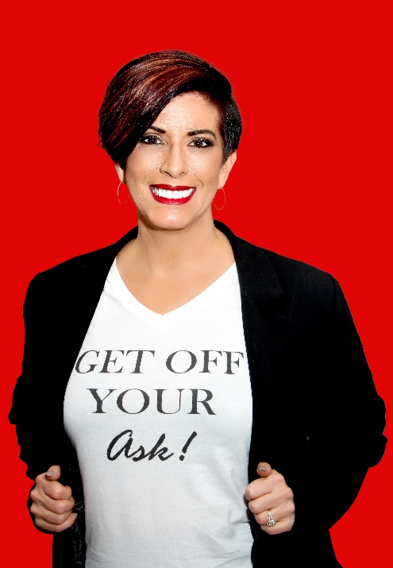

Get More
Info
Text
444999
Text
Cheatsheet

Slide 13
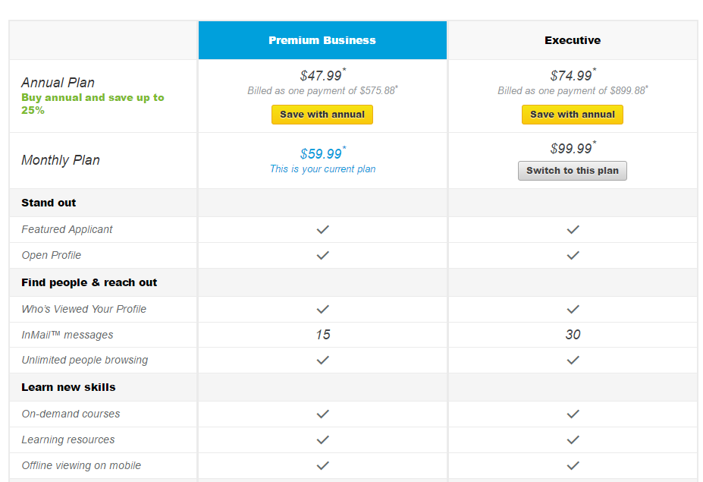
#1
Investment
Tool

Slide 14
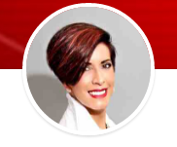
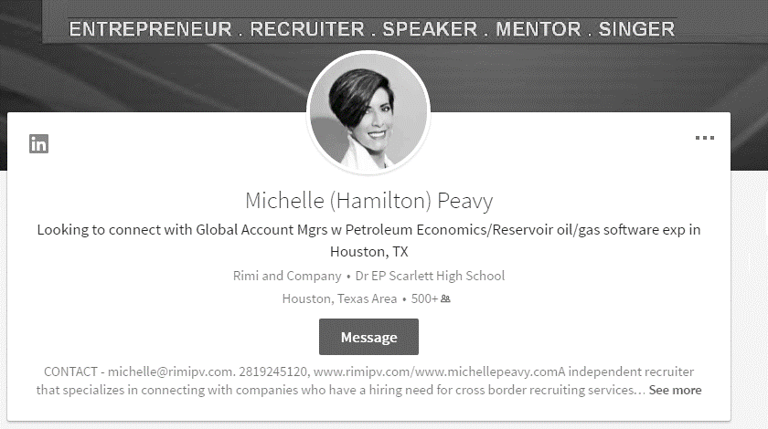

Top 3
Components
Picture
Headline
Summary

Slide 15
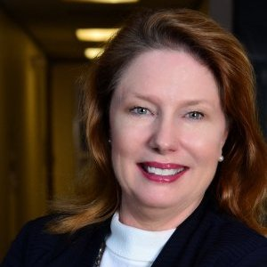

Put the Odds in Your Favor
Professional
Headshot
Add a professional photo, 36X more likely to receive a message, 14% increase to be found on Linkedin
Test Your Photo:
www.PhotoFeeler.com

Slide 16
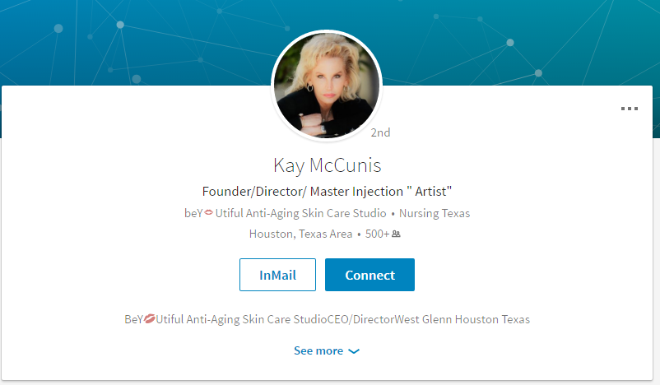

Slide 17
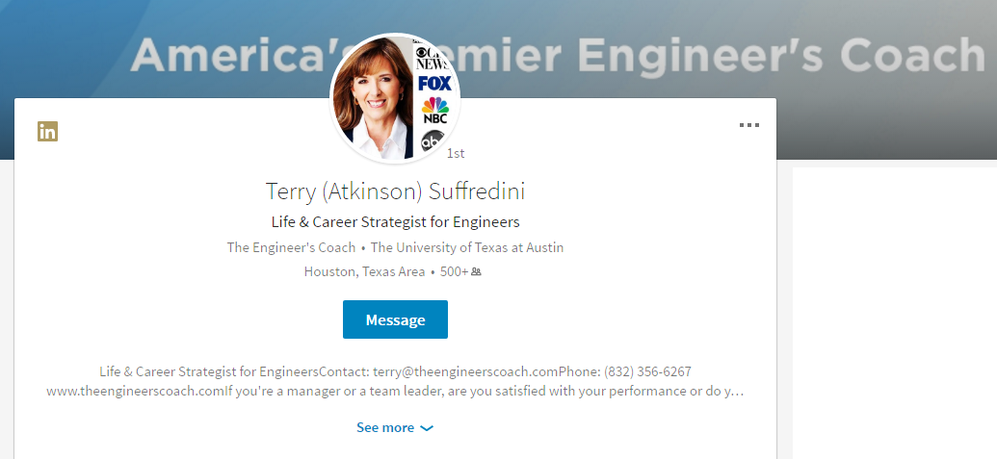

Slide 18
ASK Statement
High impact on Linkedin
search algorithm
returns Keyword Search results
Headline
Headline

Slide 19
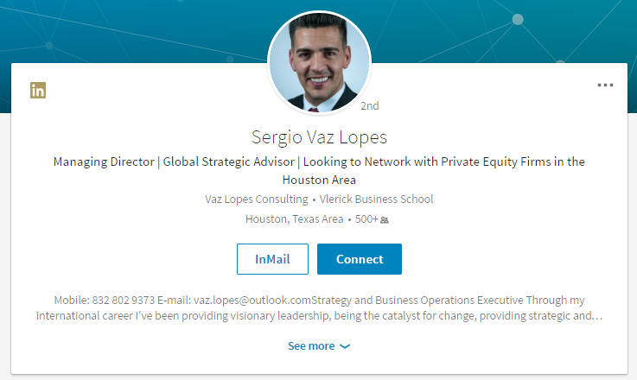

Slide 20
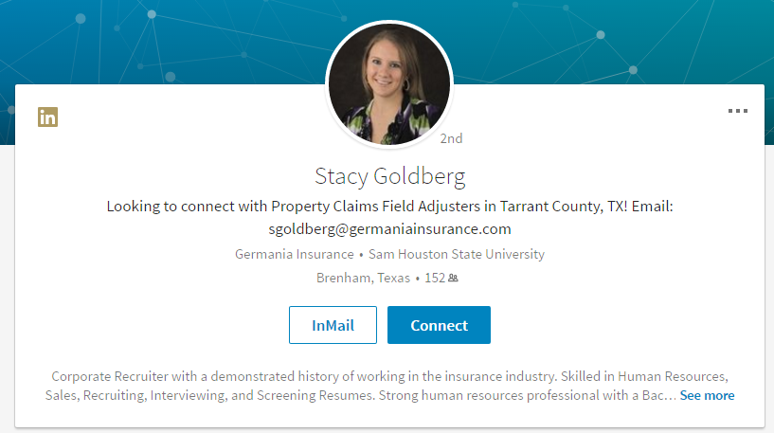

Slide 21
2,000 characters available
Tell your story “ I Help……”
Summary
Summary

Slide 22
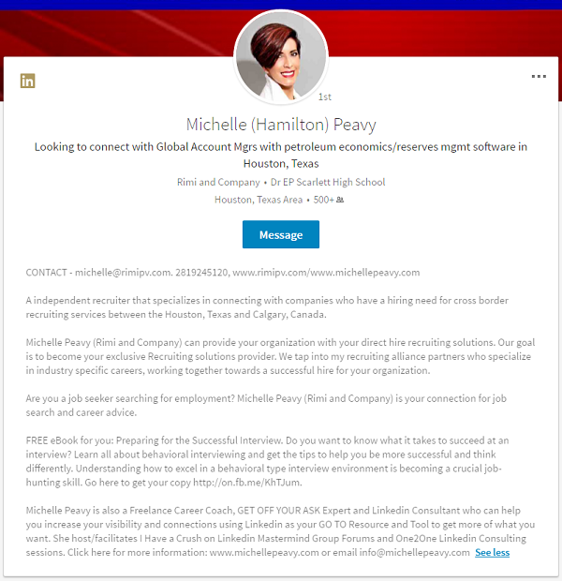
See More Summary
Summary
Use keywords, repeat for greater density

Slide 23
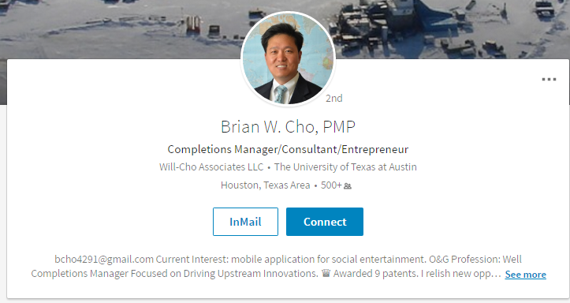

Slide 25

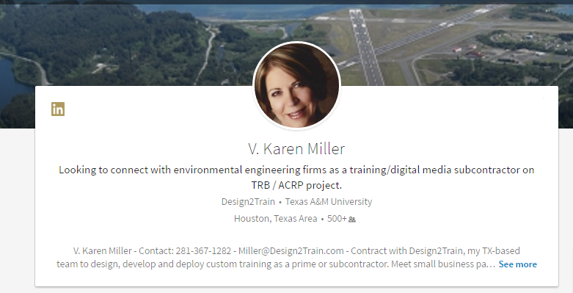

Slide 26
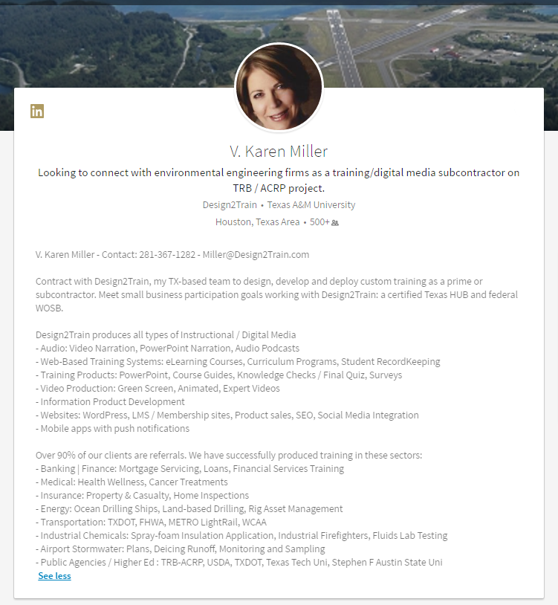

Slide 27
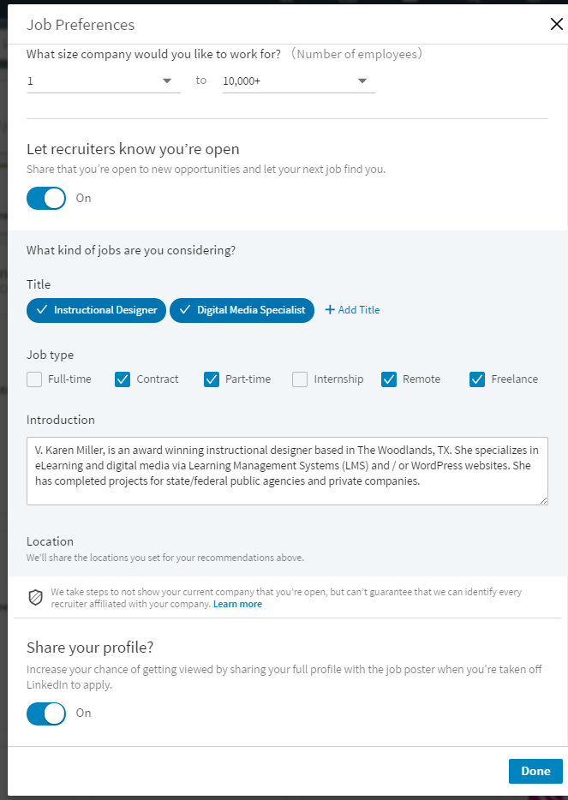
Open to Recruiters
Job >
My Prefs

Slide 28
Write an ASK Statement
Choose Professional Headshot
Write Summary
Use Linkedin 15 Minutes Daily
Call to
ACTION

Slide 29

Connect
With Me
Michelle
Peavy

Slide 30

Questions?

Slide 31

That’s
All
Folks!

