Slide 1
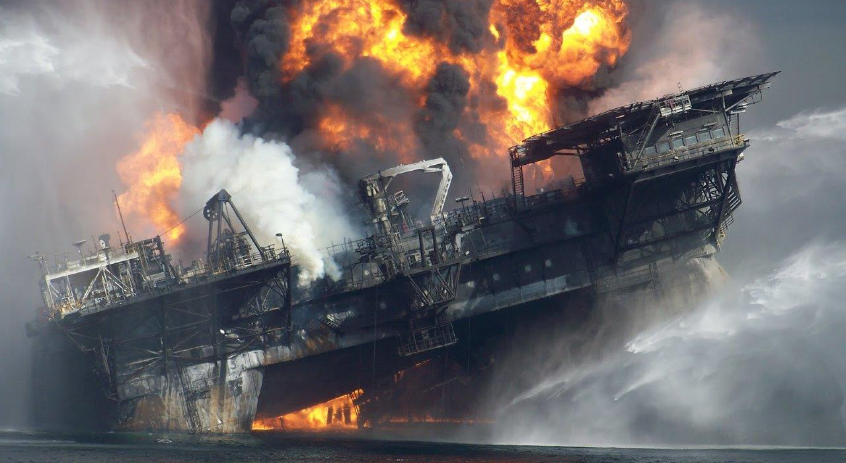
SPE HSSESR Lunch Meeting
Finding the Gaps
The Macondo Well Blowout
“Accidents are seldom preceded by bizarre behavior…”
Sidney Dekker, The Field Guide to Understanding Human Error
Mary Beth Mulcahy, Ph.D.
marybeth.mulcahy@csb.gov
www.csb.gov
January 10, 2017

Slide 2
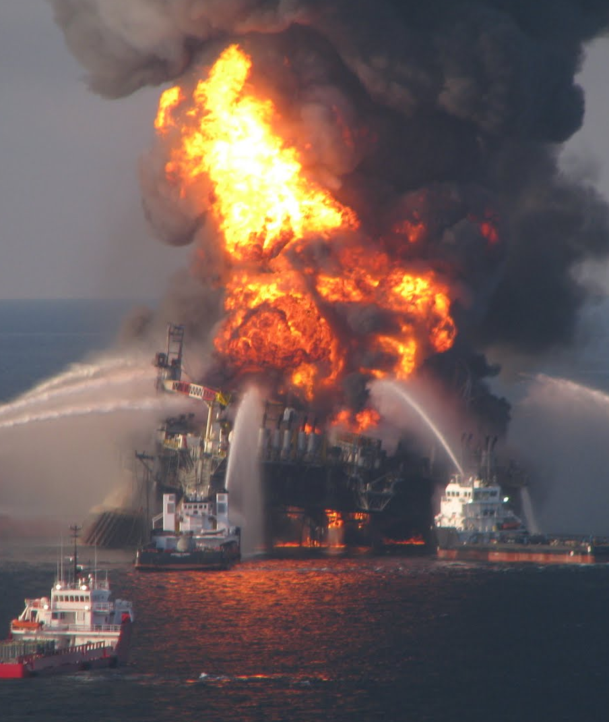
Incident Synopsis: Drilling Rig Explosion and Fire
April 20, 2010
Ignited Macondo well blowout
11 deaths
17 airlifted for critical physical injuries; many others injured – burns, broken bones, anguish…
Evacuation of 115 individuals from the rig
Worst oil spill in US history
Sinking of the Deepwater Horizon drilling rig— Transocean-owned rig; BP-leased

Slide 3
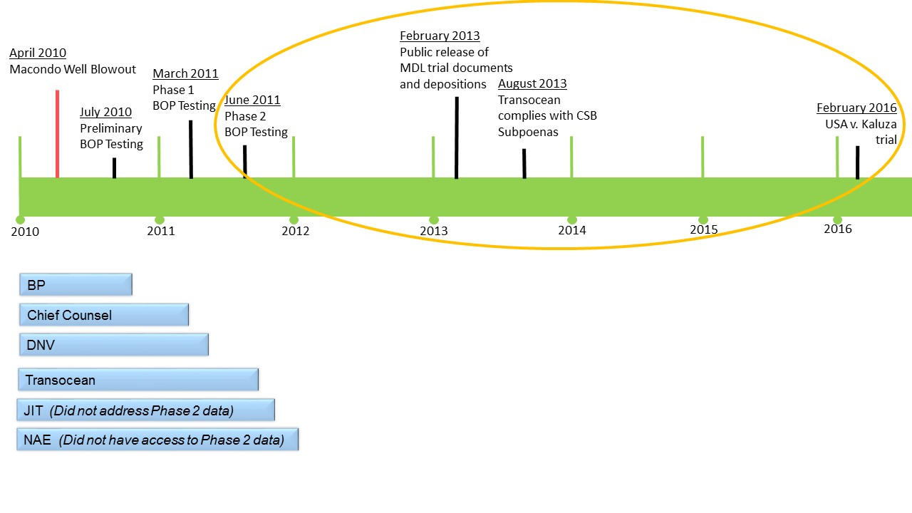
Macondo Investigations Timeline
June 2014
Vol. 1 & 2 CSB Macondo Report
April 2016
Final Vol. 3 & 4
New Learnings

Slide 4
Chemical Safety Board (CSB)
Independent Federal Agency
Non-regulatory
Mission
To protect workers, the public, and the environment
Conducting independent root cause investigations
Reporting findings publicly
Making recommendations to groups that can affect change
Companies
Government Agencies (local, state and federal)
Standard setting bodies, e.g. API, NFPA, etc.

Slide 5
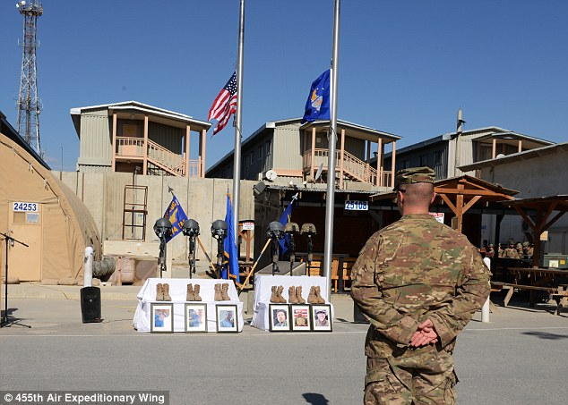
Photo Source: http://www.dailymail.co.uk/news/article-3548263/U-S-cargo-plane-crash-Afghanistan-killed-14-people-cause-case-night-vision-goggles-wedged-control-column-used-steer-aircraft.html#ixzz4Nds3bt8v

Slide 6
Photo Source: http://www.dailymail.co.uk/news/article-3548263/U-S-cargo-plane-crash-Afghanistan-killed-14-people-cause-case-night-vision-goggles-wedged-control-column-used-steer-aircraft.html#ixzz4Nds3bt8v

Slide 7
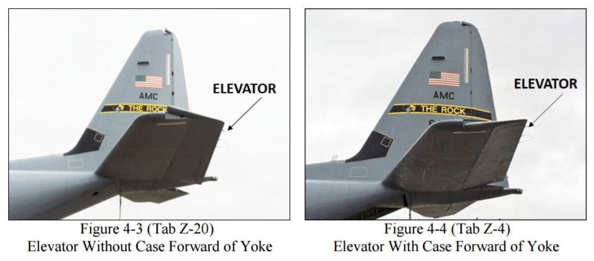
Photo Source: Accident Investigation Report http://i2.cdn.turner.com/cnn/2016/images/04/19/afd-160415-009.pdf

Slide 8
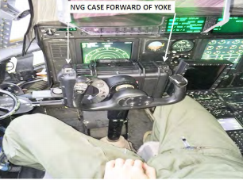
Source: http://i2.cdn.turner.com/cnn/2016/images/04/19/afd-160415-009.pdf

Slide 9
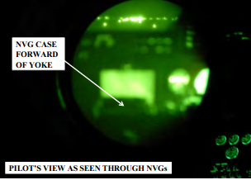
Source: http://i2.cdn.turner.com/cnn/2016/images/04/19/afd-160415-009.pdf

Slide 10
Work-as-Imagined*
Work-as-Done*
Policies, procedures, standards that describe what designers, managers, or regulatory authorities expect will or should happen
How workers accommodate current work conditions in order to achieve the desired work goals
“Pilot was asked to raise the flap to aid loading of tall cargo”
“complex procedure requiring the full attention of the aircrew to maintain safe parameters”
“The onload also included five passengers not included in the original load plan, prompting a decision …”
“For 50 minutes crew preformed ground operation duties”
*Dekker, S., Chronicling the Emergence of Confused Consensus: Work as Imagined versus Work as Actually Done, chapter 7, pp 86-90, within Hollnagel, E., Woods, D.D., and Leveson, N., eds., Resilience Engineering: Concepts and Precepts, Ashgate Publishing: Hampshire, England, 2006.

Slide 11
The Incident that Did Not Happen at Macondo

Slide 12
BOP Emergency Systems
Emergency Disconnect System (EDS):
Manually initiated by the crew
Mode 1—closes the BSR
Mode 2—closes the CSR, then BSR;
AMF/deadman:
Automatically activated;
Not capable of the 2-step CSR/BSR closure
Autoshear:
Automatically activated
Not capable of the 2-step CSR/BSR closure

Slide 13
Work-as-Imagined
Work-as-Done
“the BSR must be capable of shearing the highest grade and heaviest drillpipe…in one operation.”—Transocean (TO) Well Control Manual
“The limitations of [BSR] shearing capacity should be known and understood, and a documented risk assessment shall be in place to address any such limitations”—BP Engineering Technical Practice

Slide 14
“How could I get the chart in this attachment to change color on the 4614 psi for shearing the 6.625 [6 ⁵/₈”] pipe to RED. Would Cameron have to edit this chart? That is what Rod wants. He says if we can’t shear it then it should be RED…”
Oct 6 – 29 Marianas Drills Macondo Well
January 10 email
January 31 Deepwater Horizon arrives to replace the Marianas at Macondo

Slide 15
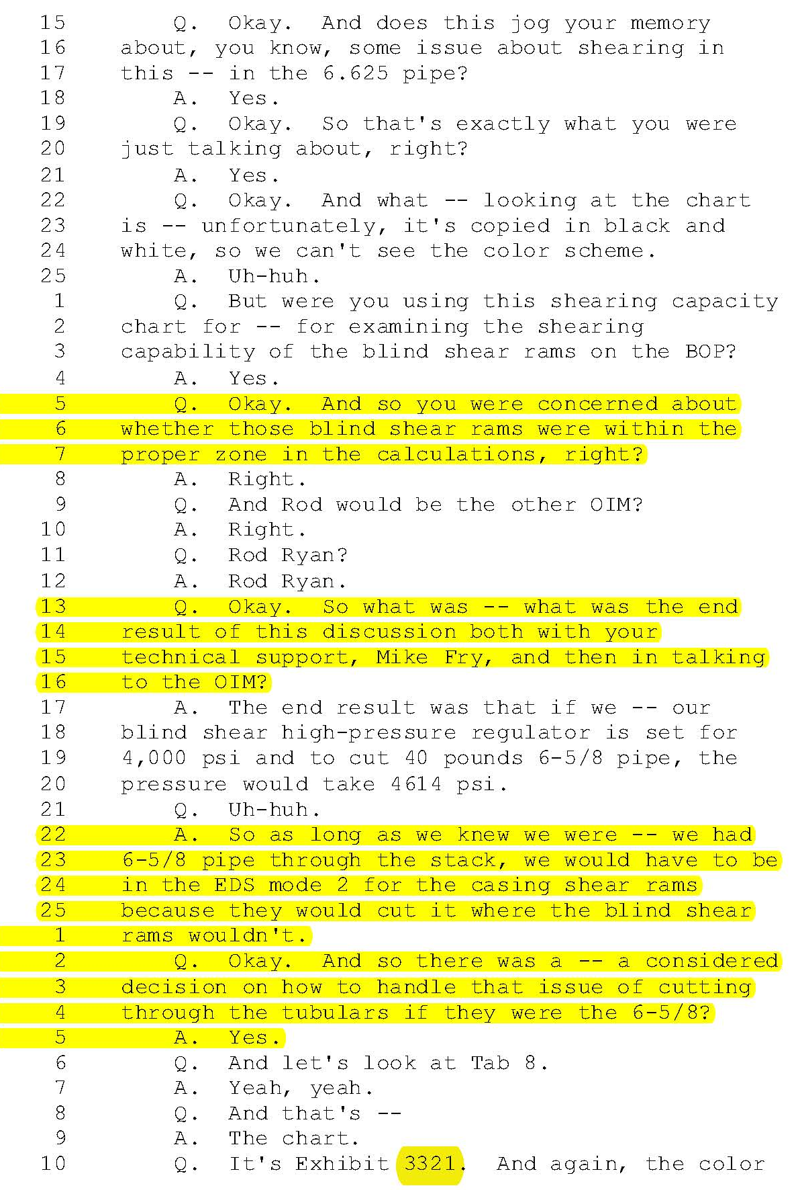
TO Senior Subsea Supervisor Testimony
Q. […] so you were concerned about whether those [BSR] were within the proper zone in the calculations, right?
A. Right.
Q. So what was -- what was the end result of this discussion […]?
A. The end result was that […] as long as we knew we were—we had 6-5/8 pipe through the stack, we would have to be in the EDS mode 2 for the casing shear rams because they would cut it where the blind shear rams wouldn't.
Q. And so there was a -- a considered decision on how to handle that issue of cutting through the tubulars if they were the 6-5/8?
A. Yes.

Slide 16
Work-as-Imagined
Work-as-Done
“the BSR must be capable of shearing the highest grade and heaviest drillpipe…in one operation.”—Transocean (TO) Well Control Manual
“The limitations of [BSR] shearing capacity should be known and understood, and a documented risk assessment shall be in place to address any such limitations”—BP Engineering Technical Practice
Rig personnel created 2-step workaround which accommodated BP’s drilling plan
Unintended Consequence
2 of 3 emergency systems were not capable of this two-step process

Slide 17
BSR Does not Seal the Well

Slide 18
4-Stages of Temporary Abandonment

Slide 19
Temporary Abandonment
Phase One: Preset the Diverter

Slide 20
Temporary Abandonment
Stage Two: Partially remove the drilling mud barrier

Slide 21
Temporary Abandonment
Stage Three: Monitor the pressure or flow (Negative Test)

Slide 22
Temporary Abandonment
X
Stage Three: Monitor the pressure or flow (Negative Test)

Slide 23
Temporary Abandonment
Stage Four: Displace the riser (fully remove the mud barrier)

Slide 24
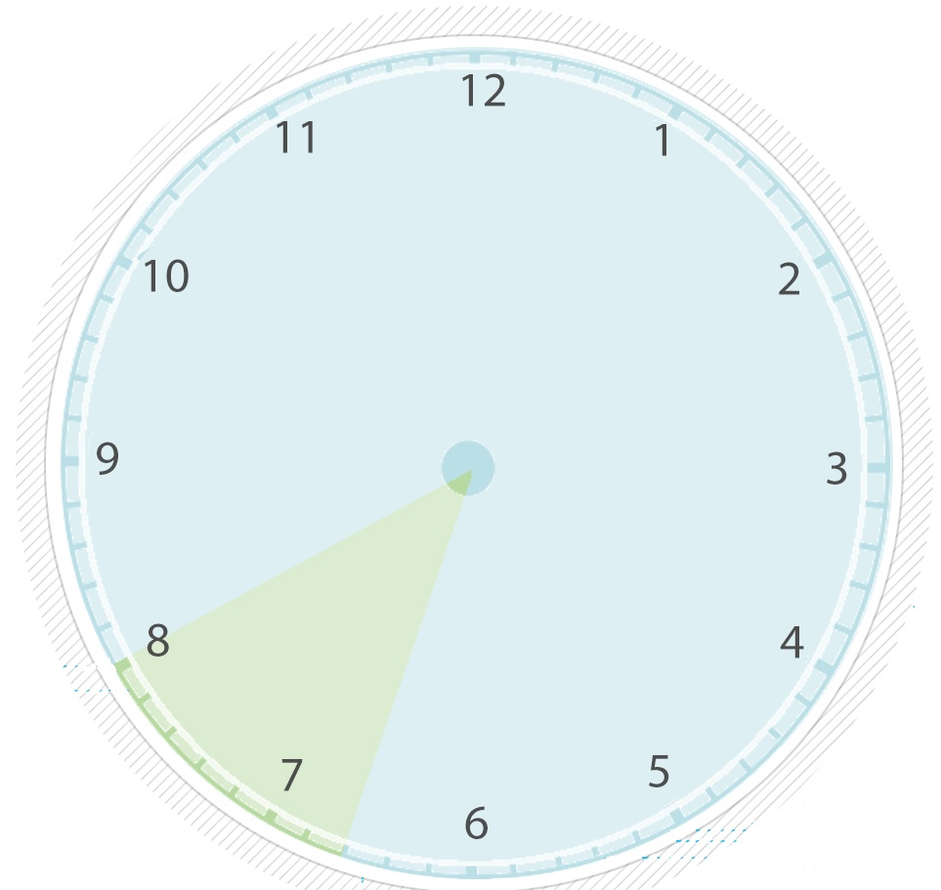
Negative Test
Stage 2: Partially remove the mud barrier
Observe pressure & flow several times
Stage 4: Crew accepts negative (pressure/flow) test results
Stage 3: Negative (pressure/flow) test(s)

Slide 25
Macondo Well Kick
9:49 pm
9:47 pm
9:40 pm
Ocean Floor
9:31 pm
9:43pm
Depth of oil & gas to rig (1,000 ft)
9:37 pm
~8:50 pm

Slide 26
Macondo Well Kick
9:49 pm
9:47 pm
“Free gas in the riser represents one of the most dangerous situations on a rig from a standpoint of personnel safety… It is not out of the realm of possibilities that this slow migration of gas in the riser could go unnoticed as the other activities are taking place, and the gas will begin to unload before anyone notices it.”
BP Well Control Manual
9:40 pm
Ocean Floor
9:31 pm
9:43pm
Depth of oil & gas to rig (1,000 ft)
9:37 pm
~8:50 pm

Slide 27
Work as Imagined
vs
Work as Done at Macondo

Slide 28
Natural Gap: Work as Imagined vs Work as Done
Design Risk
Operational Risk

Slide 29
Natural Gap: Work as Imagined vs Work as Done
“…it is not possible to write a drilling program that foresees all circumstances and covers every detail, or that crewmembers can follow exactly as written”
CSB Macondo report
Design Risk
Operational Risk

Slide 30
Macondo Gap
[the negative test procedure] “broad, operational guidelines” [and the crew would use] “the method consistent with their regular practice on prior wells.” BP
“BP was responsible
developing detailed plans as to where and how the Macondo well was to be drilled…and for obtaining approval of those plans from MMS.” TO

Slide 31
Managing the Gap

Slide 32
Policy vs Actuality (Transocean)
“essential to verify that the [ MGS] is capable of handling […] a severe kick. The relevant information of the well […] should be obtained from the Operator […].”
2009: Gas in riser is “the biggest concern” for improving well control
Diverter drills “improve the crew’s reaction time”

Slide 33
Policy vs Actuality (Transocean)
Assistant Driller
Over 23 years offshore experience
6 years with Transocean
He was taught to always divert to the MGS
Divert overboard only MGS became overwhelmed
Senior Toolpusher
Unaware of any drills to simulate gas in the riser event
Transocean—”essential to verify that the [ MGS] is capable of handling […]a severe kick. The relevant information of the well […] should be obtained from the Operator and […] compared to the [MGS].”
Diverter drills “improve the crew’s reaction time.”

Slide 34
Post Macondo Policy Change
An engineering control replaces manual intervention—Does this bridge the gap?

Slide 35
The Reality
High potential that gas volume might have overwhelmed the system anyway
“it is impossible given the magnitude of the blowout to know if the diverter packer would have kept flow diverted overboard and if the gas ignition could have been prevented.”—Transocean

Slide 36
The Reality
No adequate engineering tools/software exist to model the complex gas migration and 2-phase flow of gas and liquids in a riser
Various industry tests have given inconsistent results
At Macondo, contents of 5,000-ft riser erupted on rig floor only 2-3 minutes after the BOP initially sealed the well

Slide 37
Managing the Diverter Gap
Potential technical gap, not human “failure”
Improved kick detection capabilities and further study on riser unloading events
Environmental/regulatory penalties may cause drift back to original practice of MGS-routing

Slide 38
‘Upcoming’ Critical Operations
No negative test indicated

Slide 39
‘Upcoming’ Critical Operations
“I told [the BP Well Site Leader] it was my policy to do a negative test before displacing with seawater.”
-Deepwater Horizon OIM
No negative test indicated

Slide 40
Risk Management Gap
BP did not send a corrected “Forward Plan”
Transocean had policy to co-develop Standing Instructions to the Driller (SID) with its customer (BP)
described as a key communication tool that should be discussed with drillers at the beginning of a shift
A Transocean advisory issued weeks before noted that a SID should “raise awareness and […] highlight” underbalanced conditions in a well when a single barrier is present
No evidence SIDs were used on the Deepwater Horizon

Slide 41
Procedure Assumes Successful Test
Close [BOP] and conduct negative test. After successful negative test open [BOP]

Slide 42
Procedure Assumes Successful Test
The night shift WSL recalled participating in approximately 50 previous negative tests; to his knowledge, never had one failed.
Close [BOP] and conduct negative test. After successful negative test open [BOP]

Slide 43
Beyond the Piece of Paper…
“The rig crew does not have to be told how to run a negative test. This should be a routine operation that fits within their training.” —MDL Expert (for BP)
“But we do warn that every time we do a job, the conditions are changed. The weather conditions may be different. The experience of the crew may be different. You have to take into account that every time you do it, it may not be exactly the same as the last time.” —Transocean VP QHSE

Slide 44
Managing the Risk Awareness Gap
(1) Generic DWH procedures identified personal safety or relatively minor spills of drilling mud on the rig and overboard.
(2) Transocean required written procedures for safety critical tasks—including negative tests
review and discuss;
confirm control measures;
ensure personnel understand their responsibilities;
understand the hazards; and
ensure the expected results are understood prior to commencing the activity.
At least 6 different procedures used 8/07—4/10, generally falling into 2 categories—the Macondo procedure different

Slide 45
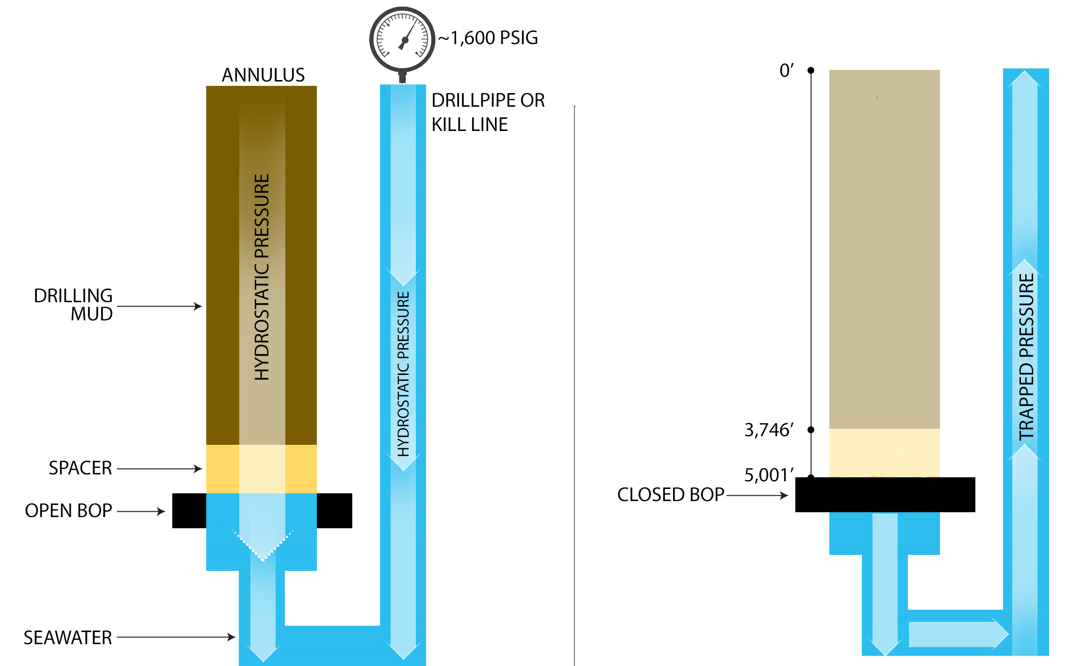
Predictable Results

Slide 46
Equipment Assumptions

Slide 47
Crew Rationalization During Negative Test
Riser level was not full.
The level could have dropped before BOP was closed or after.
*After = leak past annular
*Before = well integrity lost
Crew assumed it was after the BOP was closed. This option made more sense to them.

Slide 48
Post-Incident Well Data Analysis
Real-time Deepwater Horizon data indicates the drillpipe pressure began to drop just after the crew closed an annular preventer, implying a loss of well integrity NOT leaking annular.
Why did that assumption seem more plausible?
Challenges of well up to this point successfully overcome, reinforcing mentality that success was inevitable
Multiple loss-of-well control events
Changes to drilling plans to accommodate challenges
Various personnel deemed the cement job successful
Positive pressure test was successful (e.g., no leaks from inside the well to the outside)
It is “not uncommon” to see an annular leak.

Slide 49
Broad Take Away
By:
Not identifying your safety critical tasks/equipment
Not having indicators to monitor the safety management systems designed to manage safety critical tasks/equipment
Then you are missing the opportunity to identify and manage the work-as-imagined/work-as-done gap.
‘Culture’ is understanding why you have that gap and discovering the underlying reasons for it.

Slide 50
Culture

Slide 51
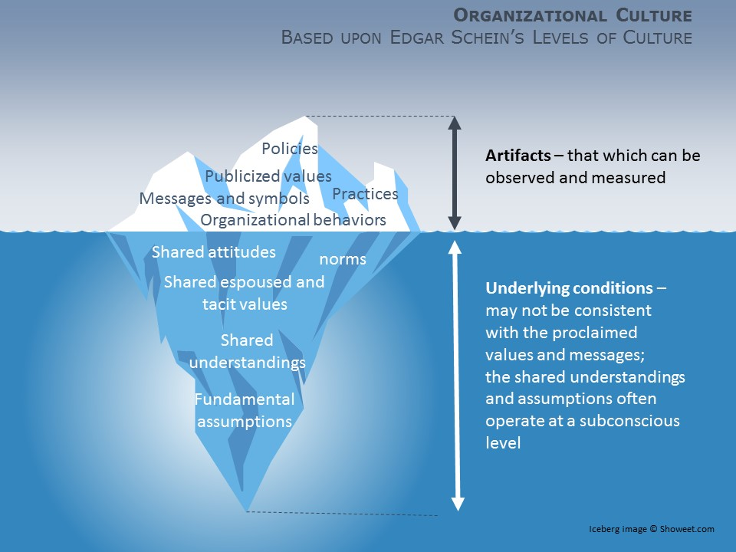
Organizational Culture

Slide 52
Real World Culture Example Same Policy, Different Behaviors & Expectations
Policy: Employees shall observe and report unsafe situations/activities
Transocean crews required to submit daily START card
Crewmembers believed the focus on the quantity not quality of observation.
“people [tried] not to rat people out so to speak, you know like you wanted to be helpful, […] whereas some of the higher-ups in the office, they kind of wanted to weed out problems …”
“I’ve seen guys get fired for someone [writing] a bad START card about them”
(pg 143-144, Vol 3 CSB Macondo Report)

Slide 53
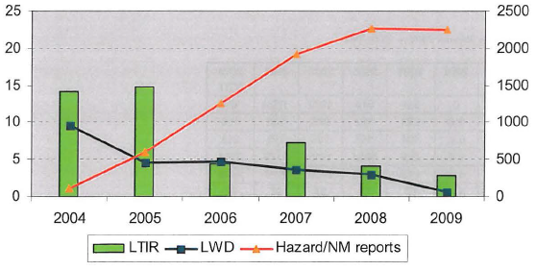
Real World Culture Example Same Policy, Different Behaviors & Expectations
Policy: Employees shall observe and report unsafe situations/activities
While # of reports went up, # of incidents went down
Initial resistance to program but attitudes changed when worn tools and equipment were repaired/replaced
B. R. Read; A. Zartl-Klik; C. Veit; R. Samhaber; H. Zepic; Safety Leadership that Engages the Workforce to Create Sustainable HSE Performance; The SPE International Conference on Health, Safely and Environment in Oil and Gas Exploration and Production held in Rio de Janeiro, Brazil, 12-14 April 2010.

Slide 54
Process Safety Indicator Pyramid
API Recommended Practice, 754, 1st ed., Process Safety Performance Indicators for the Refining and Petrochemical Industries, April 2010, pp 8

Slide 55
2010
Macondo Well Blowout
2008 – 2009
6 riser unloading events
2009
121 well control events (71 kicks)
32 different operators
various geographical locations

Slide 56
Beyond today’s presentation…

Slide 57
Volume 3 further addresses
HUMAN FACTORS
ORGANIZATIONAL FACTORS
SAFETY PERFORMANCE INDICATORS
(1) Metrics of barriers and safety systems and
(2) Active monitoring of real-time barrier indicators meant to drive daily decisions, as well as slow moving management system indicators.
RISK MANAGEMENT PRACTICES
The complexity of the operator-contractor relationship can lead to vaguely defined safety roles for both parties.
CORPORATE GOVERNANCE
SAFETY CULTURE
Poor adherence to own corporate major hazard management policies, which were stronger than regulatory requirements;

Slide 58
Volume 4 further addresses
US OFFSHORE SAFETY REGULATION DURING AND AFTER MACONDO
ATTRIBUTES OF AN EFFECTIVE REGULATOR AND REGULATORY SYSTEM

Slide 59
Questions?

