Slide 1
Successful Engineers…How to Be a Great One?
Kathryn Humphrey
Currently Principle Well Engineer at Add Energy & Summerduck Resources

Slide 2
Talking Points for How to be a Great Engineer
Success can be measured but ‘greatness’ is an objective, not a distinction.
Internal definitions of a ‘good engineer’
External definitions of engineering standards
Shades of leadership and teamwork
My axioms for how to become a successful engineer
and a story…
Wrap up discussion as time allows

Slide 3
How We Internalize the Message
  Never needs help
  Always knows the answer
  Invented using technologies
  Is so poised and confident
  Is a licensed engineer
  Delivers successful projects
He or She…
  Has a Master’s Degree
  Has a PhD
  Is a Vice President
  Had a 3.9 GPA
  Has been promoted very fast
  Is so popular with management
  Always get recognized
  Has written a lot of technical papers
  Never makes mistakes

Slide 4
External Descriptors for Good Engineering
Societies of Engineers
  Society of Petroleum Engineers
  American Society of Mechanical Engineers
  American Society of Civil Engineers
  etc.
ASME’s The Unwritten Laws of Engineering
Ritual of the Calling of an Engineer (Canada)
Societies of Professional or Chartered Engineers
Why is grading us as engineers necessary?

Slide 5
Reasons to Remain Vigilant
Who | Spill (mmbo) | Cost Lives | Cost $M | When | Where | What
Piper Alpha |  | 167 |  | 1988 | North Sea | Platform
Alexander Kielland |  | 123 |  | 1980 | North Sea | Platform
Seacrest Drillship |  | 91 |  | 1989 | S China Sea | Rig
Ocean Ranger |  | 84 |  | 1982 | Canada | Rig
Glomar Java Sea |  | 81 |  | 1983 | S China Sea | Rig
Bohai 2 |  | 72 |  | 1979 | China | Rig
…
Macondo |  | 11 | 4,000+ | 2010 | GoM | Rig
PBU A-22 |  | 1 |  | 2002 | Alaska | Well

Slide 6
Reasons to Remain Humble
Who | Spill (mmbo) | Cost Lives | Cost 2010 $M | When | Where | What
Macondo | 5+ | 11 | 4,000+ | 2010 | GoM | Rig
Kuwait Fires | 5+ |  | 485 | 1990 | Kuwait | Wells
Ixotoc 1 | 3.3 |  | 284 | 1979 | GoM | Rig
Express + Captain | 2.2 |  | 187 | 1979 | Tobago | Tankers
Fergana Valley | 2.1 |  | 178 | 1992 | Uzbekistan | Field
ABT Summer | 1.9 |  | 163 | 1991 | Angola | Tanker
Nowruz | 1.9 |  | 162 | 1983 | Persian Gulf | Tanker+Platform
Amoco Cadiz | 1.6 |  | 136 | 1978 | France | Tanker
Odyssey | 1 |  | 87 | 1988 | Canada | Rig
Let’s look an example of an ethics standard…

Slide 7
Taken from The Ritual of the Calling of an Engineer
Greg Evans 2011 Words by Rudyard Kipling (1865 – 1936)
I will not henceforward suffer or pass, or be privy to the passing of, Bad Workmanship or Faulty Material in aught that concerns my works before mankind as an Engineer, or in my dealings with my own Soul before my Maker.
My time I will not refuse; my Thought I will not grudge; my Care I will not deny towards the honour, use, stability and perfection of any works to which I may be called to set my hand.
My fair wages for that work I will openly take. My Reputation in my Calling I will honourably guard; but, I will in no way go about to compass or wrest judgment or gratification.
I will early and warily strive my uttermost against professional jealousy or the belittling of my working colleagues, in any field of their labour.
Okay wow, now how do I learn to work like this? Whose example do I follow?

Slide 8
The Typical Pattern of Engineering Growth
‘Challenger’ programs for the first three years of employment
  Field work
  Mentorship
  Training classes
Mid-career development
  Excellence Programs are too rare
  Technical networks often become social ‘good old boy’ networks
  Stand out by hard work, fortune and/or networks
  Can be ‘self-made’ by actively competing for key assignments (doing what no one else will do)
What is ‘good enough?’ What is ‘great’?
What we are given is often leadership training…

Slide 9
Leadership Training for Personality Traits
Meyers-Briggs
  Introverted vs Extroverted
  Sensing vs Intuitive
  Thinking vs Feeling
  Judging vs Perceiving
This is all good stuff, but none of the descriptors should ever be force-ranked!! All are good, just different.
So how do we get to be better engineers?!?
Insights
  Fiery Red
  Sunshine Yellow
  Earth Green
  Cool Blue
Here’s what I’ve come up with….

Slide 10
Here are Kathryn Humphrey’s Professional Axioms
There are ’shiny pipe people’ and ‘dirty pipe people’
The right personal style is the one that works for you
Treat all people fairly and treat all people differently
Every problem in the oil patch can be found in these four areas:
  Rock, Fluids, Steel or People
If you do what’s right for the reservoir and the wells, project economics usually work.
Make decisions as late as possible, but as early as necessary.
Great Engineers deliver results while also affecting good outcomes for the future.
Great Engineers need to be equal parts
  Greedy - Always want more or pay less - Ambitious
  Lazy - LOVE efficiency HATE re-work cycles - Efficient
  Ethical - Be ethical, follow regulations and standards - Ethical

Slide 11
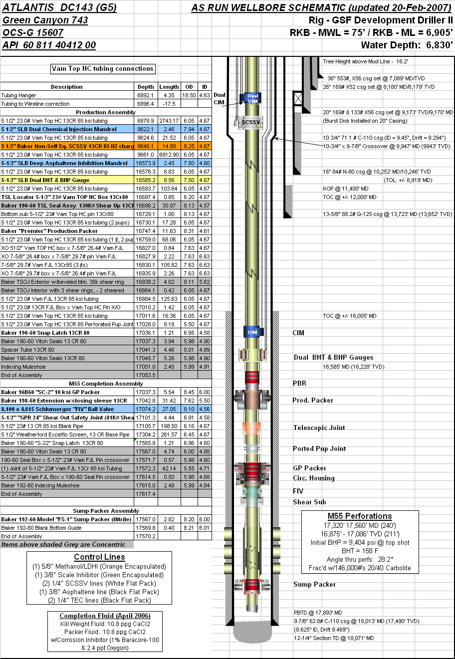
An Example Production Problem
Producing MODU in GoM, moored in 7000’ water depth
One of the biggest producers has an mechanical integrity problem: it loses annulus pressure when the well ramps up.
Diagnostics prove it’s a one-way leak from the annulus to the tubing, below the SCSSSV, probably near the packer. Therefore both primary & secondary barriers are in place.
What to do?
  Keep on production?
  Shut in?
  Workover?
Let’s discuss options using the lens ‘Ambitious-Efficient-Ethical’

Slide 12
An Example Production Problem
Option | Considerations | Ambitious | Efficient | Ethical
Keep on Production? | 18 mbd Leak WILL become two-way eventually [soon] | Good for near term | Good for near term | BOEMRE doesn’t have a rule for this
Shut in? | HAZID & HAZOP the situation. | Not very greedy! | It’s easy, but is it necessary? | No regulations to consider, but additional failures would compromise the integrity envelope, especially on the annulus side.
Workover? | Cost $35.0M Must wait 3 years to get priority on rig schedule as new wells are higher NPV | Not very greedy! | Ultimate repair | Once the leak becomes two-way, the primary barrier is lost and the well must be shut in.
Intervention OTC 23941 | Try pressure activated sealant Deploy non-rig Cost $1.2M Execute in 1 year | Risked opportunity Keep producing at curtailed rate (-4 mbd) Keep leak one-way Trying a cheap option with a low Ps is a good risked gamble | No rig or intervention vessel, used drilling riser busy on nearby well. Had to wait for that well on the schedule, but great to do SIMOPS | Aligned with regulations, procedures and internal processes using stage gate alignment.

Slide 13
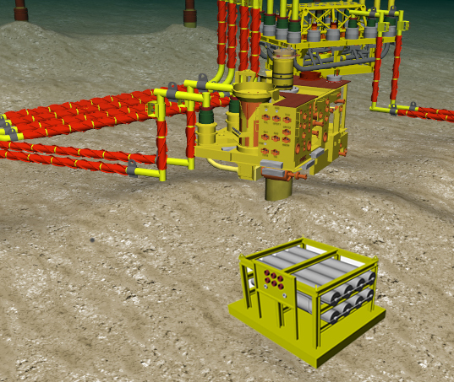
Sealant Subsea Delivery System
SV1 Penetrator (SCSSV1)

Slide 14
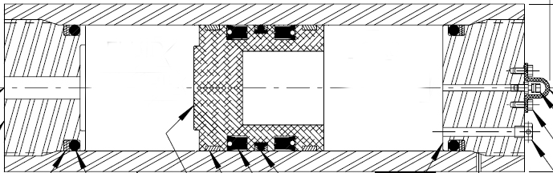
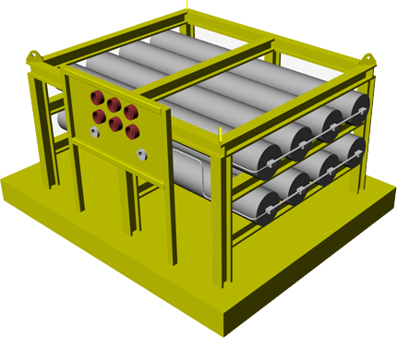
Sealant Subsea Delivery System
The Sealant material is loaded and stored in multiple piston-style accumulators arraigned on a typical subsea mud-mat.
The manifold system is configured to allow for the Sealant to be injected into the annulus by ROV supplied ambient hydrostatic pressure on the backside of cylinders.
Injection rates and pressures are controlled by the ROV.
Capacity of reservoir is expected to be 250-500 gallons.
Sealant
Control Fluid /
Seawater
ROV Ambient
Pressure
Supply
To Annulus

Slide 15
Sealant Subsea Delivery System Flow Path
SV1 Penetrator (SCSSV1)
From Subsea Reservoir

Slide 16
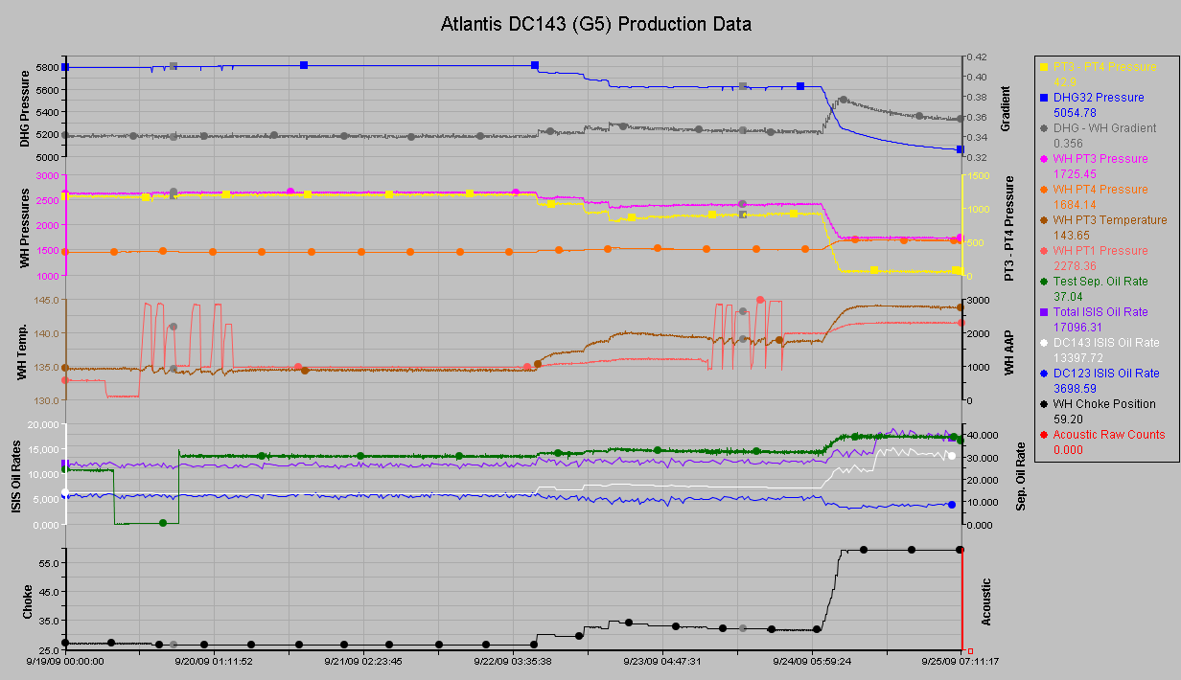
Sealant Intervention History – it worked (and is still holding 7 years later)
Testing the well…
Drawing the well down…
Bank 1
Bank2
Bank 3
Bank 4
Incremental rate up to 10 mbod

Slide 17
The Intervention Worked
Not all engineered gambles work. Both successes and failures should be congratulated.
Ambitious or ’Greedy?’
  I was not going to shut in a well that posed no risk to people or the environment.
  I was not going to let the leak become two-way, therefore adding risk to a future rig workover.
  The intervention cost for the incremental production was $0.14/boe
Efficient or ‘Lazy?’
  Since the intervention had a low Ps, better make the attempt cheap and use resources that are low cost (convenient drilling riser, ambient sea bed pressures…)
  Waiting for the cheap opportunity had low cost and ultimately preserved value
Ethical?
  Timely reporting and discussion with regulatory bodies
  Internal cross-disciplinary reviews and collaboration
  Open and transparent

Slide 18
Final Thoughts
There’s a pattern to the life of a Petroleum Engineer
Education
Learning in the Field and Office
People Management (Self and Others)
Finding and embracing wisdom
Our engineering should always be safe, and we try to make projects economic considering the fluctuations in commodity price.
Finally, thank you. I use my axioms all the time, and perhaps at least once too often in front of an SPE coordinator. I had to write it down sometime, so I appreciate you letting me share it today.
YOU
Education
Learning
Grow
Lead

