Slide 1
Growth Equity Investments in Oil & Gas Technology
Jim Sledzik
SPE Members in Transition seminar – Sept 2016

Slide 2
Agenda: Entrepreneurship in Oil and Gas
1
Your belief system
2
Predicting the future
3
Entrepreneurship in Oil & Gas versus Silicon Valley
4
Where are the opportunities and where are the inevitable surprises

Slide 3
What drives your beliefs?
Norway
Canada
England
Albania
Turkmenistan
U.S.
Morocco
U.A.E.
India
Mexico
Venezuela
Nigeria
Singapore
Peru
Bolivia
Brazil
Mozambique
Australia
Argentina
Lived
Worked for 2+ weeks

Slide 4
What drives your beliefs?
2 + 2 = ..?
2 + 2 = 3 < x < 5
2 + 2 = 4.00
Geologist
Geophysicist
Engineer

Slide 5
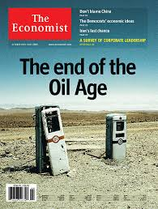
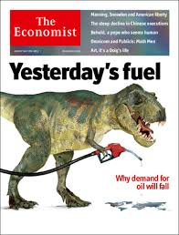
What future do you believe in?
1999
2003
2013

Slide 6
What future do you believe in?
2014
2015
2016

Slide 7
Agenda: Entrepreneurship in Oil and Gas
1
Your belief system
2
Predicting the future
3
Entrepreneurship in Oil & Gas versus Silicon Valley
4
Where are the opportunities and where are the inevitable surprises

Slide 8
Power to the people – the insatiable demand for energy
1970
Today
Image source: NASA

Slide 9
What future do you believe in?
World Primary Energy Demand by Fuel
2004
2013
Energy demand remains driven by oil, coal and natural gas.
Renewable demand increases quickly but only maintains a small percentage of the energy mix.
Oil
Gas
Coal
Mtoe
Biomass
Nuclear
Hydro
Sources: IEA World Energy Outlook 2004 & 2013

Slide 10
The growth of coal in the midst of the shale gale

Slide 11
Predicting the inevitable surprises
Those who fail to learn the lessons of history
are doomed to be surprised by them…
Oil
Mass migration
Stronger European Union
Gas
Coal
Mtoe
US out of oil/gas by 2025, nuclear re-emerging
Biomass
Nuclear
Conflict hot spots: Africa, Saudi Arabia, N. Korea, Iran
Hydro
Look at what was predicted vs. what has happened (2003)
What future do you believe in?
Source: “Inevitable Surprises”, Peter Schwartz, 2003

Slide 12
The future is energy
Energy Ventures investment philosophy: hydrocarbons will continue to supply the world’s energy demand for the foreseeable future
We invest in technology and service companies that create substantial value for the oil & gas sector.
What is sustainable?
What is next?

Slide 13
Agenda: Entrepreneurship in Oil and Gas
1
Your belief system
2
Predicting the future
3
Entrepreneurship in Oil & Gas versus Silicon Valley
4
Where are the opportunities and where are the inevitable surprises

Slide 14
Funding Stages & Technology Adoption Life Cycle
Second value inflexion: Proven commerciality
Value
First value inflexion: Successful field trial
Cash Flow/EBITDA
Time
Harder to predict
Easier to predict
EARLY VC
LATE VC
GROWTH

Slide 15
Entrepreneurism in Oil & Gas versus Silicon Valley ** The Start-up Team
Incubators: HTC - Station Houston - Rice Alliance
MBA
SPE Engineers

Slide 16
Entrepreneurism in Oil & Gas versus Silicon Valley ** Funding Sources & Competition
Investors: Angels/VC’s (HAN, Family offices, corporate VC’s, independent VC’s)
Competitors & Potential Acquirers: OFS companies & lawyers

Slide 17
Entrepreneurism in Oil & Gas versus Silicon Valley ** Lessons Learned
Episode 1: Minimum Viable Product
Be very capital-efficient. Get to cash flow breakeven as quickly as possible. Don’t make “Engineering”, make “$$$”
Episode 2: The Cap Table
Understand the capital structures very well – KISS methodology recommended
Episode 3: Articles of Incorporation
Choose your board members very wisely and prioritize excellent corporate governance
Episode 4: Fiduciary Duties
You are working for all existing shareholders
Episode 5: Signaling Risk
Be excellent and honest in your communications to the board and shareholders
Episode 10: Runaway Devaluation
Sometimes valuation isn’t the most important consideration
Episode 11: Bad Money
Pick your partners wisely – The Brisket Worthiness Test
Episode 17: Binding Arbitration
Your Intellectual Property strategy is very important – and sometimes being right doesn’t matter

Slide 18
Agenda: Entrepreneurship in Oil and Gas
1
Your belief system
2
Predicting the future
3
Entrepreneurship in Oil & Gas versus Silicon Valley
4
Where are the opportunities and where are the inevitable surprises

Slide 19
Not a demand crisis
Demand in 2016 will be 95.9 mbbls/day a 1.2 mbbls/day growth relative to 2015
Significant oilfield services and equipment activity needed to meet this demand
* Source: BP

Slide 20
Decline in existing production is significant
20-30 mbbls/day will have to be brought on production by 2020

Slide 21
Current oil price not sustainable for OPEC
OPEC Production, Break Even oil price and Fiscal deficit

Slide 22
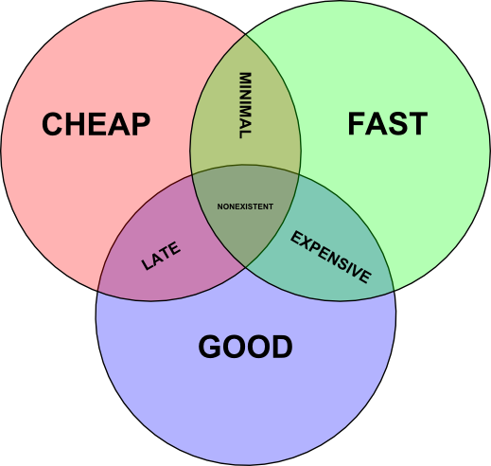
The inevitable winners ……

Slide 23
The inevitable winners ….
The future is bright for natural gas
Source: ExxonMobil’s 2016 The Outlook for Energy: A View to 2040

Slide 24
Key trends in the oilfield

Slide 25
Conclusion
1
Rumors of the oil industry´s death are greatly exaggerated
2
The boom years since 2000 have made the industry complacent - technology that reduce cost, reduce risk and improves productivity are key.
3
Funding sources are shrinking in the current environment
4
Companies that can effectively articulate their economic value proposition will get market adoption and attract investment $$$
5
Market is ripe for a strong alpha uptick.

