Slide 1
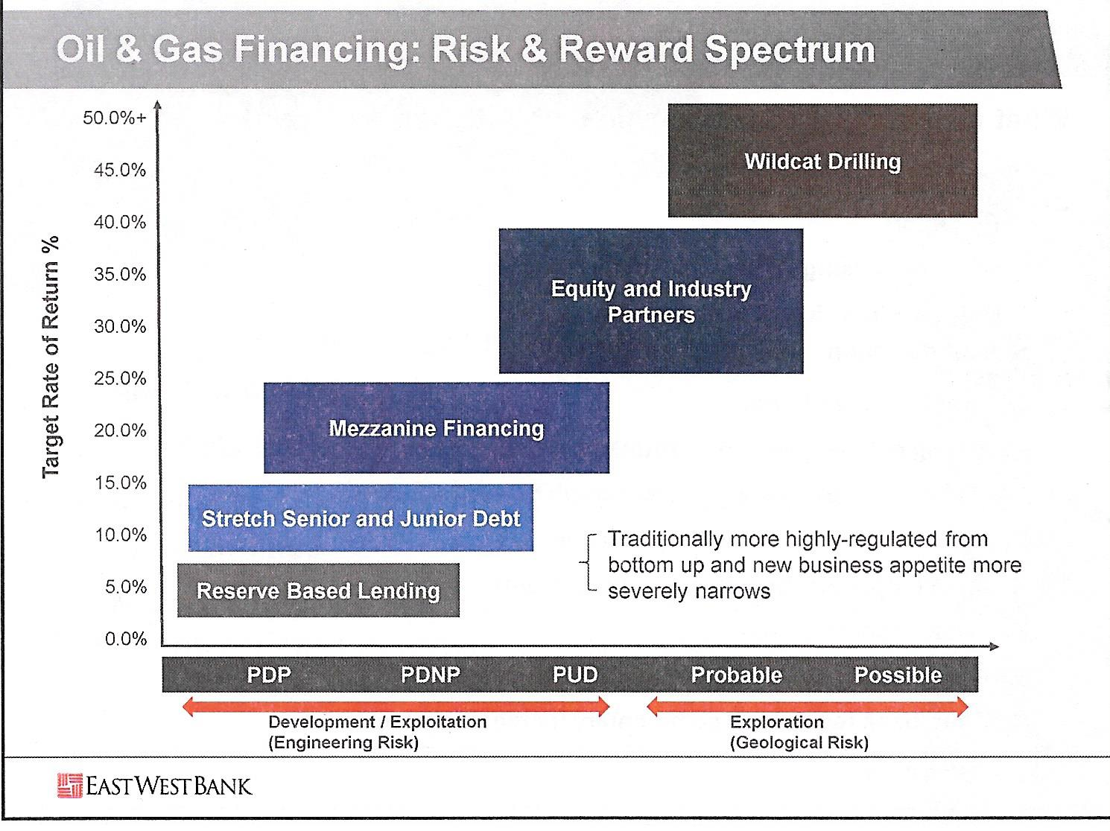
, Christina Kitchens, 2016 East West Bank Energy Forum, OTC, May 4, 2016

Slide 3

Stages of Progress and Funding:
Funding Sources and Stages:
1. Self Funded (Boot-Strap),
2. Family & Friends,
3. Venture Capital,
A. Angels (High Net Worth Individuals),
B. PE – Private Equity**
C. Mezzanine,
4. Loans (Debt Financing),
A. Small Business Administration,
B. Commercial Banks,
C. Convertible (Debt to Equity),
5. Non-Traditional,
A. Cash Awards (Competitions),
B. Vendor Credit,
C. Factoring of Account Receivables,
D. E-Funding.
#2
Funding Your LLC!
Copyright @ 2003-2016 Riverford Exploration, LLC, All Rights Reserved

Slide 4
Business Plan (16 Basic Questions/Steps and 32 subsets to answer in writing or by Action:
You may be a great employee and superior technical contributor but do you really want to run a business and, perhaps more importantly, do you have the skills to run a business?
If so, can you write a well written, thoughtful and complete answer to the following sub-questions on this topic (answers to these should be written not just considered.
Ideas or concepts are Dreams …
Written down with timelines they become Goals …
With Defined Action they are Results …
The considerations are: …
Copyright @ 2003-2016 Riverford Exploration, LLC, All Rights Reserved

Slide 5
Business Plan (16 Basic Questions/Steps and 32 subsets to answer in writing or by Action:
You may be a great employee and superior technical contributor but do you really want to run a business and, perhaps more importantly, do you have the skills to run a business?
  Why do you want to start a business?
Copyright @ 2003-2016 Riverford Exploration, LLC, All Rights Reserved

Slide 6
Business Plan (16 Basic Questions/Steps and 32 subsets to answer in writing or by Action:
You may be a great employee and superior technical contributor but do you really want to run a business and, perhaps more importantly, do you have the skills to run a business?
  Why do you want to start a business?
  What are your technical and managerial strengths and weakness?
Copyright @ 2003-2016 Riverford Exploration, LLC, All Rights Reserved

Slide 7
Business Plan (16 Basic Questions/Steps and 32 subsets to answer in writing or by Action:
You may be a great employee and superior technical contributor but do you really want to run a business and, perhaps more importantly, do you have the skills to run a business?
  Why do you want to start a business?
  What are your technical and managerial strengths and weakness?
  How can you and how do plan on hiring to compliment your strengths and weakness and the volume of work your firm will generate?
Copyright @ 2003-2016 Riverford Exploration, LLC, All Rights Reserved

Slide 8
Business Plan (16 Basic Questions/Steps and 32 subsets to answer in writing or by Action:
You may be a great employee and superior technical contributor but do you really want to run a business and, perhaps more importantly, do you have the skills to run a business?
  Why do you want to start a business?
  What are your technical and managerial strengths and weakness?
  How can you and how do plan on hiring to compliment your strengths and weakness and the volume of work your firm will generate?
  Have you managed previously and had P&L responsibility in GM?
  Do you have an accounting and finance background to supervise, managing and coordinate these disciplines adequately to run a business and to the degree your partners including your investors will require and have confidence in your abilities?
Copyright @ 2003-2016 Riverford Exploration, LLC, All Rights Reserved

Slide 9
Business Plan (16 Basic Questions/Steps and 32 subsets to answer in writing or by Action:
You may be a great employee and superior technical contributor but do you really want to run a business and, perhaps more importantly, do you have the skills to run a business?
  Why do you want to start a business?
  What are your technical and managerial strengths and weakness?
  How can you and how do plan on hiring to compliment your strengths and weakness and the volume of work your firm will generate?
  Have you managed previously and had P&L responsibility in GM?
  Do you have an accounting and finance background to supervise, managing and coordinate these disciplines adequately to run a business and to the degree your partners including your investors will require and have confidence in your abilities?
  Do you really want to be an entrepreneur, desire, commitment, fortitude or is this a tie me over until the market picks up?
  Can you survive for 3 years without taking any income or living expenses out of the business? Real money may not be realized until 4-5th years.
Copyright @ 2003-2016 Riverford Exploration, LLC, All Rights Reserved

Slide 10

Business Plan:
2. Idea, what is your service or product,
Copyright @ 2003-2016 Riverford Exploration, LLC, All Rights Reserved

Slide 11
Business Plan:
2. Idea, what is your service or product,
3. Marketing Research, is your service or product needed?
Copyright @ 2003-2016 Riverford Exploration, LLC, All Rights Reserved

Slide 12
Business Plan:
2. Idea, what is your service or product,
3. Marketing Research, is your service or product needed?
  Do you know who and how many customers you have?
  Do you know who and how many competitors you have?
  What is your competitive advantage to getting customers over your competition?
  How are you going to promote and get customers for your business?
Copyright @ 2003-2016 Riverford Exploration, LLC, All Rights Reserved

Slide 13
Business Plan:
2. Idea, what is your service or product,
3. Marketing Research, is your service or product needed?
  Do you know who and how many customers you have?
  Do you know who and how many competitors you have?
  What is your competitive advantage to getting customers over your competition?
  How are you going to promote and get customers for your business?
4. Write a good business plan:
  Executive Summary: 30 sec, 2 minute, 5 minute elevator speech,
  Company Description, what differentiates your company,
  Organizational Structure,
  Management and Key Employee Bio’s,
Copyright @ 2003-2016 Riverford Exploration, LLC, All Rights Reserved

Slide 14
Bill Fairhurst
Bill recently turned around a mid-size, private equity (PE) financed Exploration & Production (E&P) firm from a $70 million loss to a $600 million dollar gain in two years. Previously he was a key Executive leader at well-known, private E&P firm driving growth, strategically advancing a $200 million firm into a billion dollar organization in six years, adding two new regional offices and multiple new investment opportunities. He has successfully led Acquisition & Divestiture (A&D and M&A) teams in technical and general management positions and as President, CEO and COO. Bill has obtained equity and debt financing for several organizations.
Upon joining Eagle, Eagle and Eagle’s Financial Partners (EnCap and Liberty Energy Holdings (now Old Ironside Energy)) in 2009, these partnerships were $70 million in the hole for unsuccessful Exploration and Development efforts in traditional plays and reservoirs, primarily onshore Gulf Coast and Permian Basin. Bill lead Eagle in the transitioning into several significant resource plays including the Haynesville-Bossier play in North Louisiana and East Texas and the WolfBone play in the Delaware Basin. Eagle and partners have since discovered and are developing 1.5 TCFG in the Haynesville-Bossier and over 400 MMBOE in the WolfBone Trend, Delaware Basin which was sold in December, 2011 to Comstock Resources and others for $400 million, recently resold by Comstock to Rosetta for $780 million and then to Noble Energy for $2.8B (including some Eagle Ford assets). A midstream system developed with the Haynesville-Bossier exploration and development has been sold for $60 million with the producing assets and reserves remaining with Eagle. Over a $750 million turn around in just over two years. Bill also generated, developed and negotiated a joint venture with EXL during these efforts. EXL sold these Delaware Basin assets to Oxy. EXL has recently been backed with a $500 million commitment from Quantum using a similar acquisition model as developed by Fairhurst and his team.
Bill has been involved in the majority of U.S. resource plays prior to the resource revolution directing new investment opportunities, portfolio development, strategic planning, reserve evaluation and cash flow models. Bill is credited with economic discovery of the WolfBone play in the southern Delaware Basin and placing his company in Elm Coulee (Bakken) Field prior to discovery, the largest onshore U.S. discovery in 56 years. He and his teams have discovered dozens of new fields in traditional plays in the Rocky Mountains, Williston and Permian Basins, ArkLaTex-Mississippi Salt Basins, South Texas, South Louisiana and offshore Gulf of Mexico.
Bill has successfully developed exploration, development-production teams and organizations adding several hundred million barrels of reserves and generating more than a billion dollars of wealth for multiple organizations. He has over 20 years of Oil & Gas General and Senior Management experience with Profit & Loss Responsibility for Major and Independent Oil & Gas Companies. Bill has developed, implemented and managed corporate probabilistic risk analysis, economic evaluation and portfolio systems and been an active team member in developing successful business development, exploration, drilling and asset-management programs primarily onshore U.S. focusing most recently on several very successful unconventional resource plays. He remains a technical contributor in exploration, exploitation and development geology; reservoir engineering; drilling and production operations; project and corporate finance and budgeting.
Copyright @ 2003-2016 Riverford Exploration, LLC, All Rights Reserved
4

Slide 15
Business Plan:
2. Idea, what is your service or product,
3. Marketing Research, is your service or product needed?
  Do you know who and how many customers you have?
  Do you know who and how many competitors you have?
  What is your competitive advantage to getting customers over your competition?
  How are you going to promote and get customers for your business?
4. Write a good business plan:
  Executive Summary: 30 sec, 2 minute, 5 minute elevator speech,
  Company Description, what differentiates your company,
  Organizational Structure,
  Management and Key Employee Bio’s,
  Service or Product from customer’s perspective, lifecycle and re-marketing,
  Marketing and Sales,
  Funding, are you contributing 10-30% (see other discussions in this presentation),
  Financial Projections and Financial Modeling,
  Additional: full resumes, leases, permits, additional staff and hiring.
Copyright @ 2003-2016 Riverford Exploration, LLC, All Rights Reserved

Slide 16
Marketing Plan:
5. Marketing Plan:
  Rallying document for your team,
Copyright @ 2003-2016 Riverford Exploration, LLC, All Rights Reserved

Slide 17
Marketing Plan:
5. Marketing Plan:
  Rallying document for your team,
  Focus on first year,
Copyright @ 2003-2016 Riverford Exploration, LLC, All Rights Reserved

Slide 18
Marketing Plan:
5. Marketing Plan:
  Rallying document for your team,
  Focus on first year,
    how the organizations functions by position,
      Job Function and Action more important than titles
      Organizational and Inter-relational Accountabilities,
    specific task for the year,
    Financial goals and metrics,
    Servicing all interest holders, investors, customers, employees,
    Exploratory and specific Market Research,
    Marketing Processes and Methodologies,
    Office space and location,
    Now outline the 1-5 year plan.
Copyright @ 2003-2016 Riverford Exploration, LLC, All Rights Reserved

Slide 19
Logistics:
Check your company name on Texas Comptroller entity search public information section,
7. File on-line at the Secretary of State (LLC is form 205),
8. Irs.gov online application for EIN (make sure you are on the irs.gov site),
Once you have received the certificate of formation from the state and EIN from the Federal government, take that information to the bank to set up your bank account,
Articles of Organization,
LLC structure as partnership and corporation, state filings, IRS filings each year.
Copyright @ 2003-2016 Riverford Exploration, LLC, All Rights Reserved

Slide 20
Logistics:
12. Do you have all your insurance in place?
13. Do you have furniture, computers and software needed?
14. Office supplies and working inventory?
15. Web hosting and email accounts adequate for your Marketing Plan?
16. Design your web page (professionally or in-house)?
Copyright @ 2003-2016 Riverford Exploration, LLC, All Rights Reserved

Slide 22
, Christina Kitchens, 2016 East West Bank Energy Forum, OTC, May 4, 2016

