Slide 1

Career Reinvention through
Franchise Ownership
Notes:
Welcome and Thank You
Encourage questions
Names and expectations from seminar

Slide 2
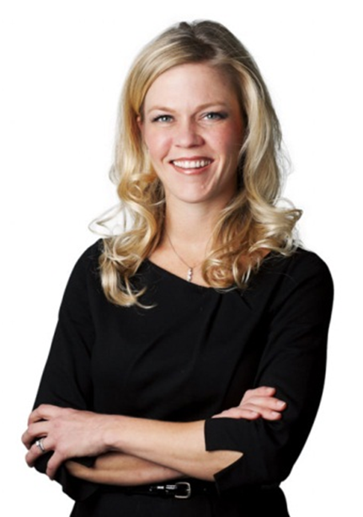
Diana Trondsen
FranNet of South Texas
FranNet Owner for South Texas
Over 20 years experience in the Franchise Industry
Franchise Owner, Hair Care Industry

Slide 3
Who is FranNet?
International Franchise Consulting Firm
Offices throughout North America
Worked with the SBA since 1987: www.sba.gov
Local SCORE and SBDC offices
We match people who want to be business owners with a franchise that meets their needs.
NO COST!

Slide 4
FranNet -
A Unique Approach
We want to make sure we understand your
- Goals
- Criteria
- Needs
Focus on the best possible companies that meet your needs
Providing you will coaching as you follow our proven system for research

Slide 5
FranNet –
A Unique Approach
We are a FREE service to qualified prospective
franchise owners
We are compensated by the franchisor if and when a prospective franchise owner commits to a franchise we recommend
Franchisors work with us because the best potential franchisees.. business people who have a high chance of success, not “tire kickers”
WIN - WIN - WIN

Slide 6
Topics for Discussion
Why business ownership can be attractive
Roadblocks to Success
Three options for going into business
Franchise Myths & Success Strategies
Simplifying the search and getting help

Slide 7

Why Own Your Own
Business?
Imagine for a minute…
You are the owner
of a successful business…
How would your life
be better?

Slide 8
Why Own Your Own
Business?
SUCCESS
Fulfillment
Flexibility
Independence
Control
Financial Security
No More Layoffs
Money
What is it for you?

Slide 9
The Question:
Yet … most people choose to work for someone else!

Slide 10
Some of the Answers
Risk:
A job is safer than a business
I’ll wait until the economy is better
Money:
A business costs a lot of money to start and run
Knowledge:
I don’t know where to start or find what I’m looking for
Skills:
Running a business takes specific talents and skills
Fear of Failure

Slide 11
Dealing with the
Fear of Failure
You will feel fear – normal part of the process
MANAGE & REDUCE FEAR
Doing the research – make fact based decisions
Making judgments based on perceptions and uneducated decisions
“Is this want I think, or what I know is a fact.”

Slide 12

Business Ownership
Options
Build your own business
Buy an Existing Business
Buy a Franchise

Slide 13
Buying a Franchise
Disadvantages
  Overwhelming number of concepts to choose from
  Structured operating system in some franchises
  Territory restrictions
  Can only sell their products
  Upfront Franchise fee
  Ongoing royalty payments
Advantages
Name recognition / licensed trademark
Proven business system to start and operate
Training and support (initially and ongoing)
Marketing expertise / Purchasing power
Lower failure rate
Lower cost / Financing options
Location choices
Ability to conduct unbiased research
Disclosure

Slide 14
What is Franchising?
Franchise Headquarters
Franchise Operators
Customers
The creation of a distribution channel to build brand identity and attain market dominance…
QUICKLY!

Slide 15
Franchise is…
A license to use:
  Name and trademarks
  Products
  Business Systems
In exchange for:
  Initial franchise fee
  Ongoing royalties

Slide 16

Government Disclosure:
FDD
Franchisor Info
  Time in business
  Business experience
  Bankruptcies
  Litigation
Costs
  Total Investment
    Franchise fee
    Other fees
    (Adv, Equip, Supplies,
    Insurance, etc.)
    Working capital
  Royalties
Franchise Contract

Slide 17
Government Disclosure:
FDD
Obligations for Franchisor & Franchisees
Territory
Listing and Contact Info For:
  Current franchisees
  Past franchisees
Earnings Claims
Financial Statements
Manager Policy
Renewal, Termination & Transfer Policies

Slide 18

Franchising Myths

Slide 19
Franchising Myth
“Only fast food and retail”
Notes:
- Food & Retail – location drives the business
- B2B/C - brains drive the business
- No demand in last 6-7 years for food & retail (less opportunity for growth & success))

Slide 20
Franchising Fact
Popular Categories
Education
Staffing
Pet Care
Cleaning
Real Estate
Senior Care
Home Repair
IT Services
Over 3,100 different franchise companies
In more than 80 industries
With over 900,000 operating units

Slide 21
Franchising Myth
“Franchises succeed because of the quality of the product”

Slide 22

Franchising Fact
Can you make a hamburger?
Is your hamburger better than McDonald’s?
If it is not the product then what is it?

Slide 23
Franchising Fact
FACT:
It is all about the Business System:
Marketing
Sales
Operations
Accounting

Slide 24
Franchising Myth
“Successful franchises emerge in a new industry with no new competitors”

Slide 25
Franchising Fact
FACT:
Successful franchises emerge from
well established industries
by creating consolidation.

Slide 26
Franchising Myth
“Franchises are expensive”

Slide 27
Franchising Fact
FACT:
Average Initial Investment Range | Percentage
Under $50,000 | 13%
$50,001 to $100,000 | 17%
$100,001 to $250,000 | 28%
$250,001 to $500,000 | 23%
Over $500,000 | 18%
Source December 2010 FranData
Notes:
Focus on under $100K investments, service and B to B businesses.

Slide 28
Financing Facts:
How Much Do I Need?
Typically, 25-30% of the total investment will be your money.
Financing is relatively easy to get for 70-75% of the total investment including working capital.
Notes:
Give personal examples of clients who got financing.

Slide 29
Financing Facts:
Sources:
Personal savings
401K, IRA capitalization strategy
Lines of credit
SBA: 7a program
Third party lenders/leasing companies
Friends, relatives or partner
Notes:
Demonstrate how to leverage 401K

Slide 30
Franchising Myth
“High return requires
a high investment”

Slide 31

Franchising Fact
FACT:
There is no automatic correlation between the cost of the franchise and the potential return.

Slide 32
Why Pay Royalties?
Good franchisors lose money in the short term on almost every franchisee
  Small royalty payment
  Support costs are high
They make money in the long term
  Bigger royalty payment
  Support costs are low

Slide 33
Why Pay Royalties?
You’re making a trade-off:
You’re exchanging some profits
in the long term for risk reduction in the short term

Slide 34
Why Franchising Works
Proven, systematic approach to starting and staying in business
    Experience
    Simplicity
    Initial Training & Ongoing Support
    Name Recognition
    Sales, Marketing & Operational Systems
    Culture of Teamwork

Slide 35
Why Franchising Works
You’re in business for yourself, but not by yourself… Franchises are a hybrid between corporate executive and an entrepreneur.

Slide 36
Success Strategies

Slide 37
Mistake #1
Choosing the franchise because you love the product or service.

Slide 38
Success Strategy
Choose a franchise because:
You possess the particular skills that franchise requires to succeed.
You can afford it.
Owning it will give you the outcomes that are important to you:
  Desired income
  Quality of life and flexibility
  Career independence
  Security and control
  A family legacy
  The future exit strategy you need

Slide 39
Mistake #2
Choosing a franchise because you already have experience in that industry.

Slide 40


Success Strategy
Separate the function
of the business
from the function
of the owner.

Slide 41
Mistake #3
“The business has to fit my personality. I have to be passionate about it if I am to succeed.”

Slide 42
Success Strategy
  Look at your business as a means to an end. It is a vehicle, delivering you to your end destination.
  Successful franchise owners are passionate about achieving their goals.

Slide 43
Questions?
What are my choices?
How do I get started?
Notes:
Notes
43

Slide 44
Your Choices in Franchise Ownership
Food
Automotive
Retail
Business Services
Home/ Personal Services

Slide 45
High Growth Trends
  Growing markets driven by demographics
  Senior Care, Residential Repairs & Cleaning, etc.
  Essential services
  Hair Care, Automotive, Damage Restoration,
  Supplemental Education, etc.
  Business that help other small businesses thrive
  Business Coaching, Expense Analysis, IT, Personnel, Sales Training, governmental regulated services
Many businesses thrive in all economic conditions

Slide 46
How Do You Find a
Business That is a Great Fit?
Separate the function of the business,
from the function of the business owner!

Slide 47
Short Term
Find a business you can comfortable afford
Upfront investment
Cover personal expenses during ramp up
Stepping stone to long term $ goals

Slide 48
What Are Your Transferable
Business Skills?
Sales
Customer
Service
Management
Marketing

Slide 49
Your Business Model
Employees
Types of Customers
Service or Product
Budget
Business
Environment
Business Preferences
New or Established Industry
Full or Part-time
Hours
Room for Growth
Number of Units
Other Items?

Slide 50
Long Term
The most important element:
\
The business must give you the lifestyle you want and allow YOU to meet your goals
Freedom, Recognition, Achievement, Control, Money, etc.

Slide 51
Exit Strategy
Your goal is to create a valuable asset that has strong resale value:
- Sell the business
- Run business past retirement
- Keep the business but back away from the day-to-day:
- Pass it down to the kids
- Bring in a manager

Slide 52
Franchise Selection
Decision Process
Select franchises to consider
Initial phone interview with Franchisor
Receive and read FDD
Validation calls to 6-10 Franchisees
Discovery Day
Review agreement with franchise attorney
Decision YES or NO

Slide 53

STEP 1:
Complete your online profile, the Personal Franchise Assessment (PFA)

Slide 54
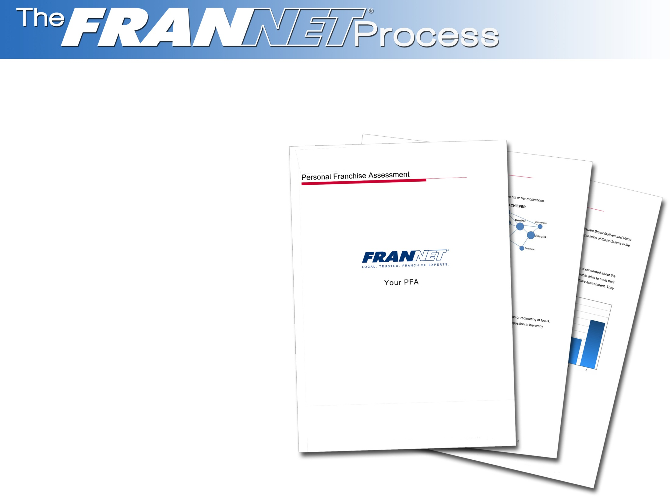
STEP 2:
You will receive a copy of your PFA to review

Slide 55

STEP 3:
Meet with your consultant and get the full understanding of your PFA results

Slide 56
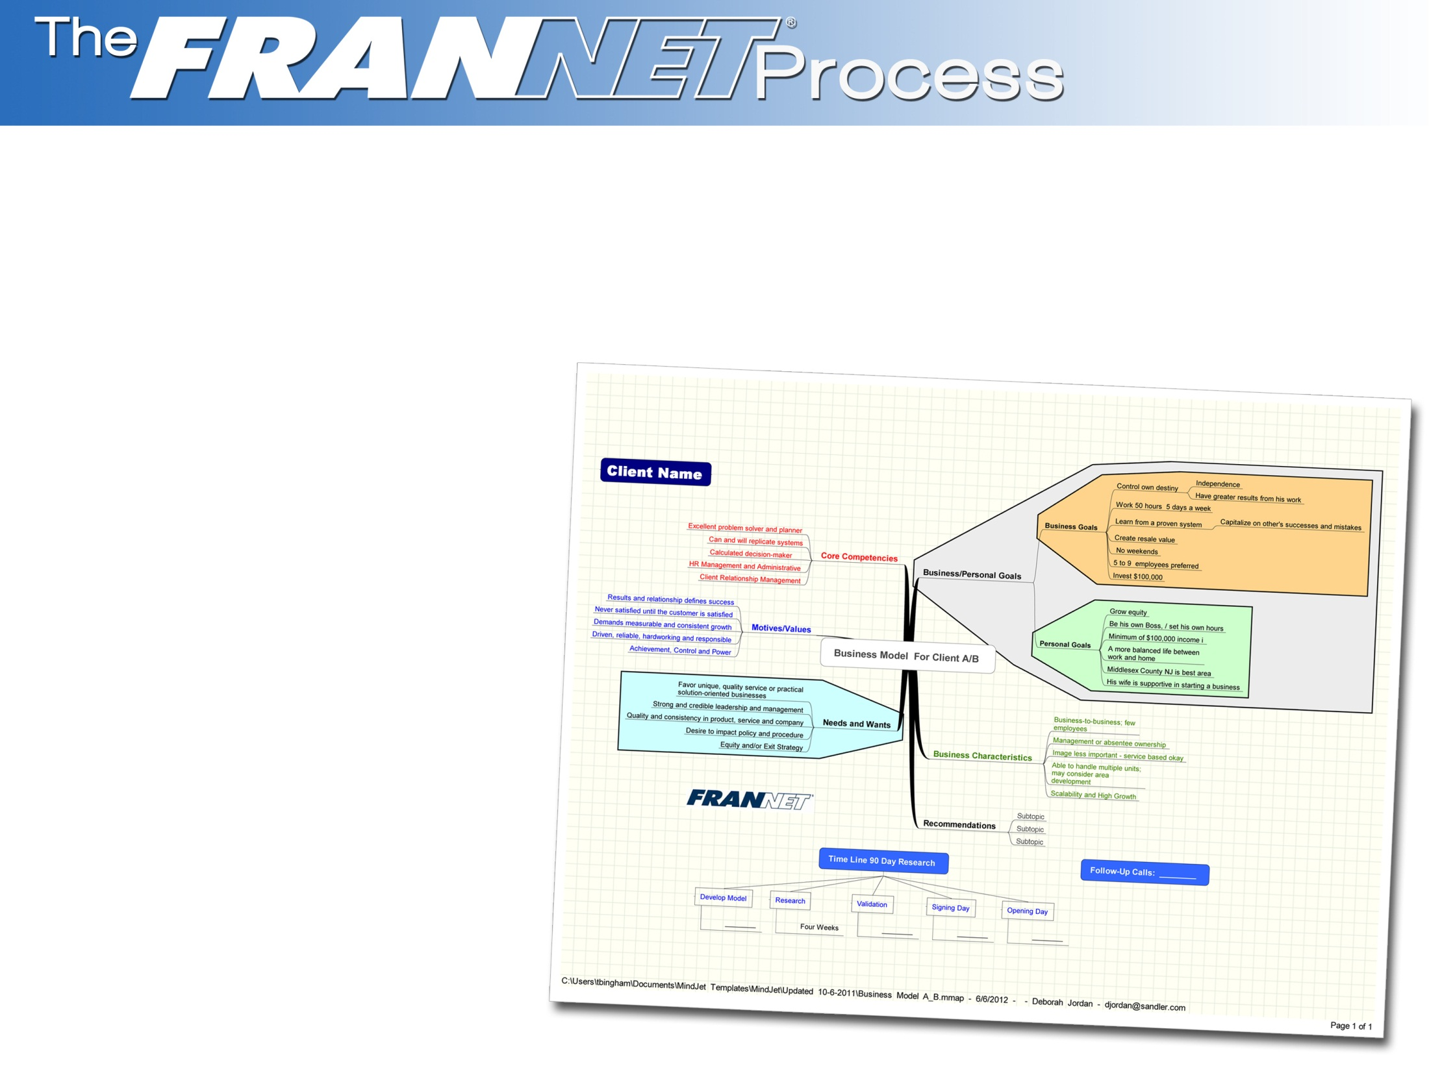
STEP 4:
Together, we will develop your unique Business Model and establish the criteria for your ideal business

Slide 57

STEP 5:
At this point, your consultant will recommend the businesses that fit your model and put you in touch with the franchise companies

Slide 58

STEP 6:
Now the work begins!! You will be
busy learning about
each business –
talking
with company representatives and ultimately current
franchise owners

Slide 59

STEP 7:
Your consultant will be talking with you once a week to review your research.
We do not sell franchises. Our job is to help you gather the facts and decide if the businesses you are considering are the right ones. We can always change direction and companies if your model evolved.

Slide 60
Thank You!
Diana Trondsen
832.215.2903
dtrondsen@frannet.com | www.frannet.com

Slide 61
Determine Your Business Model
5 Years
20 Years
10 Years
Identify your Financial & Lifestyle Goals

Slide 62

Franchising Fact
Less than 25% of franchisees are in the same industry as they were employed.

