Slide 1

Society of Petroleum Engineers
Gulf Coast Section
Executive Breakfast
Chair: Jeanne Perdue
February 10, 2015

Slide 2
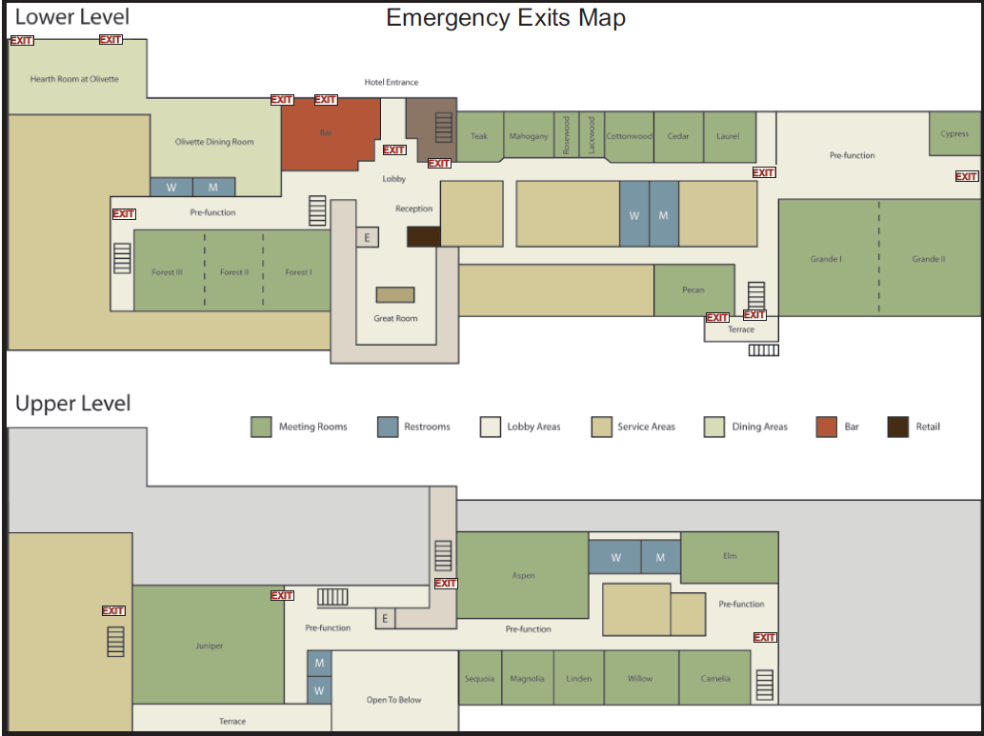
Safety Minute
X
Notes:
One-third of our unpaid members are YPs

Slide 3
Safety Minute
Notes:
One-third of our unpaid members are YPs

Slide 4
Agenda
7:30 – 7:55 AM | Jeanne Perdue, SPE-GCS Chair | Safety Moment and State of the Section
7:55-8:30 AM | Ganesh Thakur, Helge Hove Haldorsen, Nathan Meehan | Panel of Past, Present, and Future SPE Presidents and Q&A
8:30-8:45 AM | Break | Break
8:45-9:20 AM | Rustom Mody, VP Technology, Baker Hughes | One Degree of Separation: SPE’s Pivotal Role in Keeping the Wheels of Innovation Turning During $50 Oil
9:20 – 9:40 AM | SPE Leadership Team | Committee Table Tour with Executives
9:40 – 9:50 AM | SPE Leadership Team | Feedback and Executive Survey
9:50 – 10:00 AM | Jeanne Perdue, SPE-GCS Chair | Closing Remarks & Acknowledgments
10:00-10:30 AM | Coffee Break | Photos, Networking & Coffee

Slide 5
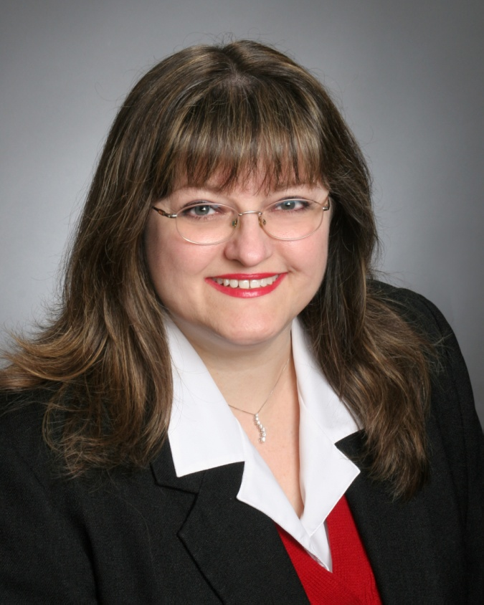
State of the Gulf Coast Section
Technical Writer, Occidental MEST
Technology Editor, Hart's E&P
Chemist, Texaco Research Labs
Alief ISD Board of Trustees
Joined SPE 1981
Technical Editor, SPE Resv. Engrg.
Review Chairman, Elec. Publ. Cmte.
Magic Suitcase Chair
Scholarship Chair
Community Services Chair
Membership Chair
Secretary, Vice Chair
Distinguished Lecturer 2005
Jeanne Perdue, Chair
Notes:
Last year we were 16.6 % of total membership

Slide 6
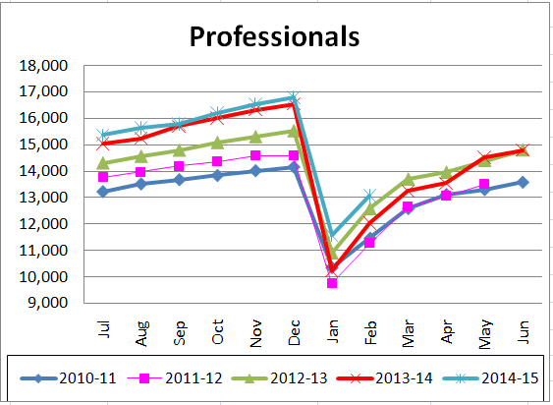
Membership
17,042 Professionals, 16% of global SPE
New Section record!
2,089 Students in 4 Chapters (UH, Rice, A&M, HCC)
Member Directory = 144,000 contacts!
JPT and Connect
Notes:
Last year we were 16.6 % of total membership

Slide 7
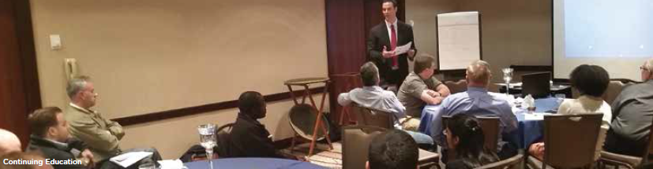
Programs
4 Distinguished Lectures – 235 attendees
6 Full-Day Conferences – 794 attendees
10 Technical Presentations – 509 attendees
15 Study Groups: Discipline, Location, Function
114 Study Group Meetings – 5,956 attendees
Students and Unemployed can attend Study Groups for $10
Continuing Ed.: Soft Skills, Ethics, Oil Patch Orientation
Career Management: Resumes, Interviewing, Entrepreneur
Notes:
Last year we were 16.6 % of total membership

Slide 8
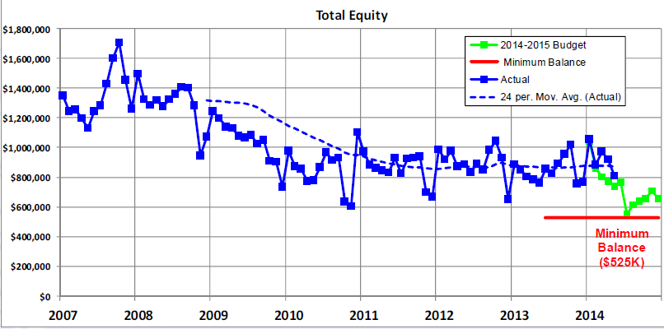
Financial Health
Budget: $1.5 million income, $1.75 million expenses
UBS Cash: $265,000 + Vanguard: $501,000
 | Actual |  | Budget |  | Difference
 | December | FYTD | December | FYTD | December | FYTD
Revenue | 45,804 | 919,084 | 919,084 | 725,394 | 16,669 | 193,690
Expenses | 157,075 | 877,964 | 65,416 | 753,180 | 91,659 | 124,783
Net Income | -111,271 | 41,120 | -36,281 | -27,786 | -74,990 | 68,907
Notes:
Last year we were 16.6 % of total membership

Slide 9
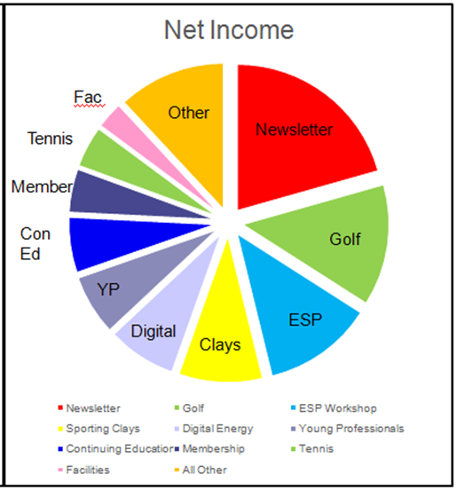
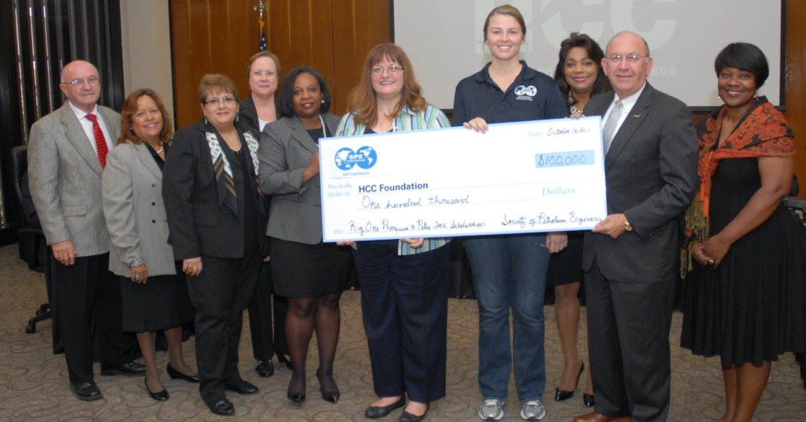
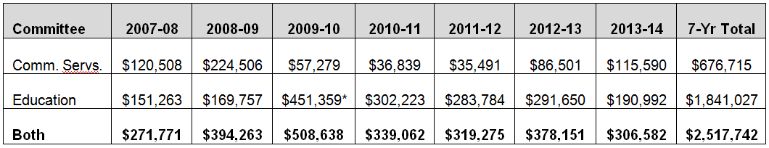
Net Income Stars, Beneficiaries
Where does it come from?
Newsletter/Website Ads: $500K + $16K
Sponsorships: 307K + In Kind
Where does it go?
Notes:
Last year we were 16.6 % of total membership

Slide 10
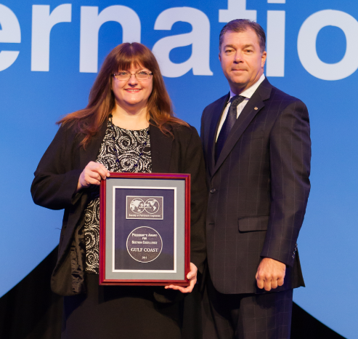
Cool Things We Did Last Year
Sponsored meeting for Pakistan Energy Trade Mission
Hosted Movie Night (FrackNation), panel discussion
Invited 60 high school students to Permian Basin SG
Started a Business Development Blog
Member survey, YP salary survey
YP App rolled out
Sponsored Student Paper Contest at UH
Sponsored Student Summit at TAMU
Sent newsletter to 4 Student Chapters
Launched Exemplary Volunteer Awards
Received President's Award =======➔
for Section Excellence
Notes:
Last year we were 16.6 % of total membership

Slide 11
Section Goals for 2014-15
Education:
Increase Study Group attendance and webinars and continuing education classes.
Mentor Mexico Section and share programs via webinars.
Increase scholarships (both number and amount) and internships.
Provide better Student Chapter support and encourage them to attend Study Groups.
Resurrect the CHASE program at U of H for master math teachers.
Notes:
Last year we were 16.6 % of total membership

Slide 12
Section Goals for 2014-15
Networking:
Launch two new FUNdraisers for scholarships: the OilSim Challenge and the Poker Tournament.
Resurrect the quarterly Membership Networking Events and the Executive Breakfast.
Launch a new Legion of Honor Dinner so YPs can capture and document some of their stories.
Improve the Connect newsletter, the e-Newsletter, social media, and the SPEGCS.org website to communicate better with our members.
Notes:
Last year we were 16.6 % of total membership

Slide 13
Section Goals for 2014-15
Volunteering:
Create new volunteer positions of Publisher and Publicity Chair to offer special packages to companies wishing to support our Section's events and activities.
Update the Section Operations Manual (dated 2003) and consolidate our policies into a nice spreadsheet.
Conduct the biannual financial review and investigate better investment options.
Boost our volunteer recognition programs through awards, publicity, and gifts.
Notes:
Last year we were 16.6 % of total membership

Slide 14

The ENVY of All SPE Sections
E = Education
N = Networking
V = Volunteering
Y = YOU!
What You Can Do for SPE-GCS:
Join SPE – it's only $90
Encourage your employees to join
Encourage your employees to volunteer on committees, study groups
Let your people present case studies at study group meetings & conferences
Allow your people to attend meetings
Sponsor scholarship fundraisers
Provide internships to students
Host SPE events at your facility
Notes:
Last year we were 16.6 % of total membership

Slide 15
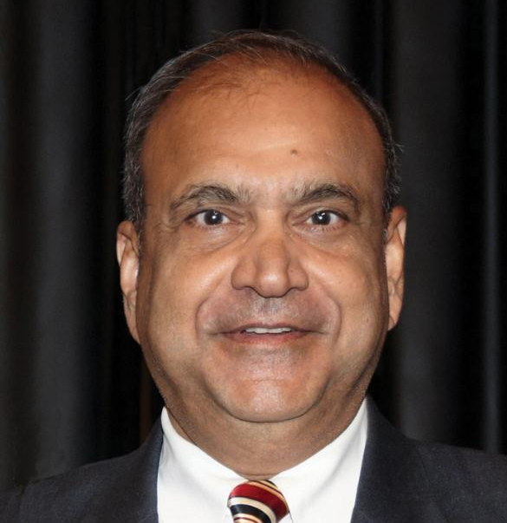
SPE 2012 President Ganesh Thakur
Retired, Consultant
Global Advisor and Fellow, Chevron
Energy Technology Company
Joined SPE 1971
MA in Math, MS and PhD, Penn State
Reservoir Management and EOR
Waterflooding and Simulation
SPE Distinguished Lecturer
Short Course Instructor
Adjunct Professor
Wrote 50 Technical Articles, 3 Books
Edited 2 SPE Reprint Series
Technical Director - Reservoir
SPE Distinguished Member
Reservoir Description & Dynamics Award
Notes:
Last year we were 16.6 % of total membership

Slide 16
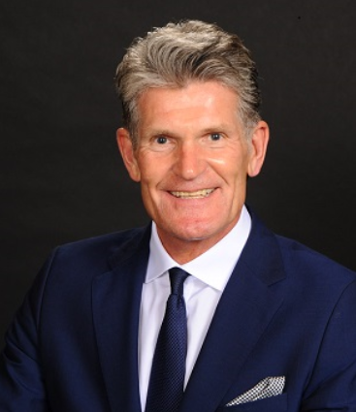
2015 President Helge Haldorsen
Vice President, Strategy and Portfolio - North America, Statoil
VP Expl. & Research, Norsk Hydro
2nd Lieutenant, Royal Norwegian Navy
Industrial Math Professor, Univ. of Oslo
Joined SPE 1978
MS Petroleum Engineering, Norwegian Institute of Technology
PhD Resv. Engineering, Univ. of Texas
SPE Distinguished Author, JPT
SPE Board of Directors
SPE Distinguished Lecturer
Notes:
Last year we were 16.6 % of total membership

Slide 17
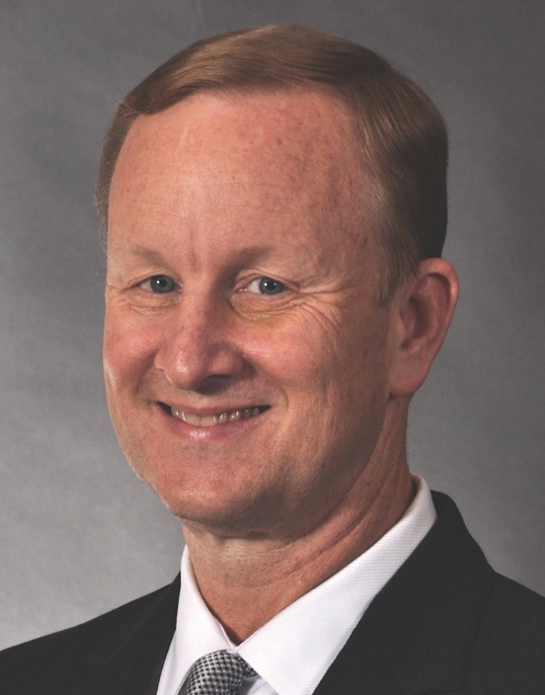
2016 SPE President Nathan Meehan
Senior Executive Advisor, Baker Hughes
President of CMG Petroleum Consulting
VP Engineering, Occidental Oil & Gas
GM E&P, Union Pacific Resources
Joined SPE 1975
PhD Petroleum Engineering, Stanford
Advisory Boards, UT and UH
Industry Relations Board, Penn State
Interstate Oil & Gas Compact Comm.
Advisory Board, World Oil
SPE Board of Directors
Lester C. Uren Award
DeGolyer Distinguished Service Medal
SPE Distinguished Lecturer
Notes:
Last year we were 16.6 % of total membership

Slide 18
Corp. Support Award: Baker Hughes
Top Sponsors 2013-14 |  | Top Membership Companies |  |  |  |  | Top Section Volunteers
Company | $ | Company | Oct-2014 | Sep-2012 | Diff | % Diff | Company | #
Baker Hughes | $28,450 | Baker Hughes | 947 | 1012 | 65 | -6.4 | Baker Hughes | 22
ExxonMobil | $18,000 | Schlumberger | 909 | 1145 | -236 | -20.6 | Schlumberger | 16
Halliburton | $15,800 | Chevron | 773 | 772 | 1 | 0.1 | Anadarko | 13
PetroSkills | $15,685 | Halliburton/ Landmark | 620 | 700 | -80 | -11.4 | BP | 13
Schlumberger | $15,200 | ExxonMobil | 598 | 849 | -251 | -29.6 | Chevron | 13
Statoil | $13,000 | BP | 580 | 630 | -50 | -7.9 | Halliburton | 12
Anadarko | $8,500 | Shell | 523 | 516 | 7 | 1.4 | Shell | 12
FMC | $8,100 | ConocoPhillips | 447 | 306 | 141 | 46.1 | Conoco | 10
Notes:
Last year we were 16.6 % of total membership

Slide 19
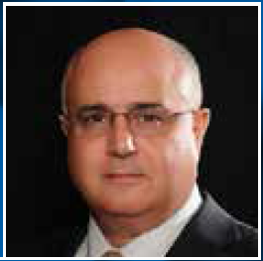
Keynote: Rustom Mody, Baker Hughes
VP and Chief Engineer – Enterprise Technology, Baker Hughes
B.S. and M.S. in Mechanical Engineering and M.B.A. in Finance
Joined SPE in 1978
15 Patents
Meritorious Awards for Engineering Innovation
Boards of Advisors:
Univ. of Oklahoma Engineering Dept.
and Mewbourne School of Petroleum
and Geologic Engineering Industry
Pumps & Pipes
Notes:
Last year we were 16.6 % of total membership

Slide 20
Table Talks, or "SPE-ed Dating"
Jenny Cronlund, BP Exploration, Director at Large
Simeon Eburi, Chevron, Past Chair of YP Board
Ivor Ellul, RPS Energy, Vice Chair
Pavitra Sainani, ExxonMobil, YP Board Chair
Eric Kocian, ExxonMobil, Director at Large
Nii Ahele Nunoo, Natl. Oilwell Varco, Career Management Chair
Trey Shaffer, ERM, Director at Large, HSSE-SR Study Group Chair
Jim Sheridan, Baker Hughes, Social Chair
Mike Strathman, The Trinity Group, Past Chair
Susan Howes, Chevron, Past Chair
Kim Thames Padeletti, BHP Billiton, Exec. Breakfast Chair
Lindsey Ferrell, Frontline Group, OilSim Competition Chair
Konstantinos Kostarelos, Univ. of Houston, Table Talk Lead

Slide 21
Acknowledgments
Speakers
2012 SPE President – Ganesh Thakur
SPE Staff
Section Manager – Kathy MacLennan
2015 SPE President – Helge Hove Haldorsen
2016 SPE President – Nathan Meehan
Keynoter – Rustom Mody
Section Admin. Asst. – Sharon Harris
SPEI Membership – Liz Messner

Slide 22

Executive Breakfast Committee
Kimberly Thames Padeletti, BHP Billiton, Chair
David Vaucher, Alvarez & Marsal, Event Coordinator
Paul Royall, RMDC Group, Registration Lead
Lynne Ritchie, Xodus Group, Graphics Director & Data Coordinator
Lindsey Ferrell, Frontline Group, Table Talk Lead
Konstantinos Kostarelos, Univ. of Houston, Table Talk Lead
April Sharr, Baker Hughes, Event and Speaker Support
Gustavo Arismendi, SPE Volunteer, Registration Support

Slide 23




sponsors
Gold Sponsor
Bronze Sponsors
Media Sponsor

