Slide 1
Refracturing: Why, When and When Not to
George E. King, P.E.
Apache Corporation
13 November 2014
SPE Luncheon
Houston, TX

Slide 2
Parts of the Presentation
Response of Refracturing
Good and Better Targets
Warning Flags
What Appears to Work at this Point
Timing
Proppant
Diverting
Missed “pay” in those tight source rocks.

Slide 3
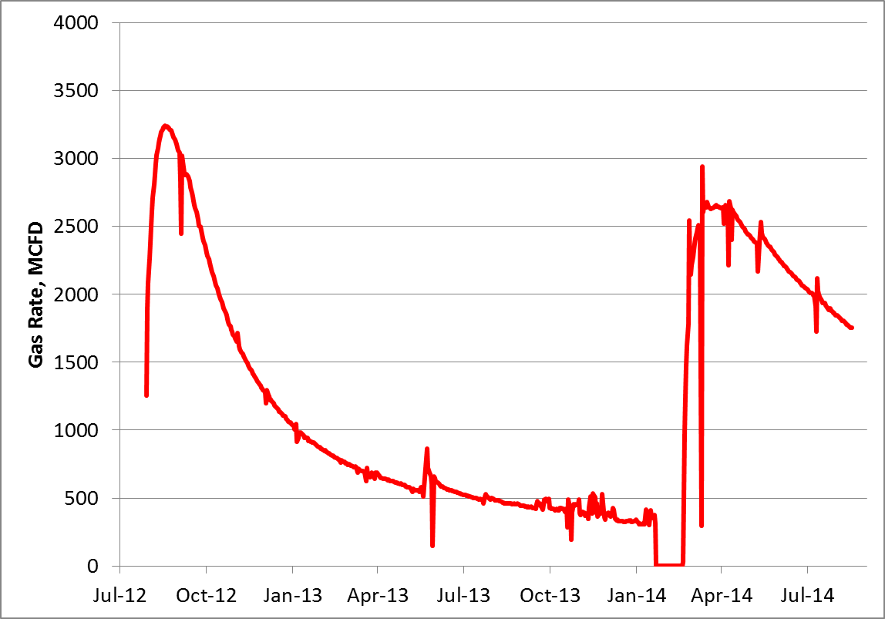
Eagle Ford Re-Fracturing – Example from BP
Dry gas well, underperforming well compared to offsets / neighbors
Original stim used low vol X-linked fracs (4,600 bbl/stg). Refrac’ed with high volume slickwater fracs (9,500 bbl/stg).
Lateral length (perf to perf) = 4,850’
Stage spacing: 305’, Cluster spacing: 61’
5 Clusters/ stage, 4 shots per cluster, 90 degree phasing
post refrac - choke = 16/64
Refrac Operations
Refrac
No perforations added for refrac
15 stages separated by slugs of biodegradable polymer diversion agent
Slide Courtesy of Sam French at BP, presented at UrTec, 2014

Slide 4
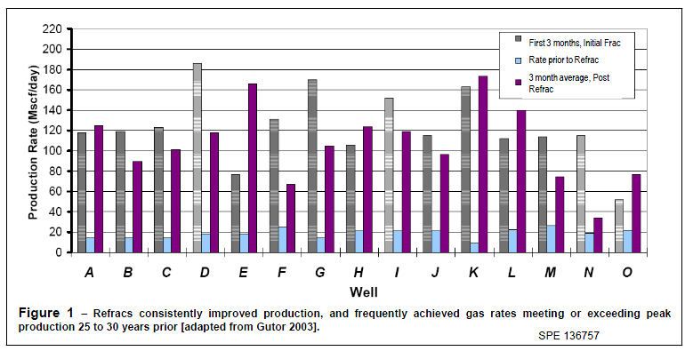
Southern Alberta Shallow Gas Well Refracs Refracs Not just for shales
Refracturing restored many wells to initial production – Is production really declining or is the flow capacity of the frac?

Slide 5
Notes:
Vertical well refracs in shale during the start of commercial Barnett shale gas development, during the Barnett’s 17 year learning curve, provided significant rate and reserve recovery increases. Most of these increases were attributed to the switch from foam or gelled fracturing fluid to a slick water fluid that was not only cheaper but had the capacity to invade the natural fracture systems and provide large increases in formation contact areas through complex or network fracturing.

Slide 6
Factors in Successful Refracs
Enlarged frac geometry, reservoir contact, add contact points
Improved pay coverage – increased frac height in vertical wells
Increased frac conductivity or restoring frac conductivity
Propping or re-propping previously unpropped fractures
Fit-for-purpose fracture fluids
Re-energizing / re-inflating natural fissures
Frac Reorientation - field stress altered – new rock contacted
Over-flushed frac jobs – repair by straddle frac & quality prop.
Suggestion: A non-shale specific criteria was advanced by Reeves, et.al., 1999 to separate poor completions from poor geology before progressing towards a restimulation.

Slide 7
Factors in Failed Refracs
Low pressured, depleted wells, limited reserves.
Wells in which diagnostics indicate effective fractures & drainage to boundaries.
Questionable mechanical integrity
Access to better parts of formation prevented.
Off-set wells recovered >> their “share” of reserves.

Slide 8
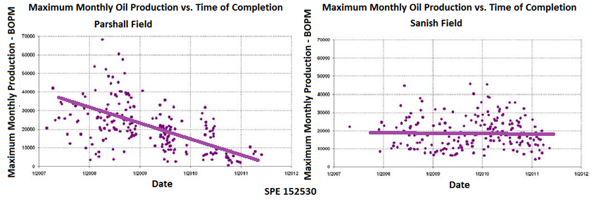
Comparison of Max Month Production of Wells across Four years
One field shows a steady decline in max month production with time – result of regional fractures?

Slide 9
What Makes a Good Refrac Candidate? and What Doesn’t?
Good Candidate?
Not so Good Candidate?
Poor initial frac
Bypassed shows
Frac spacing >300 ft
Less than 1000 lb/ft of prop over lateral
Where σ_{H} ~ σ_{h} & natural fracs present
Some frac hit wells
No natural fractures
No gas/oil shows during drilling
High stress σ_{v} < σ_{H} & σ_{H} >> σ_{h}
Poorly performing in-fill wells in UCR
Poor Integrity
Guidelines? – Yes, Absolutes? – No.

Slide 10
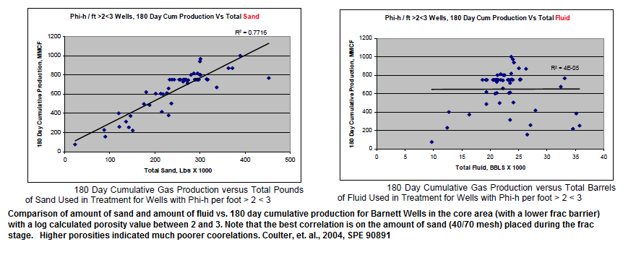
Go back to fracturing basics
Total proppant amounts can be very large & linked to well productivity – fluid volumes less important.
10
Notes:
10

Slide 11
refrac Approaches – what has been done? At Least 8 Basic Approaches
Cement squeeze & reperf
Liner patch to seal old perfs and refrac
Refrac old perfs (no new perfs) – w/ & w/o diverting
Restore proppant in near-wellbore w/ mini refrac
Add new perfs and refrac well with no diverters
Add new perfs and refrac well with diverters
Set plugs and refrac in stages down work string
Refrac specific intervals with coiled tubing

Slide 12
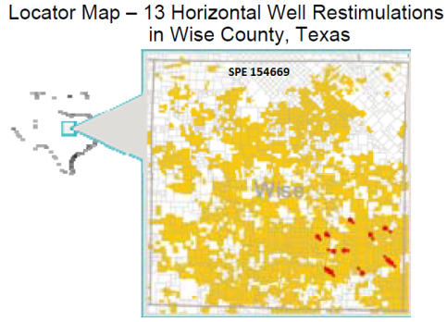
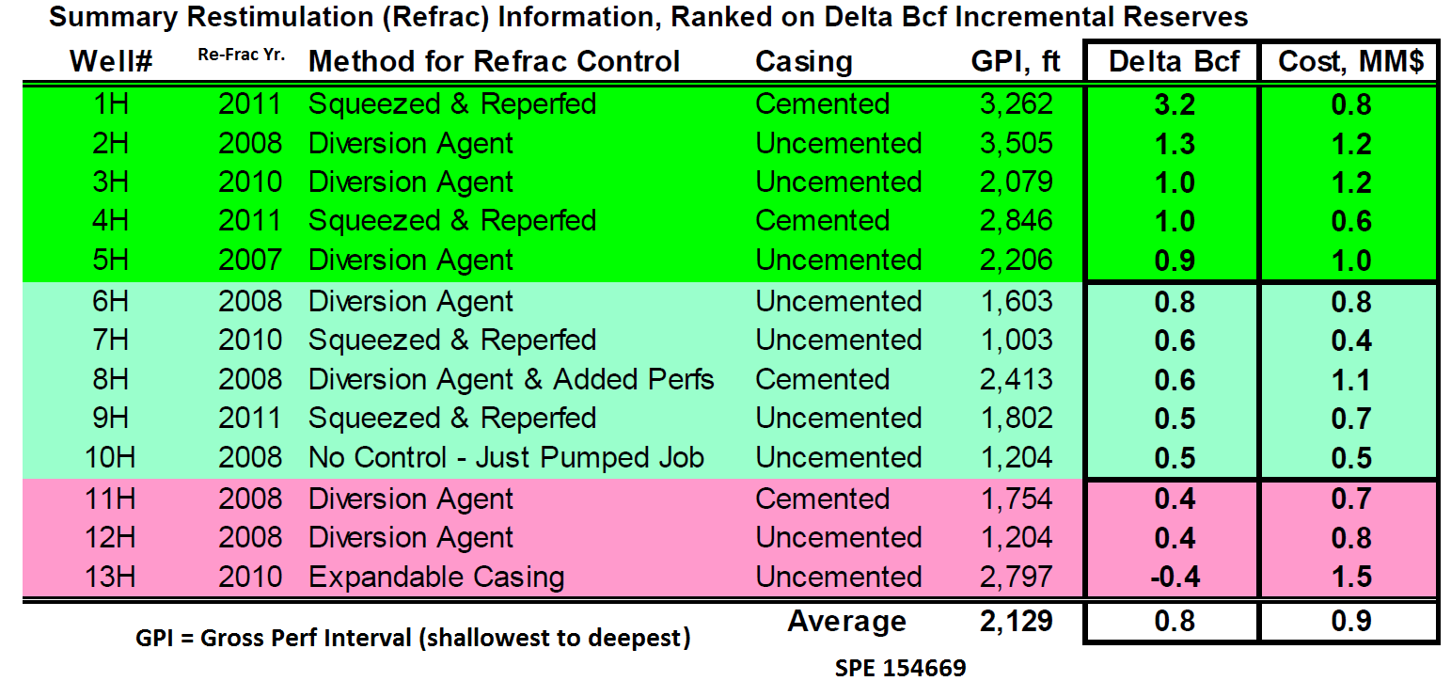
Re-Frac of Horizontal Wells
For 13 re-fracs, the average cost is 0.8 Bcf/well and the average cost is variable.
Initial uplift is about 0.6 MMcfd, stabilizing out to about 0.2 MMcfd in one year. Appears to be sustained – developed incremental reserves.
Notes:
Economics drive the justification for refracs and a refrac campaign as shown in a paper by Craig, et.al. will have both winners and losers. Neither the selection nor the technique of diversion is solely responsible for success or failure of the refrac.

Slide 13
Timing
Controls:
How old is the well?
What’s the current production rate?
Are GOR increasing and liquids decreasing?
How good was the initial completion?
What is the oil or gas price projection?
What is the cost of refracs? (~25% to 40% of a new well??)
Notes:
Timing of a refrac is more important than it may seem, perhaps more from an economic optimization recognition than an eventual reserve recovery view. The initial considerations are fairly obvious – with age, many of the wells, especially shale wells have declined rapidly, usually associated with flush production from fractures. However; two key points must be considered: first, is the flow composition changing; and second, how good was the initial completion. These are not really independent variables. If the liquids are declining and the gas is increasing, then, assuming there is no gas cap, the passages wide enough to allow liquid flow are closing while the lower viscosity gas is still capable of reaching the wellbore. If the initial completion was perfect, then fractures would have adequate proppant. If not, then unpropped fractured will respond to increasing stress and will close. The timing then is based on price – is the value of the lost fluid component worth the cost and risk to refrac?

Slide 14
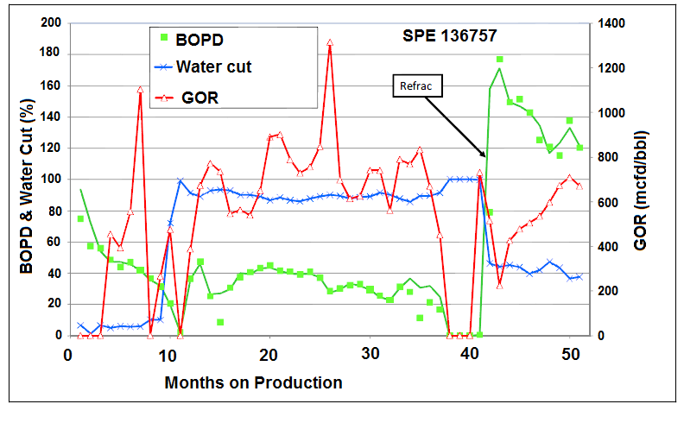
Bakken Oil Re-Frac
Liquids much more difficult to flow through narrow fracs than gas – is increasing GOR and decreasing Oil a sign of unpropped fracture closure?
Notes:
As multi-fractured, highly deviated wells have begun to dominate much of the new well market, operators gained familiarity with the process and many thought that the refracs would eventually disappear. Although the multi-fractured deviated well technology is now 40 years old, we are still experiencing many of the “ah-ha!” moments that often signify a blinding flash of the obvious and a very plain need for a corrective action. This slide from the Bakken offered by Mike Vincent illustrates one of those moments (SPE 136757). The green line shows the decline of oil production but the red line, the GOR, is moving opposite. Although this might be written off in many formations to a relative permeability issue, it is not completely to blame. After the refrac, the oil production jumps sharply while the GOR falls just as rapidly. Then the oil begins a decline and the GOR mirrors it by gaining sharply. Refracturing opened the fractures, re-establishing the flow path. This lesson is re-learned repeatedly with refracs, but industry has yet to find, or perhaps to use, a proppant that will tell us for sure whether this recovery must be re-established regularly or whether a design change can start the transition of the unconventional shales into conventionally behaving pay zones.

Slide 15
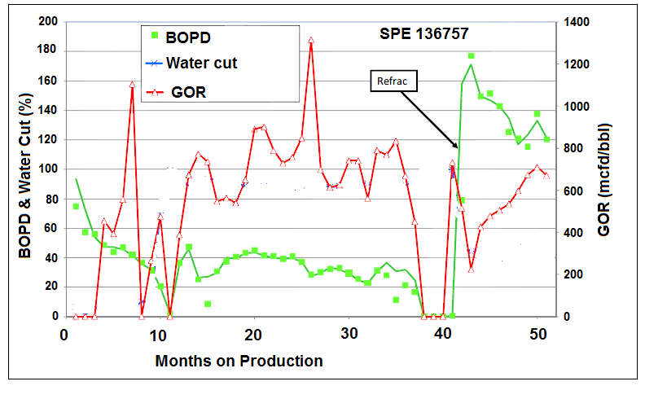
Bakken Oil Re-Frac
Liquids much more difficult to flow through narrow fracs than gas – is increasing GOR and decreasing Oil a sign of unpropped fracture closure?

Slide 16
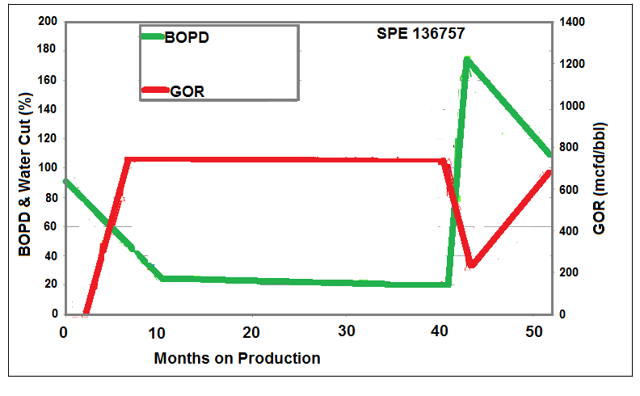
Bakken Oil Re-Frac
Opposing trend movement of GOR and Oil suggest gas can move through flow passages more easily than can oil.
Refracturing opens passages - briefly
Liquids much more difficult to flow through narrow fracs than gas – is increasing GOR and decreasing Oil a sign of unpropped fracture closure?

Slide 17
Do All Perf Clusters or Fracs Produce?
A common finding by production logs or tracers in Horizontal Multi-Fractured Wells.
- 30 to 50% of the fractures are producing 80% of the production.
Are these underperforming fracture stimulations a refrac opportunity or a waste of money?
Check for over-flushed fractures
Ask yourself why are you continuing to fracture in unproductive areas & wasting $.

Slide 18
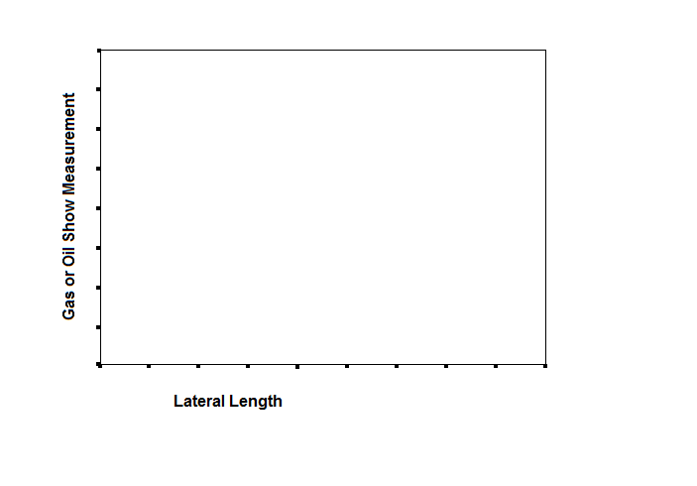
Oil & Gas Shows Along The Lateral

Slide 19
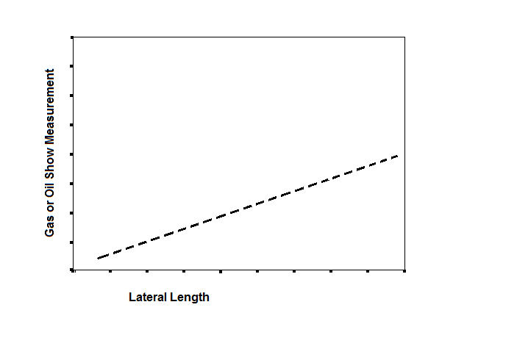
Oil & Gas Shows Along The Lateral
Estimated or Measured Matrix Hydrocarbon Contribution

Slide 20
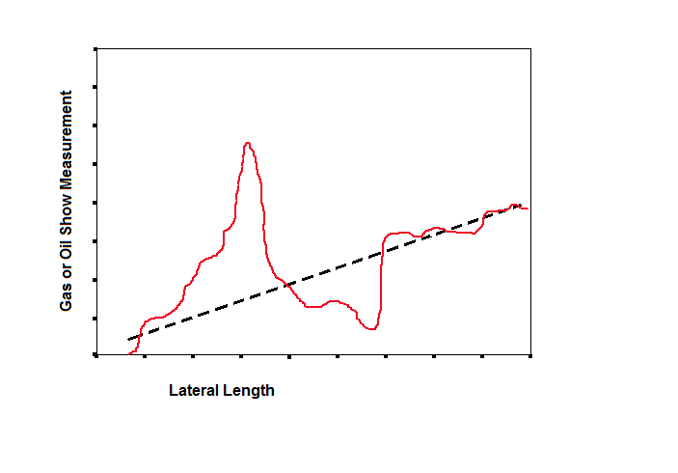
Oil & Gas Shows Along The Lateral

Slide 21
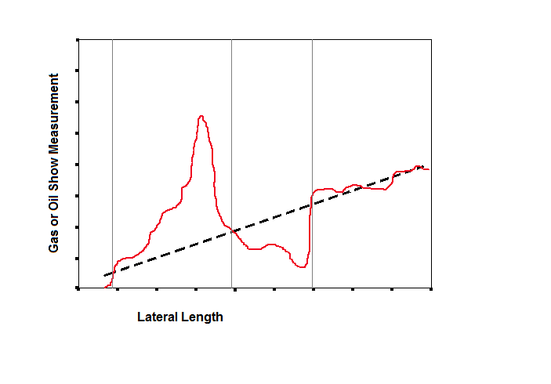
Oil & Gas Shows Along The Lateral

Slide 22
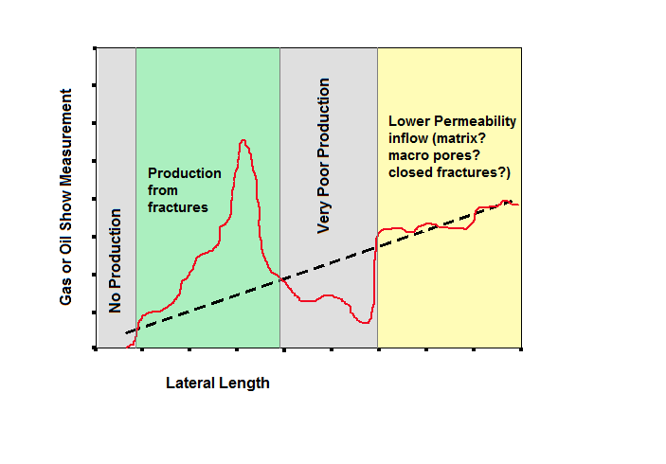
Oil & Gas Shows Along The Lateral
Adapted from: Berkat, et al.: “Identification and Characterization of Producing Fractures in Naturally Fractured Reservoirs Using PIWD,” SPE 120687
PIWD = productivity index while drilling

Slide 23
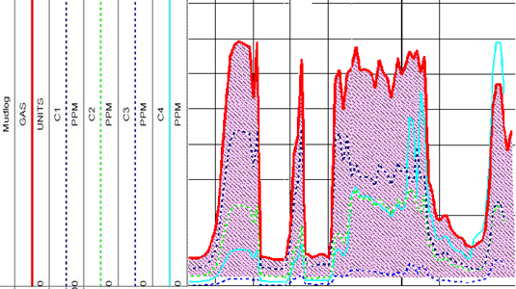
Look at the Components of the Gas Shows
Gas Show
Quantity
Ratio of gasses
Corresponding GR
Other logs (CNL, Density) to help assess TOC
Density for Brittleness
Resistivity for water saturation and salinity
ROP (rate of penetration)
Is it a hot shale or a natural fracture?
The objective is to align the perf clusters with natural fractures.

Slide 24
Conclusions
Refracturing depends on:
Target
Timing
Method

Slide 25
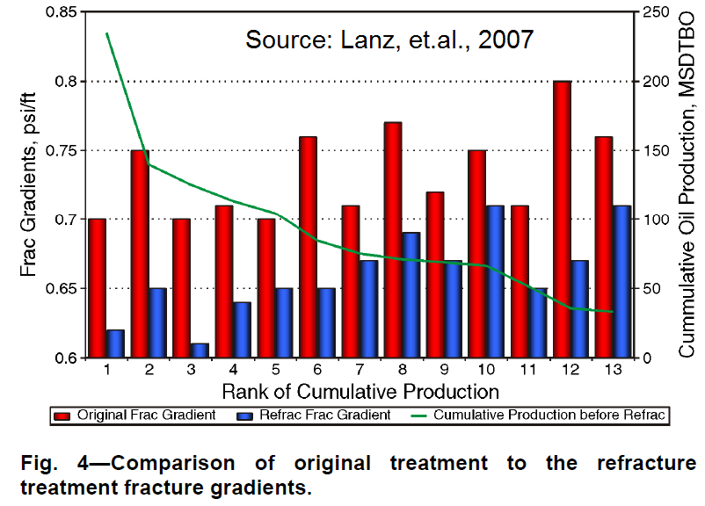
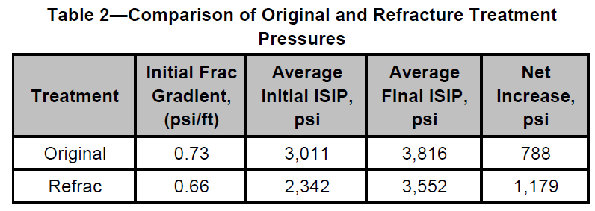
Some Observations
Refracs often have a lower fracture gradients than found in the initial fracs. The uniaxial strain equation implies that high production that produces low pore pressure should also reduce the fracture gradient.
Notes:
There are many learnings concerning fracture gradients and net pressure gains that may or may not be specific to individual formations, but a large campaign is needed to gather and study the data. How it all fits together is somewhat puzzling, but the difference in flow path development and stability over time has to be one of the biggest considerations in shales.

Slide 26
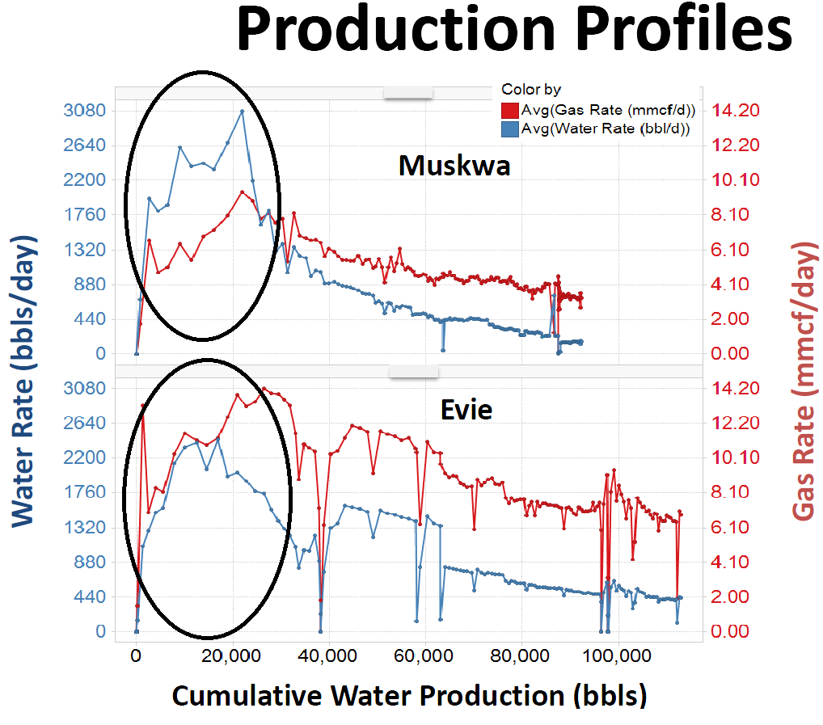
Message in a Bottle (SPE 168892)
Produced water following hydraulic fracture stimulation frequently contains unique messages (data) from the stimulated formations.
Changes in chemistry of water reflect the architecture of the producing stimulated network.
Processes of water mixing; solid dissolution ion diffusion from matrix water to fracture water and the effect of area-to-volume ratio in leaching of ions from walls of the fracture to the injected water describe where the frac water went.
Is rapid flow easier from a planar fracture than a complex fracture?
Bearinger, D.: “Message in a Bottle,” (Nexen) SPE Workshop Hydraulic Fracturing Flowback, 6-7 November 2013, San Antonio, TX. & SPE 168892

Slide 27
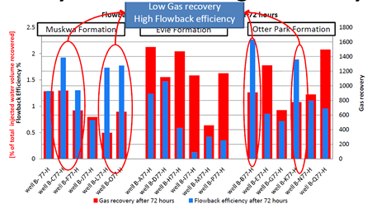
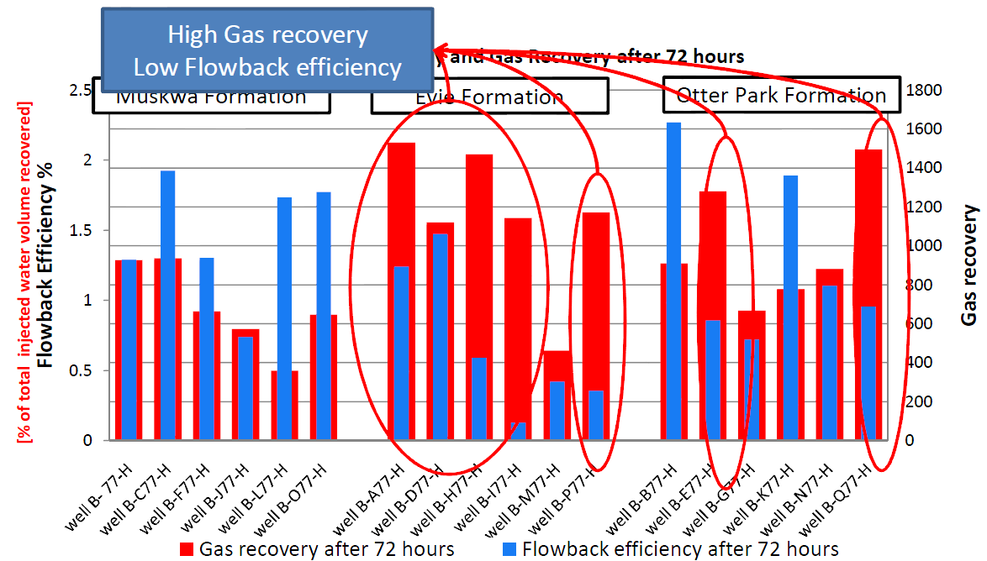
What is this telling us? If we get the highest gas recovery with lowest water recovery, should we be trying to get less early water recovery?
It may help with fracture type estimation & early is a key.
Ezulike, O.: “Flowback Analysis for Determining Load Recovery and Its Effects on Early-Time Hydrocarbon Production Rate,” (U Alberta) SPE Workshop Hydraulic Fracturing Flowback, 6-7 November 2013, San Antonio, TX. & SPE 168892

Slide 28
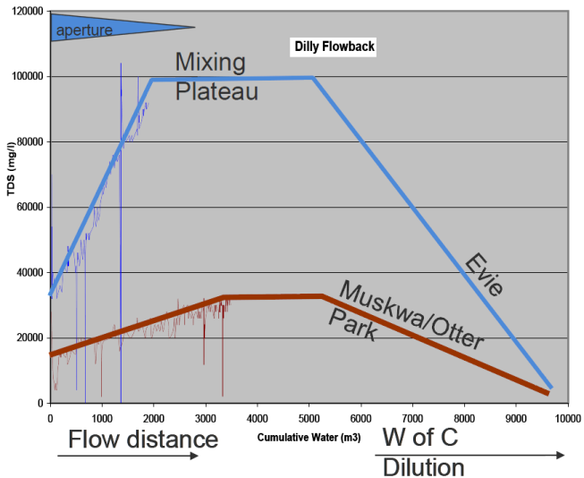
Variance in Produced water TDS
Time of sampling is the control
Induced fracture water recovered first, then salinity increases as water recovered from complex (natural fractures).
Water reaches a plateau – characteristic of stable water flow from early production.
Salinity declines after frac flowback is exhausted, connate water decreases and condensed water increases with gas production increase.
Bearinger, Doug: “Message in a Bottle,” (Nexen) SPE Workshop Hydraulic Fracturing Flowback, 6-7 November 2013, San Antonio, TX.

Slide 29
Flowback vol. vs. Gas Production
Ezulike, O.: “Flowback Analysis for Determining Load Recovery and Its Effects on Early-Time Hydrocarbon Production Rate,” (U Alberta) SPE Workshop Hydraulic Fracturing Flowback, 6-7 November 2013, San Antonio, TX. & SPE 168892

Slide 30
Ion Ratios in the Produced Water
Sodium (Na) & potassium (K) ions appeared to move faster by diffusion than Ca & Mg ions. (ion transfer & ratio judgment)
Formation clay & permeability may affect cation ratios.
Slope of TDS rise related to connate water salinity and contact area of fractures & formation.
Ion concentration & ion ratios impacted by area-to-volume ratio of fracs. Lower AVR in planar fracs & higher AVR in complex fracs.
Waters in producing wells diluted by condensation from gas, but dilution has no effect on ion ratio.
As load fluid recovered, salinity dropped radically as formation water production decreased & condensed water increased.
Bearinger, D.: “Message in a Bottle,” SPE Workshop Hydraulic Fracturing Flowback, 6-7 November 2013, San Antonio, TX. & SPE 168892

Slide 31
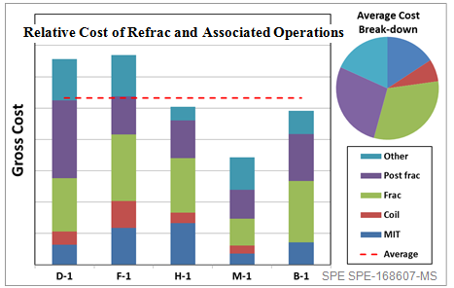
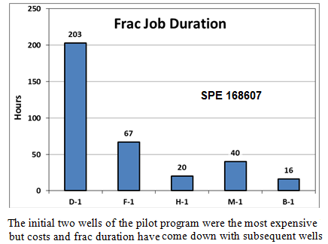
Cost & Time Breakdown of Refrac
Refracs – How Successful?
Best are older wells w/ x-link or foam initial frac
Must have the reserves in place to be economic.
Recent, horizontal multi-frac with many stages do not appear to be that good of a candidate?
Notes:
The cost components of a refrac show many elements, and when done in a campaign can generally be optimized with reductions in costs and improvements in rate and reserve gain numbers. The learning curve is a critical piece of success and must include all elements of the refrac from the initial candidate selection to the frac backflow.

Slide 32
Refrac Popularity?
Refracs small portion of fracturing activity
Refracs are about 2 to 3% of fracs per year.
Most refracs made w/o sufficient candidate analysis.
Unconventionals appear to have the highest refrac success rate – particularly in early years of shale frac modernization (i.e., 2000 to 2008)
Barnett refracs returned initial rate & EUR gained 0.6 bcf to 3 bcf.
Sources: Wolhart, 2002, Vincent

Slide 33
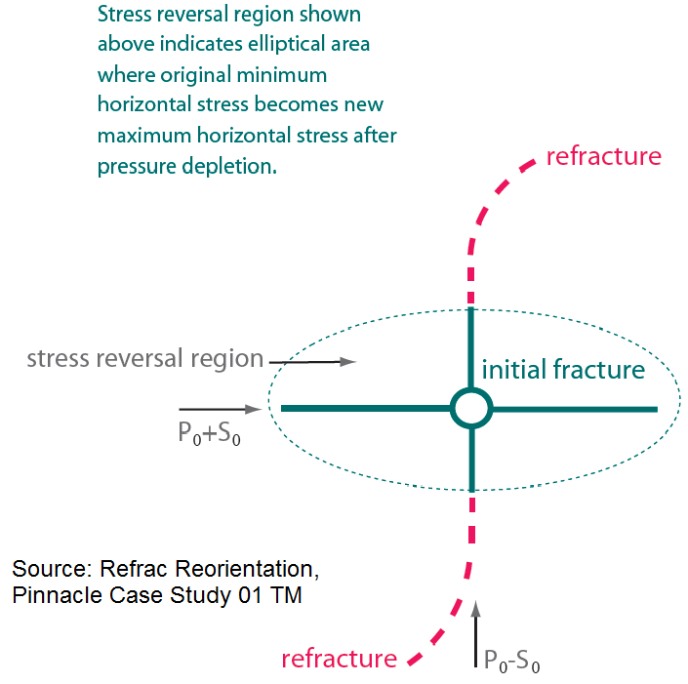
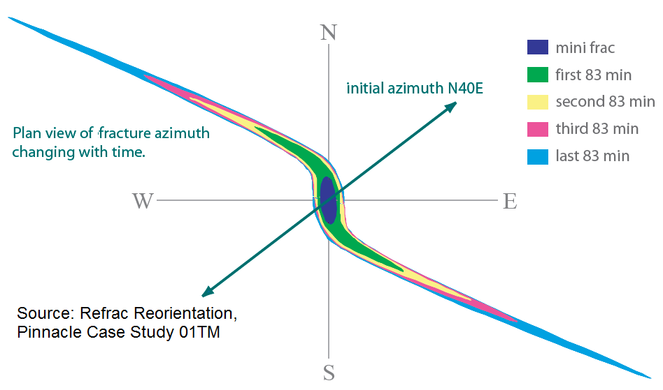
Reorientation Effects
Notes:
How the formation behaves, particularly in the case of shale formations with multiple fracture or joint sets may offer a very formation specific opportunity to re-orient a fracture during a refrac. This could increase access sharply with improved production opportunities.

Slide 34
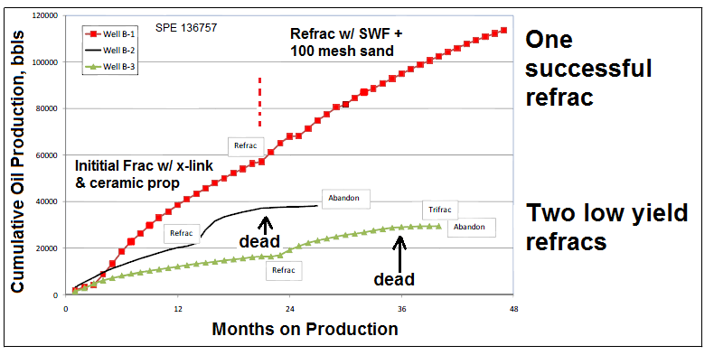
Not Every Well is a Good Candidate

Slide 35
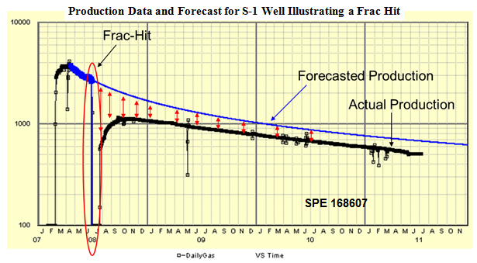
Frac Hits
A Frac “Hit” is a pressure or fluid incoming response from a frac treatment in an adjacent (?) well.

Slide 36
Frac Hits
Planar Fractures
Complex
Most likely hit distance => less than 1500 ft.
Skips wells? => sometimes
Longer hits => 4000 ft.
Mechanical damage potential => high
Likely production effect in “hit” well => reduced production 5% to 15%.
Prevention => pressure up w/field gas, auto shut in.
Design change => increase well spacing, stagger perf flusters out of frac’s way.
Most likely hit distance => about 500 ft.
Skips wells? => frequently
Longer hits => rare over 1000 ft.
Mechanical damage potential => low – water loading is main issue
Likely production effect in “hit” well => increased 10% to 50%
Prevention => most operators don’t bother, some load well.
Design change => stagger perf clusters if less than 500 ft.
Notes:
Frac Hits are an unavoidable element with closely spaced wells and fracture stages. These observations have been captured after many discussions with dozens of operators. Damage from frac hists on production or well components are known but seem to follow trends made distinct by whether the frac was complex or planar.

Slide 37
Refracturing to Mitigate Frac Hits
Adding rate & reserves is the main goal of refracturing.
Some reports indicate older wells with “new” (re)fracture before new, adjacent wells were fractured, were at least partly protected.
Wells shut in and/or loaded or pressurized also appeared to be protected.

Slide 38
References
Craig, M., Wendte, S., Buchwalter, J.: “”Barnett Shale Horizontal Restimulations: A Case Study of 13 Wells,” SPE 154669, SPE Americas Unconventional Resources Conference, Pittsburgh, PA, USA, 5-7 June 2012.
Fredd, C.N., McConnell, S.B., Boney, C.L., England, K.W.: “Experimental Study of Fracture Conductivity for Water-Fracturing and Conventional Fracturing Applications,” SPE 74138, SPE Journal, Vol. 6, No. 03, pp 288-298.
French, S., Rodgerson, J., Feik, C.: Re-Fracturing Horizontal Shale Wells: Case History of a Woodford Shale Pilot Project,” SPE 168607, SPE Hydraulic Fracturing Conference, 4-6 February 2014, The Woodlands, TX, USA.
Lanz, T., Greene, D., Eberhard, M., Pershall, R.: “Refracture Treatments Proving Successful in Horizontal Bakken Wells: Richland County, Montana,” SPE Rocky Mountain Oil & Gas Technical Symposium, Denver, CO, USA, 16-18 April 2007.
Reeves, S.R., Hill, D.G., Hopkins, C.W., Conway, M.W., Tiner, R.L., Mohaghegh, S.: “Restimulation Technology for Tight Gas Sand Wells,” SPE 56482, SPE Annual Technical Conference and Exhibition, Houston, TX, USA, 3-6 October 1999.
Siebrits, E., J.L. Elbel, R.S. Hoover, I.R. Diyashev, L.G. Griffin, S.L. Demetrius, C.A. Wright, B.M. Davidson, N.P. Steinsberger, D.G. Hill: “Refracture Reorientation Enhances Gas Production in Barnett Shale Tight Gas Wells,” SPE 63030, SPE Annual Technical Conference and Exhibition, Dallas, TX, USA, 1-4 October 2000.
Vincent, M.C.: “Refracs – Why Do They Work, And Why Do They Fail in 100 Published Field Studies,” SPE 134330, SPE Annual Technical Conference and Exhibition, Florence, Italy, 19-22 September 2010.
Vincent, M.C.: Examining Our Assumptions – Have Oversimplifications Jeopardized Out Ability to Design Optimal Fracture Treatments,” SPE 119143, SPE Hydraulic Fracturing Conference, The Woodlands, TX, USA, 19-21 January 2009.
Wolhart, S., “Hydraulic Fracturing Restimulation,” SPE Distinguished Lecturer Series. 2002.

Slide 39
End of Slide Support Package

