Slide 1

SPE/ICoTA Refracturing Through Optimized Interventions Workshop
Where is the Industry Heading
Martin Rylance
(thanks to G. King, B. Robertson, A. Daneshy and M. Vincent)

Slide 2
What Will We Talk About
Candidate Selection and Integrity.
Deployment and Delivery.
Design and Diagnostics.
Productivity and Economics.
Where does the Industry go from here ?

Slide 3
Industry Remains Fractured
“We have not tried any refracks (sic). Our outlook on that is that it is really technical”
CEO of Shale Producer
“We will re-frac any operators wells for free, if we get to choose the wells and receive a percentage of the benefit”
CEO of Service Provider

Slide 4
Candidate Selection (Resource)
GREAT
POOR INITIAL WELL
&
GOOD REFRAC
GOOD INITIAL WELL
&
GOOD REFRAC
Understimulated and Missed Pay & Fracturing Technical Advances
Good Pay Quality
Missed Pay & Fracturing Technical Advances
GOOD
Re-Fracture Treatment Quality
POOR INITIAL WELL
&
POOR REFRAC
GOOD INITIAL WELL
&
POOR REFRAC
Presence of Regional Fractures and Effective Drainage Taking Place
Poor Pay Quality
Offset Well Behaviour
Average Cum.
POOR
GOOD
GREAT
Initial Fracture Treatment Quality

Slide 5
Candidate Selection (Integrity)
Cement and cycling pressure on wells has an impact.
Candidate integrity is a fundamental part of selection.
Some key considerations.
  Slower application of applied load allows for stress redistribution.
  Unnecessary cycling should be avoided (why if not necessary).
  Identify susceptible plays/areas/conditions (factor into selection).
  Poor candidate integrity will dominate re-fracturing economics.
  Well Operational practices (e.g rod-pumping, CO₂, H₂S, FWL…).
  Look for Candidate pool of wells (20) with similar design features.

Slide 6
Deployment and Delivery
Two Major Approaches (Active and Passive).
Active Re-frac (Missed Pay, Toe Bias …).
  Mechanical Isolation (Permanent Straddles, Expandables, …)
  Coiled-Tubing Deployment (Isolation Straddles, Abrasive-Jet …).
  Insert Liners (Drop-Off Systems, Re-Frac Insert-Liners, …).
Passive Re-frac (Distributed, Re-Stim …).
  Conventional Diversion (Ball-Sealers, Disappearing Materials ...).
  Insoluble Shut-Off Materials (Cement, Gels, …).
  Fibre Approaches (Fluid Loading, Fibres, Proppant …).

Slide 7
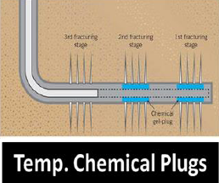
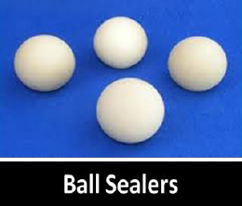
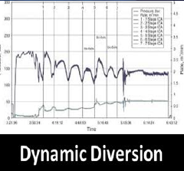
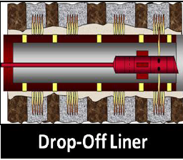
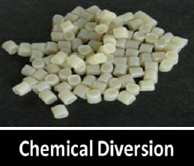
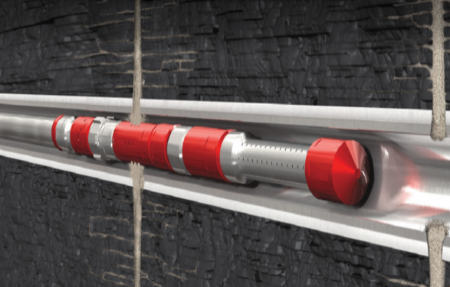
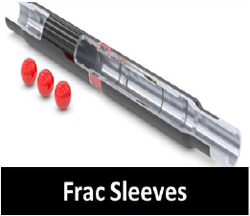
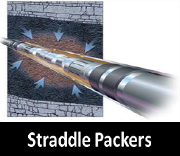
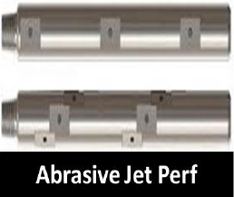
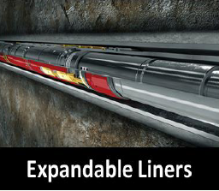
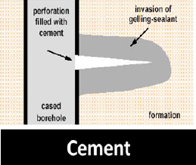
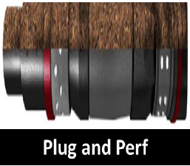
THERE ARE LOTS OF OPTIONS
Coil Deployed

Slide 8
Design and Diagnostics
Original Well
S1: Pump in Old Perfs.
S2: Pump in Old and New Perfs. Produce from All.
S3: Isolate Old Perfs. Pump in New. Produce from New.
S4: Pump in New Perfs. Produce from All.
Stimulated area around each frac is shown by:
Diversion (Soluble)
Coiled Tubing
Diversion (Soluble)
Coiled Tubing
Diversion (Insoluble)
Insert Solutions
Coiled Tubing
Straddles
Old open fracs
New open fracs
Old closed fracs

Slide 9
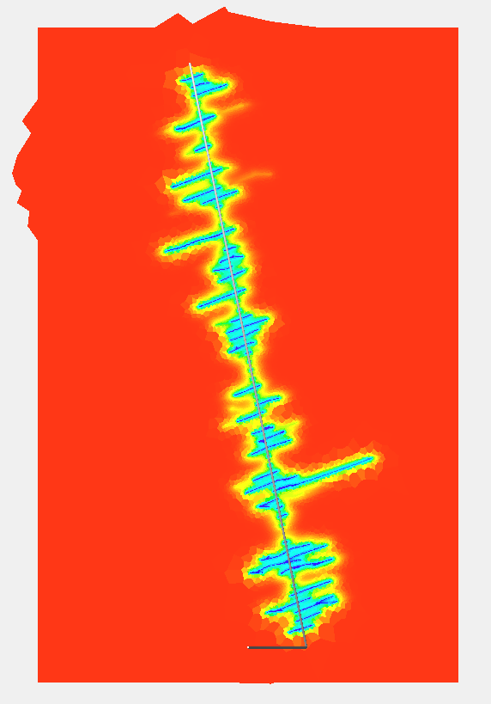
Design and Diagnostics
Cluster Productivity is Non-Uniform
(40-50% of rock is left unstimulated).
Fracture Conductivity Reduces w/ time.
(Re-Fracturing to protect near wellbore).
Maximizing Surface Area is the Key.
(Higher value in accessing new rock).
Focused Energy on Short-Section.
(Multiple Stages (smaller) in few holes).
Fluid Chemistry (Surfactants) Important.
(New Advances in additives gaining ground).

Slide 10
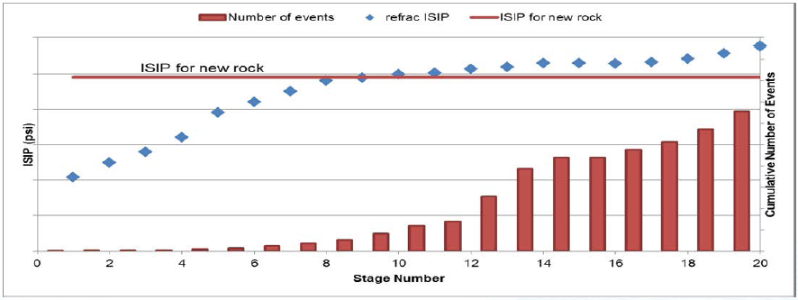
Design and Diagnostics
Re-frac can build on the original fracturing operational data.
Re-frac is a golden-opportunity for big-data to be put to good use.
Campaigns (on pads) have access to multiple offset wellbores (opportunity).
Two-step pumping (flooding and re-frac) re-pressurise system and initiate new.
Coil in Hole offers substantial real-time opportunity during re-frac.
Re-frac campaigns should be multiple wells (a pad) not selective/isolated.

Slide 11
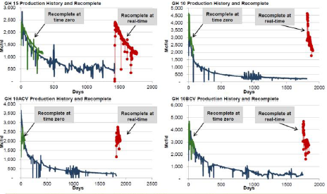
Productivity and Economics
Density of development should allow for improved economics/candidate pool.
Present day stimulation approach likely to have morphed from original concept.
Use the ‘time’ we now have to process data that we gathered but did not use.
Understanding that this is incremental reserves and not acceleration.
Recognise that increased frac density likely to be better than re-frac old fracs.
Wise to investigate re-frac (and hits) before planning new infill wells.
There is an information/publishing bias for success, work it into the economics.

Slide 12
The Industry Future
There has never been a better time for re-frac of wells.
Opportunities for risk-sharing contract approaches abound.
How can re-frac be riskier than unconventionals per se.
Efficiently employing ‘big data’ will be part of the solution.
Identify and rank (NPV) opportunity sets across well-stock.

Slide 13
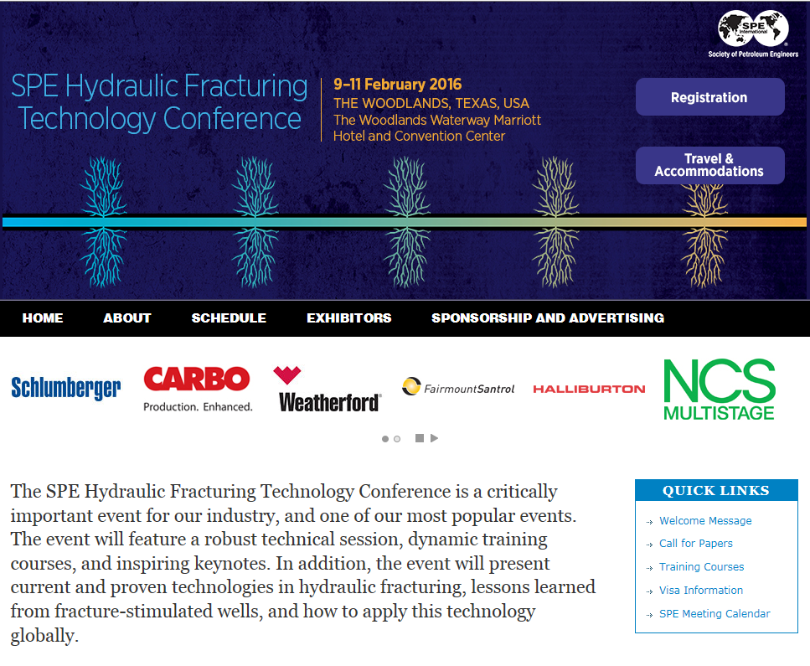
SESSION 3. RE-FRACTURING (6 Great Papers)

