Slide 1
SPE Gulf Coast Section Executive Breakfast, February 10, 2015
Mexico: The Next BIG Thing?
Dr. Helge Hove Haldorsen, 2015 SPE President

Slide 2
What is the 10th letter in the English alphabet?
Jeanne

Slide 3
JOB = GREAT!
One Incredible Day
Eight Amazing Speakers
d5 is a new event designed to inspire leaders and innovators
to drive innovation in the energy industry
d5 will bring together the brightest minds in science, technology, and leadership
for talks that will inspire participants to discover unique connections and solutions.
Register at: 2015.otcnet.org/d5

Slide 4
Haldorsen

Slide 5
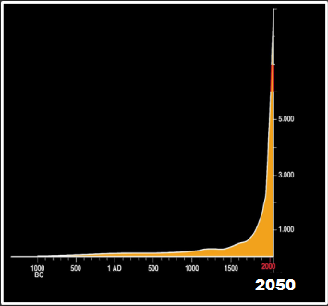
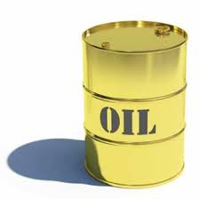
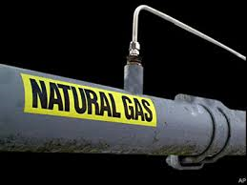
_{SPE; A KEY ROLE}
2014: Drilled ~83,000 Wells & Invested ~$1 Trillion
9.0 BILLION
Fuels Human Progress
Raises Living Standards
Huge Sense Of Purpose !
7.3 BILLION
~ 92 million barrels per day
~ 350 billion
cuft per day
2040
2014
Haldorsen

Slide 6
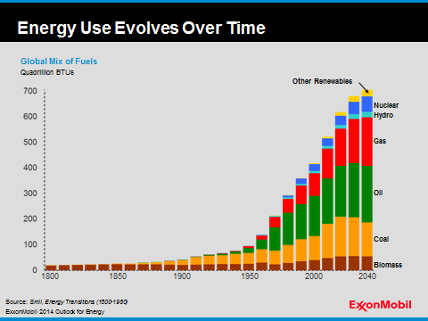
Global Energy Mix To 2040
Gas & Oil Still ‘Kings’ In 2040 !
Solar + Wind + Biofuel: ~5% Of The Global Energy Mix In 2040
-Nuclear
-Hydro
-Gas
Quadrillion BTUs
-Oil
-Coal
-Biomass
1800
1850
1900
1950
2000
2040
Source: ExxonMobil The Outlook For Energy – A View To 2040

Slide 7
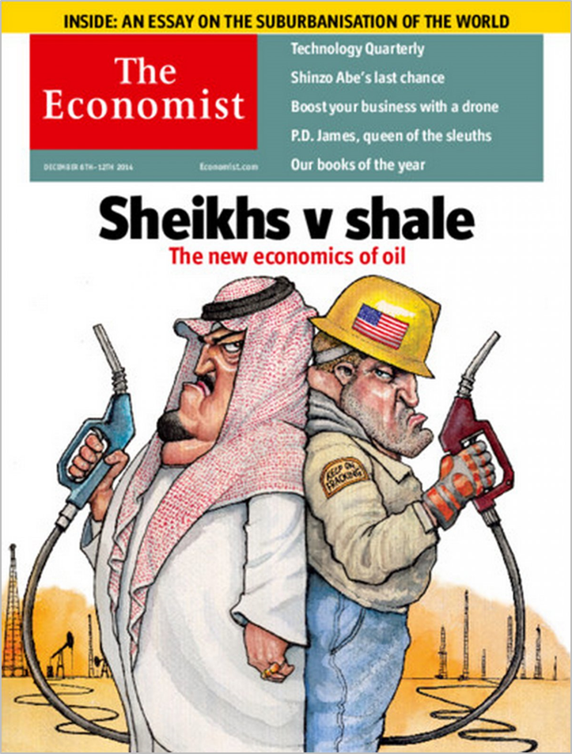
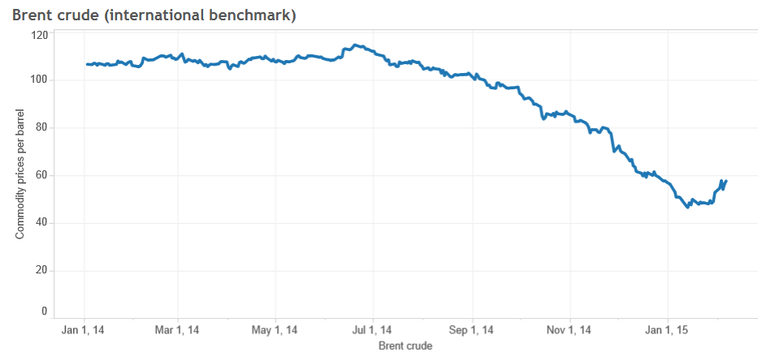
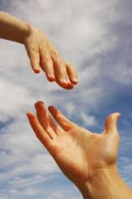
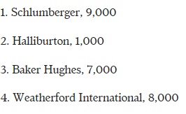
HOW CAN
In 1Q
2015
THE MASSIVE OIL PRICE FALL
SPE HELP?
RigData: -33% since Q4 rig peak

Slide 8
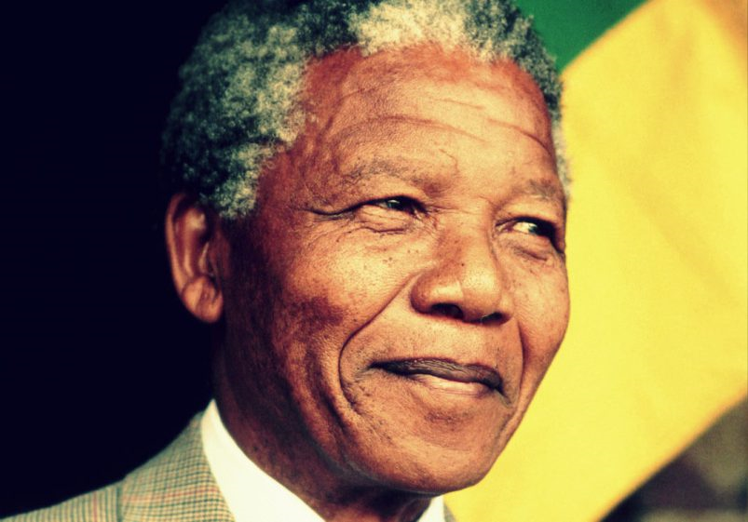
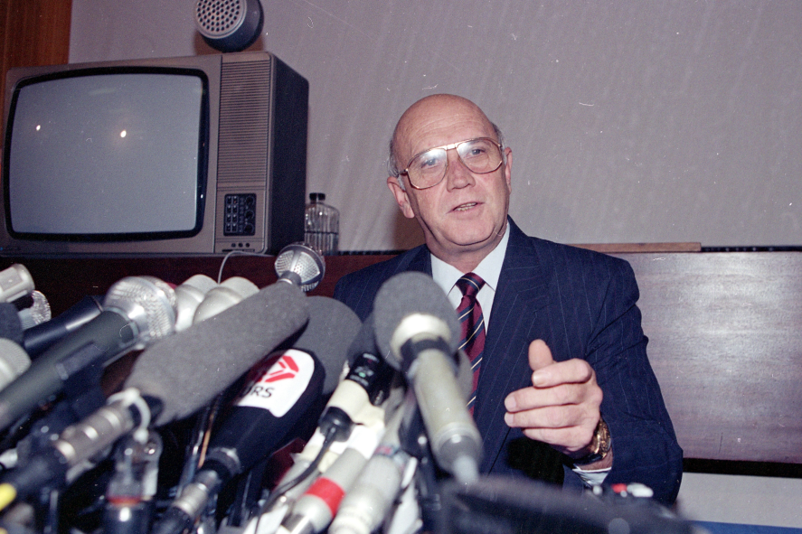
February 10,1990
Nelson Mandela will be released tomorrow Feb.11 after 27 years in prison
“ It always seems impossible until its done ”

Slide 10
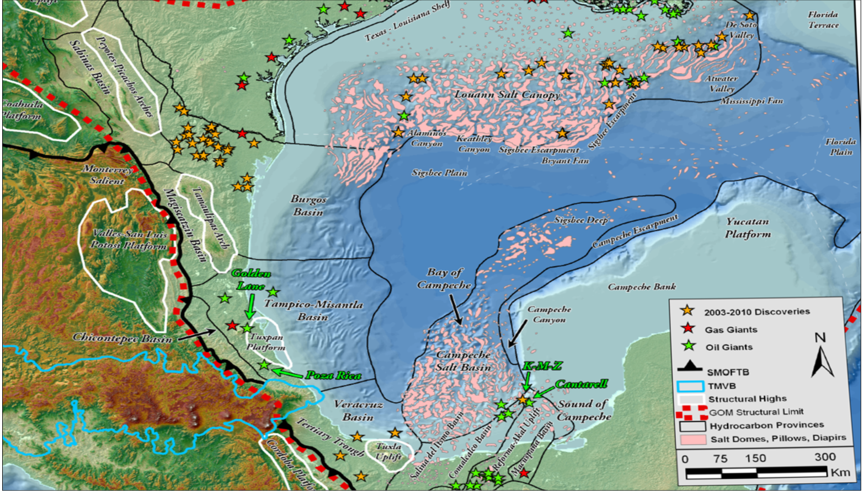
Mexico Deepwater GoM Overview
Deep-Water YTF: 25+ bill boe
3 oil prone areas
Huge area (North Sea can fit in)
Mirror image of US
Can transfer skills & learnings
Seismic coverage
Uncov. onshore potential: 60 bill boe
Shelf Margin
3000 DW
300 SS
Oceanic Crust
PERDIDO
35 DW
0 SS
Shelf Margin
Mexico’s onshore unconv. oil and gas potential > 60 BILL BOE acc. to Pemex
MEXICAN
RIDGES
The CANTARELL oil field: ~25 bill boe recoverable. Largest oil field in GoM
SALINAS
SURESTE

Slide 11
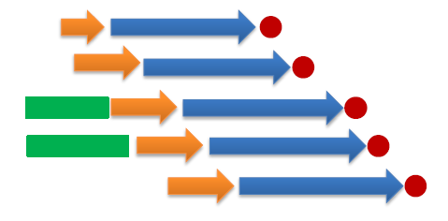
ROUND 1 – TIMELINE
STAGGERED SUB-ROUNDS THROUGH 2015

Slide 12
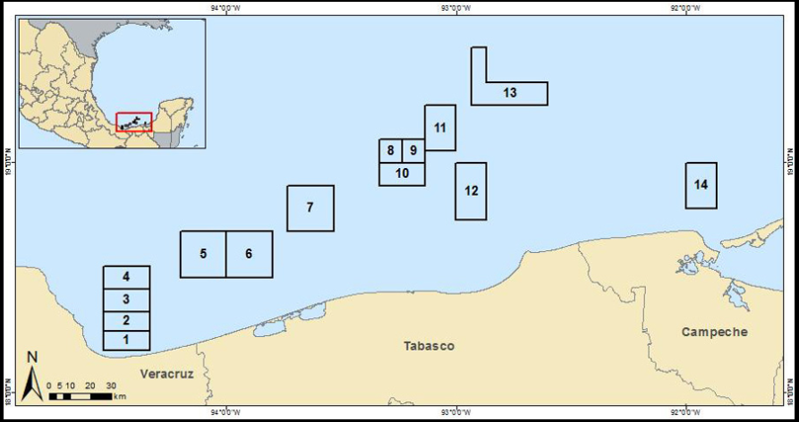
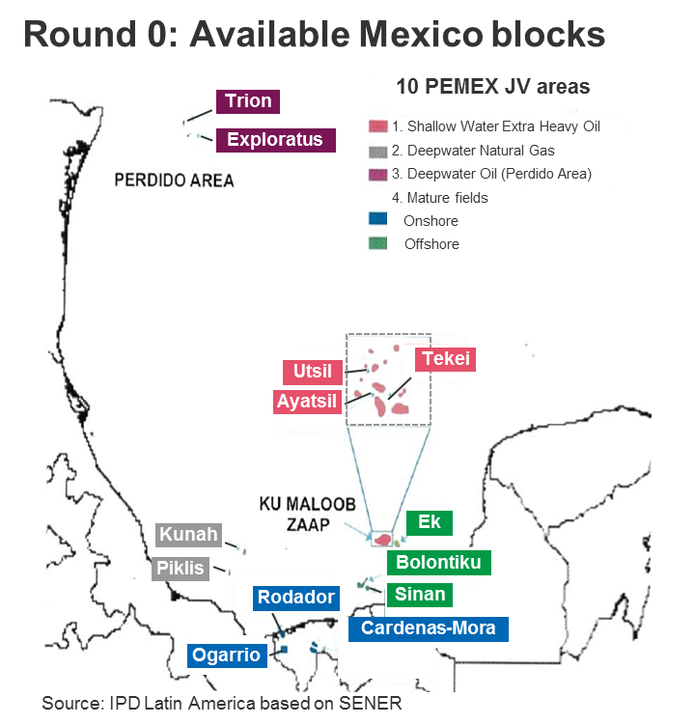
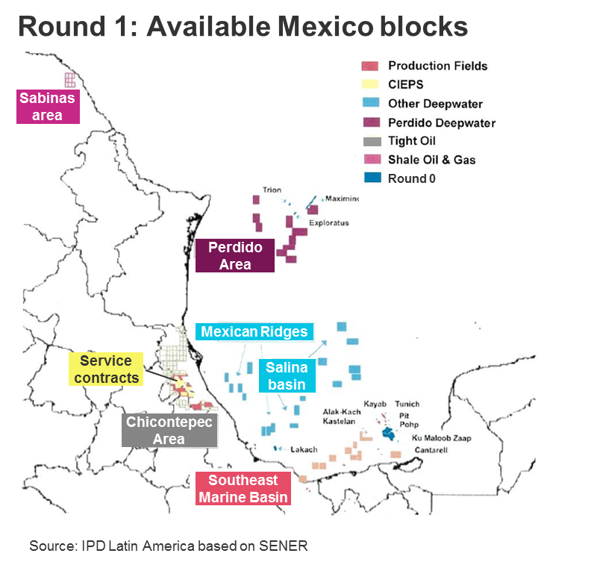
Round 1: 10 Pemex JV Farm-In Opportunities (2015)
Round 1: 169 Blocks Offered (2015)
SHALLOW WATER ROUND
Data Room Opened: Jan.15
Bids Due: July 15
WHAT IS BEING OFFERED IN ROUND 1?

Slide 13
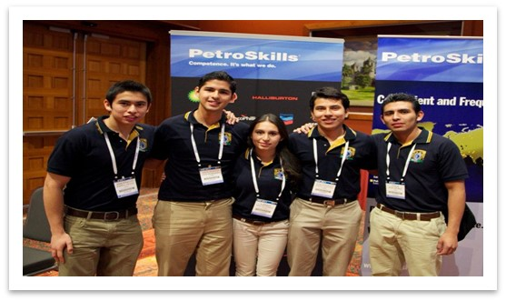
SPE’s Goal for Mexico
To create successful workshops, forums, conferences and training programs to support the energy reform and the Mexican E&P industry’s long-term success

Slide 14
Great Opportunities for Collaboration2.0
To successfully deliver valuable programs, strong partnerships and cooperation with existing Mexican industry organizations is essential

Slide 15
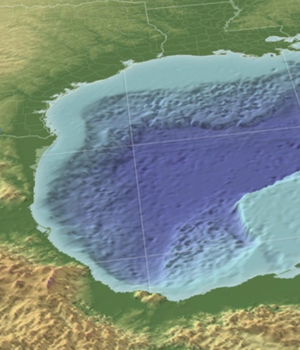
WHY? BECAUSE WE CARE!
What Ordinary People Hope To Get Out Of the Energy Reform
Employment and other real benefits
Higher living standards
A safe and prosperous community
Source: Simon Sinek

Slide 16
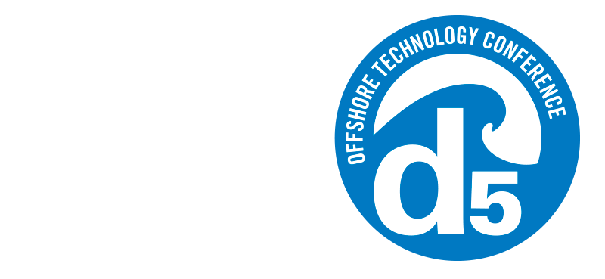
One Incredible Day
Eight Amazing Speakers
d5 is a new event designed to inspire leaders and innovators
to drive innovation in the energy industry
d5 will bring together the brightest minds in science, technology, and leadership
for talks that will inspire participants to discover unique connections and solutions.
Register at: 2015.otcnet.org/d5

Slide 17
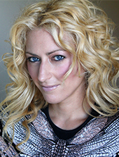
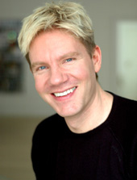
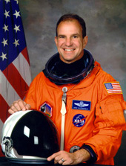
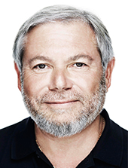
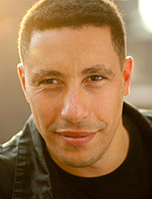
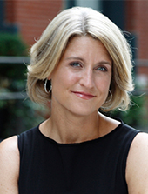
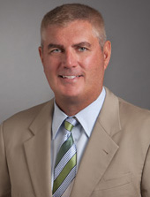
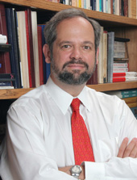
ONE INCREDIBLE DAY
EIGHT AMAZING SPEAKERS
WHAT?: d5 is a new event designed to inspire innovation in the energy industry
WHEN?: Friday May 8, 2015 WHERE?: UofH Campus
HOW MUCH?: $895
REGISTER AT: 2015.otcnet.org/d5
NOTE: d5 is capped at 450 tickets
Jane McGonigal
Bjorn Lomborg
Michael Bloomfield
Avi Reichental
Frans Johansson
Lisa Bodell
Mike Abrashoff
Juan Enriquez

Slide 18
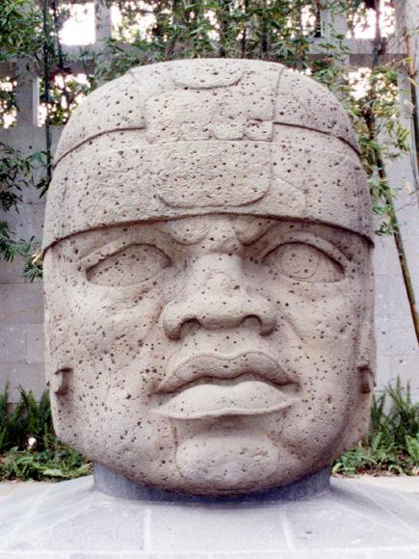
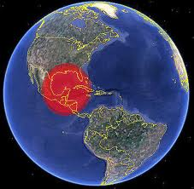
Thank
You
MEXICO OPENING
2nd biggest event in Mexico the last 65 million years
Great strategic fit for STO
STO has a strong starting position
Volume (#1) & Value (Top-3)
SSU challenges to mitigate
STO ambition: Early access at scale
Let us play to win
Opportunity knocks now !
¡MUCHAS GRACIAS!

