Slide 1
One Degree of Separation
SPE’s Pivotal Role in Keeping the Wheels of Innovation Turning During $50 Oil
Rustom K. Mody P.E
Vice President / Chief Engineer – Enterprise Technology
Baker Hughes Inc
February 11, 2015

Slide 2
One Degree of Separation
Between individuals
Between companies
Between us and the next big innovation
SPE is the platform that connects people, companies and ideas, and enables collaboration that fuels innovation
Notes:
Baker Hughes is very proud to be the recipient of the SPE Gulf Coast Section’s Top Donor Award for 2014. But, the way we look at it, SPE is a top donor…
… to our industry,
… to our companies,
… and to us as individuals.
Here is why.
There is really only one degree of separation between each of us and someone or something that can spark “the next big innovation” that will carry our industry forward. SPE is a network of bridges that connect people, companies and ideas, and enable the collaboration that fuels innovation. And, that connection and collaboration is never more important than during downturns such as the one we are experiencing now.

Slide 3
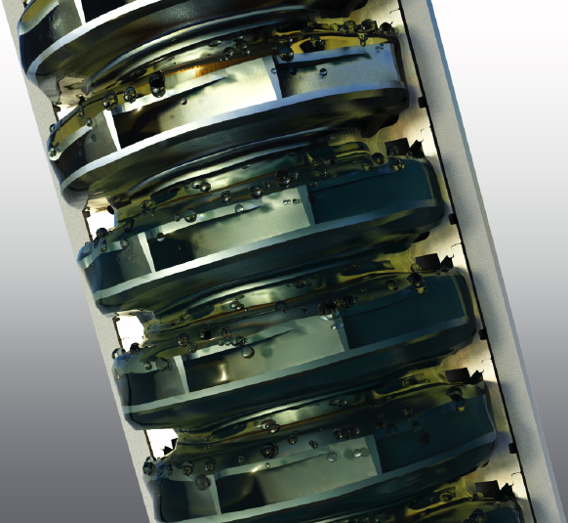
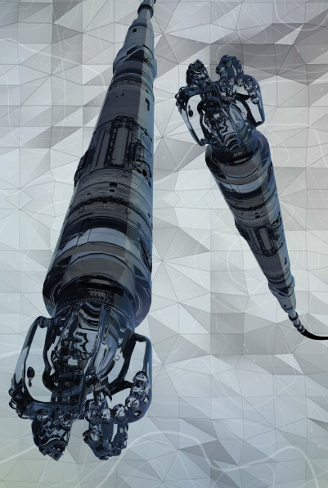
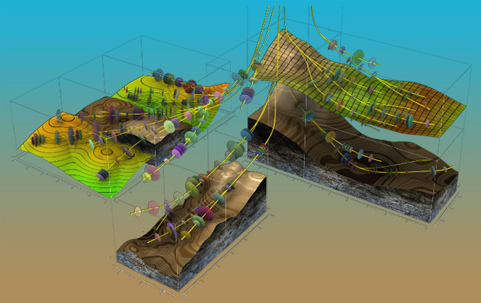
Industry Challenges - Ongoing
Wells – reduce finding and development costs. Technical limits. What is possible?
Production – how do we optimize? Reduce risk?
Ultimate recovery and booked reserves – how do we increase, to add value to the bottom line?

Slide 4
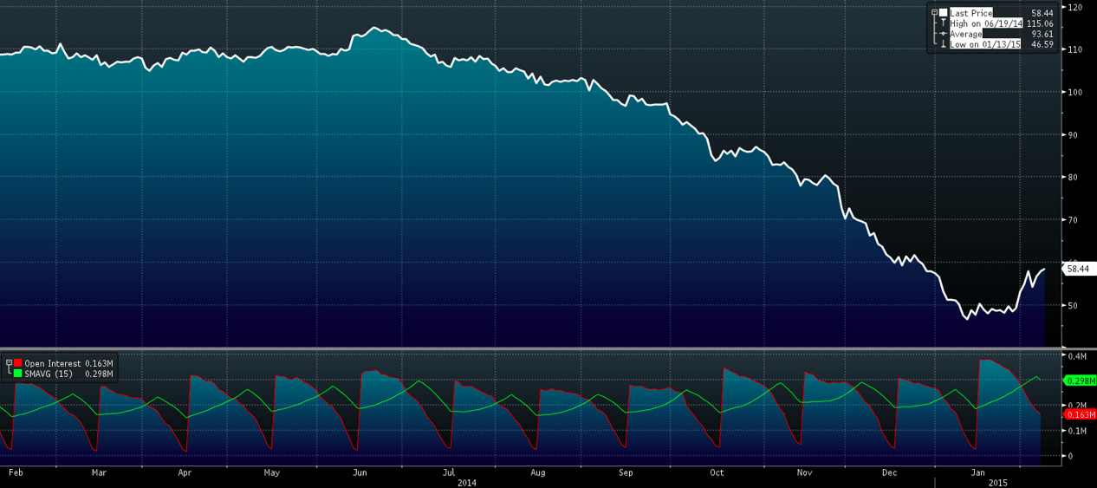
Industry Challenges - New
Low prices
Global energy needs
Sustainability
7.2 billion people, 90 million bbl/d oil, 350 billion cf/d gas. Is $100 the new $20?
Notes:
Now, on top of the ongoing challenges we face as an industry, we have to contend with low prices.
Consider this – from 2015 SPE president Helge Haldorsen’s December JPT column. The buzz at last April’s CERA week in Houston was that, with cost exceeding income in a growing number of E&P projects, hundred-dollar oil was the new 20-dollar oil, so $100 / bbl was what was needed for field development projects to fly. Imagine! Today we have no idea when or whether we will next see hundred-dollar oil! But we still have to deliver the 90 million barrels a day of oil and the 350 billion cubic feet of gas needed by the 7.2 billion people on our planet. And, we have to do it more safely, more cheaply, more quickly and more sustainably. We can’t compete – or, in some cases even survive – doing business as usual.

Slide 5
Innovation is at the Heart of Our Future
Technology Challenges and Opportunities
The Operator’s Dilemma – Every Asset is Marginal
A Seamless Approach – Together
Maximizing Asset Management and Value - Alignment
Acceptance of Technology Innovation - A Paradigm Shift
Technology Availability – Find it, Deliver it and Supply it
Differentiation – Managing Change
Can We Make it Work
Notes:
Let us review the our challenges and opportunities for Innovation and Technology which will be the heart of our future.
And a big 1….is the operator’s dilemma…every asset is a marginal asset…..from $1 million to $1 billion ….. each asset must provide acceptable ROI.
The technologies required to provide acceptable returns will vary, but ROI is key. We all get paid from the profitable access and recovery of hydrocarbons.
To achieve this goal will require more than advances in hardware, sensors, or software; it will require strep changes in processes and procedures.
The only way we can achieve these changes is to work together seamlessly. Understanding what is possible, what changes can we make to impact ROI.
By working together we achieve alignment between Maximizing Asset Management and Value and the required innovations or technologies to pursue.
By having a seamless integration and alignment, we can implement change more rapidly and effectively. Everyone knows, appreciates, jointly identified acceptance criteria for the acceptance and application of new innovations and technologies. We need to shorten the cycle time for acceptance of new innovations and new technologies which will require a significant paradigm shift in our industry.
Technology and innovation must be used to impact our industry,
we have to find it; it can come from any where from Aerospace to Medicine to Automotive
We have to deliver it so that it is fit for purpose and impacts our industry
We have to ensure a reliable supply of quality innovative products, services, and processes across our global community.
New innovations and new technologies can change the game across the board from exploration to abandonment. Change is a hard thing to accept, we have all experienced it. To achieve faster quicker uptake of the new, we must learn to manage innovation and technology change more effectively.
Can we establish a culture within our industry to embrace new ways of working together, can we make it work?

Slide 6
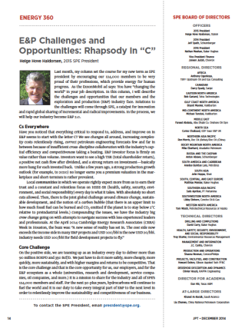
A Silver Lining
Stormy times for our industry
When the going gets tough, the tough innovate
Openness to “fixing what is broken”
Weather the storm
Emerge stronger and more competitive
Involvement in SPE is crucial
Notes:
There is no question that our industry is going through stormy times. But, there is a silver lining. And, that is that innovation, which drives our industry forward, has an opportunity to flourish during this market downturn. That is not as counterintuitive as it might sound.
Innovation involves disruptive technologies and processes. And, as Helge talked about in his December 2014 JPT column, “creative destruction”.
During good times, people tend to be opposed to disruption. Who wants to rock the boat and threaten a good thing? We’ve all heard the saying, “Why fix something if it isn’t broken?”
But when the going gets tough, the tough innovate. The same people who were averse to disruptions during the good times become far more willing during a downturn to consider creative destruction of what is broken and incremental or even radically disruptive ways of fixing it.
That’s why it is so important to keep the wheels of innovation turning when prices are low. As we have seen numerous times before – and we will certainly see again – the innovations that carry us through the storm help us emerge stronger than before.
That is also why active involvement in associations such as SPE is even more important in times like these than when we’re riding high. Because it is pivotal in helping erase the degrees of separation that stand between companies and individuals, and the efficiencies, differentiation and commercial success they are looking for going forward.

Slide 7
What is Innovation?
Innovation is the process by which an idea or invention is translated into a good or service that can be marketed and traded
Tied to customer needs
Economically sound
Built on viable technology
Invention x Organization = Innovation
Notes:
As we’ve already discussed, innovation is disruptive. It’s also commercial. In fact, it is commerciality that distinguishes innovation from invention.
What makes innovation commercial is its desirability to users,
… its viability in the marketplace,
… its economic soundness,
… and its basis in viable technology.
This is another reason why keeping the wheels of innovation turning is more critical now than ever before. And, why the role of SPE is so pivotal.
Consider this – again from Helge’s December JPT column. The buzz at last April’s CERA week in Houston was that, with cost exceeding income in a growing number of E&P projects, hundred-dollar oil was the new 20-dollar oil, so $100 / bbl was what was needed for field development projects to fly. Imagine!Today we have no idea when or whether we will next see hundred-dollar oil! But we still have to deliver the 90 million barrels a day of oil and the 350 billion cubic feet of gas needed by the 7.2 billion people on our planet. And, we have to do it more safely, more cheaply, more quickly and more sustainably. We can’t compete – or, in some cases even survive – doing business as usual. We need disruptive change. We need innovation. We need SPE.

Slide 8
How Does Innovation Happen?
Cognitive Ability
“Associating”
Creative Thinking
Lateral Thinking
Right Brained Thinking
Associational Thinking
Thinking differently - creatively
Connecting seemingly unrelated ideas
Putting them together in unrelated ways
Producing something novel or original
Requires knowledge
Ref: The Innovators DNA
Prof: JEFF DYER - BYU and Wharton
Notes:
To “Think Different” So what exactly are creativity skills? They are generally defined as the ability to connect seemingly unrelated ideas, thereby producing something that is novel or original. The term we are going to use for this cognitive ability is “Associating,” though other terms that have been used include Creative Thinking, Lateral thinking, Right Brained Thinking, or Associational Thinking. We like the term Associating or Associational Thinking.

Slide 9
Where is Knowledge Today?
Everywhere
Departments
Disciplines
Everywhere…
Departments Agencies
Universities
Geographies
Disciplines
Everywhere…
Departments Agencies
Universities
Geographies
Disciplines
Industries
Universities
Agencies
Labs
Geographies
SPE Vision – enable the global oil and gas E&P industry to share technical knowledge needs to meet the world’s energy needs in a safe and environmentally responsible manner
SPE Mission – to collect, disseminate, and exchange technical knowledge
Notes:
So where is knowledge today. It’s everywhere, thanks in part to computers and the internet. It’s in other departments, agencies, universities, different geographies and different disciplines.
The vision of SPE is to enable the global oil and gas E&P industry to share technical knowledge needed to meet the world’s energy needs in a safe and environmentally responsible manner. With 124,000 members and staff, SPE’s font of knowledge is wide and deep. And, its reach and focus are global. No wonder it is where so many of us come to share and expand our knowledge!

Slide 10
Creating Value Through Technology Innovation
Unlock market potential $$
Sustainable Chemistry
High Performance Information
Designer Materials
Reduce risk vector
Increase efficiency
Advanced Measurement & Actuation
Notes:
After more than 40years in the industry, I have seen technological innovation around three major themes make an enormous impact on our industry: Horizontal Drilling, Deepwater Drilling and Unconventional Shales. We as an industry are always quick to criticize our uptake of new technology but if one looks back over the past 50 years, it quickly becomes evident that we are among the most innovative and technologically progressive industries in the world. It is this innovative spirit that has accelerated the growth of Unconventional Shales in North America and the same spirit that will open up similar opportunities in China and the rest of the world.
Sustainable Chemistry, High Performance Information, Advanced Measurement & Actuation, Designer Materials and HP/HT Electronics are just a few technologies that will make a major impact on Unconventional Shales as a sustainable hydrocarbon source for years to come.

Slide 11
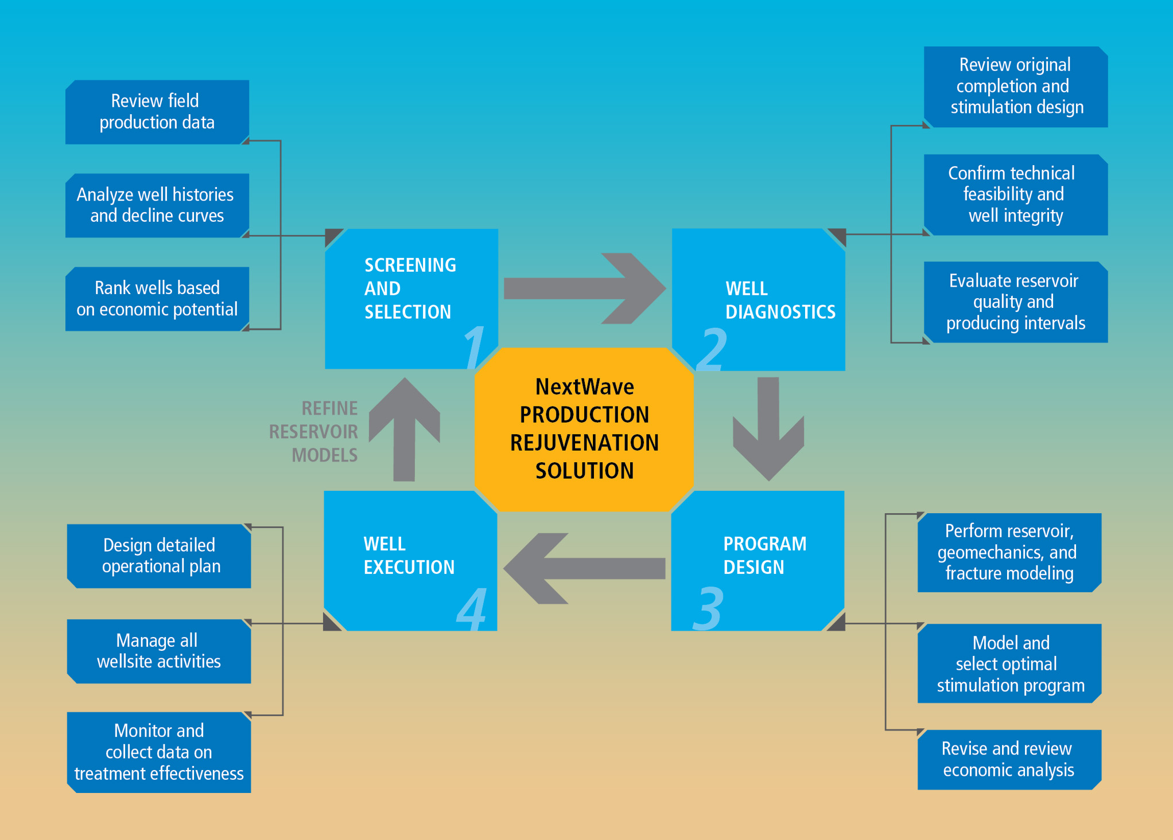
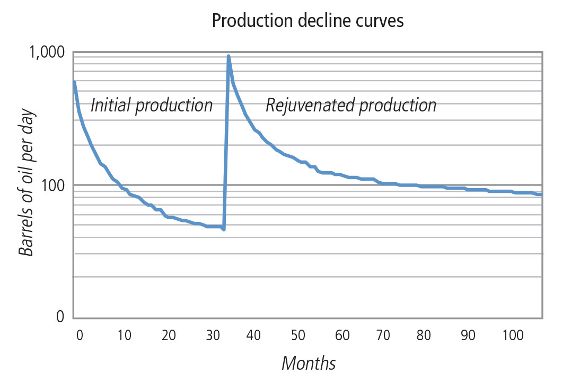
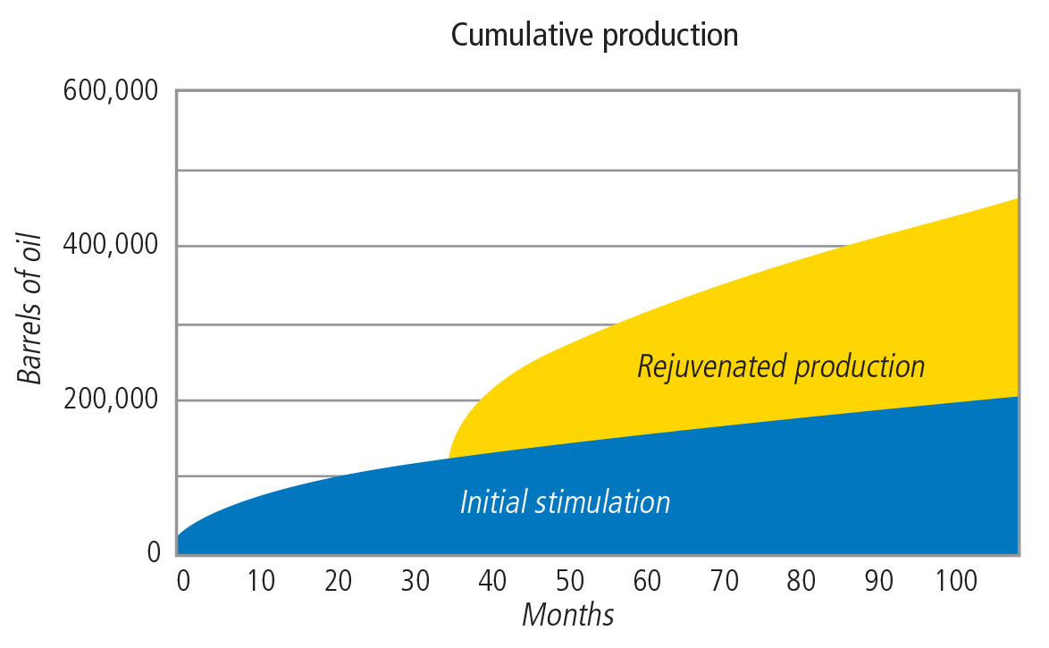
Scope of Innovation – Beyond Technology
Technology
Product
Service
Operational
Economic
Management
Business model
Industry
Notes:
But the scope of innovation goes far beyond technology.
An example is Baker Hughes’ NextWave Production Rejuvenation solution for unconventional wells. NextWave is a new, strategic approach to unconventional development that spans the scope of innovation to help operators maximize value from wells that still have production to offer.

Slide 12
Innovation is More Than Knowledge
Vision
+
Diversity
+
Environment
=
Innovation
Should be concrete
Differentiate
Define success
Establish what/when
Creates a roadmap to success
Aligns all team members
Drives ownership
Produce results
Culture
Gender
Age
Academic
Discipline/Expertise
Research Model
Internal
External
Challenging
Risk Tolerant
Team based
Fun place to work
All the latest tools and toys
Empowerment
Yields highly charged, motivated people
Unleashes creativity
Fosters entrepreneurship and innovation
$
Notes:
But Knowledge alone is not Innovation. There are other issues fueling innovation. The key to successful innovation starts with Vision, makes effective use of diversity, and creates an environment that fosters creativity.
It all starts with Vision. The Big Picture, The Roadmap to Success. I like to think Vision is the Root of Innovation. People have to have ownership in that vision. They have to feel that they are helping to paint that picture if innovation is to flourish. It is Leaderships responsibility to create the Vision, communicate it effectively, and make sure the team members understand it and embellish it. But that’s not as simple as it sounds. In my experience this rarely occurs and it could very well be due to something I heard 10 years ago. Our company had embarked on a Continuous Improvement Program and hired a professional facilitator. He told us that if we wanted people to understand a message, they needed to hear it 12 times. The first three times they are not paying attention, 3 to 6 they don’t understand it, 6 to 9 they don’t believe it and 9 to 12 they want to argue about it until the light suddenly appears. There are those who believe that Creativity can be taught. What makes more sense to me is that all individuals have a certain level of creativity that lays dormant until stimulated. The Work Environment is a great stimulus; a fun place to work, interesting projects, all the latest tools and toys. Don’t ever discount the value in giving an individual a software package or instrument he thinks will make his work more productive. It can really open the door to creativity.
But the most powerful stimulus by far is Empowerment. It motivates people like nothing I’ve seen before. It unleashes creativity and fosters innovation exponentially. It makes people believe the vision is theirs and they are not just part of the big picture. Creating a Risk Tolerant environment is yet another way to foster creativity. Allowing individuals to fail occasionally and learn from their mistakes without retribution will establish an innovative culture.

Slide 13
Collaboration – The New Competitive Advantage?
Collaboration
Technology We Don’t Know About, Yet
On-Time Delivery of Critical Equipment
Trained, Certified, Competent People
Baker Hughes 3 i’s
Innovation
Interdependence
Integration
Solving our industry’s challenge will require a global effort
Core of SPE vision and mission
Around the world, we’ll be solving challenges we’ve never addressed… with technology that doesn’t exist yet … with people who need to be certified and tested to work safely, reliably, and with care for the environment
Notes:
1) SOLVING OUR INDUSTRY’S CHALLENGE WILL REQUIRE A GLOBAL EFFORT
We all know what the challenges are:
Water depths between 5,000’ and 10,000’
Well depths between 25,000’ and 30,000’ TVD
Reservoir pressures >25,000 psi
Reservoir temperatures up to >300°F moving to >400°F
Zone lengths as long as 3,000’
These challenges exist to some degree in all the world’s deepwater reservoirs
2) WHAT WE DO ANYWHERE WILL SET THE PACE FOR WHAT HAPPENS IN THE REST OF THE WORLD
And in looking forward at these very daunting challenges, I can tell you that a few very critical components will make or break our endeavors
3) TECHNOLOGY WE DON’T KNOW ABOUT YET
Intimate reservoir knowledge
Reliable and high-quality technology to withstand the harsh environment
A systems approach
Better surveillance, monitoring and control
State-of-the-art R&D facilities, labs, technology centers
Stimulation vessels that handle enough proppant in a single load
ON-TIME DELIVERY OF CRITICAL EQUIPMENT
Supply chain
Equipment availability
Traceability
Delivery methods
Better manufacturing capabilities
Better manufacturing practices
TRAINED, CERTIFIED, AND COMPETENT PEOPLE
Reservoir experts
Engineers
Technologists
Mathematicians
Strategies to recruit the best talent
An innovative culture
A safety culture
Training programs
Certifications from the Regulatory Agencies like BESSE, ASTM, NACE, API, and ISO.
4) AND ONE MORE THING - COLLABORATION
Given the unknowns ahead, it makes sense for us to team up, apply our own respective strengths, and cross that frontier together. It make sense for us to use what we do know to mitigate the traps that might be ahead of us. That’s why Baker Hughes’ focus is on collaborating with our customers, academia, consortia, and other industries to meet these challenges head on, before they happen.
In view of these challenges, let’s review some of these Needs in more detail.

Slide 14
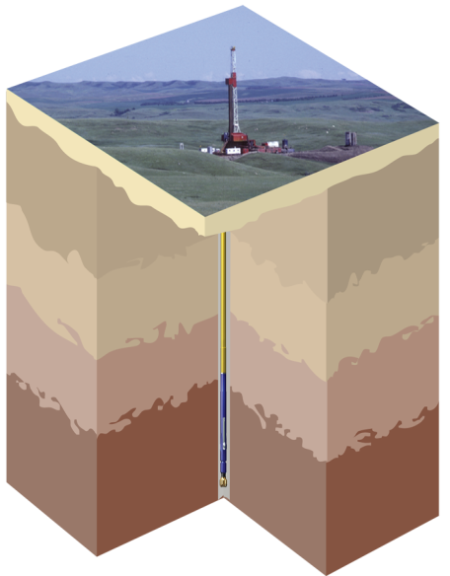
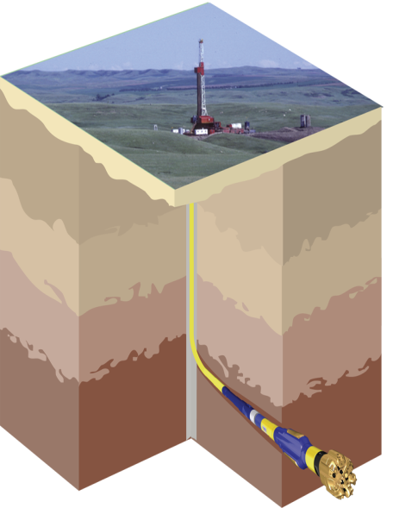
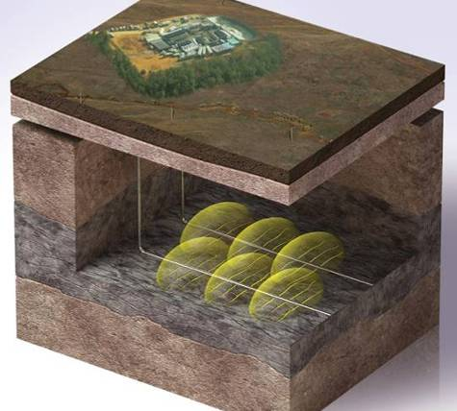
Key Enablers
3 technologies have made Unconventional Resources economically viable
Horizontal Drilling
Hydraulic Fracturing
Multistage Isolation
Vertical Well
Horizontal Well
Vertical well, Single-zone frac
Horizontal wells, Multi-zone fracs
Notes:
3 technologies have made Unconventional Resources economically viable: horizontal drilling, hydraulic fracturing, and multistage isolation
In the past, the typical natural gas well was drilled vertically and then completed and fractured in one zone, as illustrated on the left.
Today, unconventional gas wells are drilled horizontally with geosteering technology to keep the lateral section in the productive zone.
The horizontal sections are then completed and fractured in stages to produce from multiple zones extending thousands of feet.

Slide 15
Innovation Through Association and X- Discipline Collaboration
Aerospace
Medical
Nano-Tech
Material Sciences
Defense
Automotive
Composites
IN-Tallics TM
Compressed Coils
Laser
Additive Manufacturing
SRP Polymer
Degradable Thermosets
Nano Medicine
Hydrophobic Coatings
ConFINE TM
Nano Microgel Swelling Polymer
Silapore TM
E.M. Telemetry
ExPhite TM
Magnetostrict D.T.S.
Shape Memory Polymer
Brazed Bead Matrices
Fiber Optics
Distributed Acoustic Sensors
Tuned Vibrating Absorbers
Nano-Oil
Notes:
There is so much innovation occurring around the globe that focusing within ones’ own organization or industry is a recipe for failure. My own company has been leveraging technologies from other industries for the past 10 years and the benefits are huge.

Slide 16
TECHNOLOGY COLLABORATION
Collaborations Accelerate Innovation, Development and Commercialization
Company-university collaborations
Labs
Co-op programs
SPE student chapters
Expand infrastructure
© 2014 Baker Hughes Incorporated. All Rights Reserved.

Slide 17
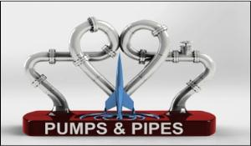
Technology Collaboration
Collaborations Accelerate Innovation, Development and Commercialization
Pumps & Pipes

Slide 18
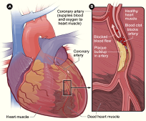
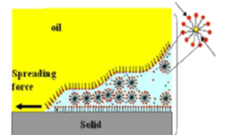
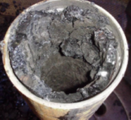
Pumps & Pipes: X-Industry Collaboration (Flow Assurance)
Notes:
Talk about Pumps & Pipes – oil and gas, medicine, now aerospace. EoM, TMH and BHI involved since the beginning.
SPE facilitates collaboration within our industry.

Slide 19
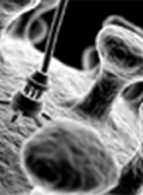
Cross-industry Collaboration - An Opportunity for SPE
Nanorobots for Saudi Aramco
In-vivo propulsion and navigation of magnetic nano particles in cardiovascular system

Slide 20
Leverage Your SPE Membership to Stay Connected
Active chapter member
Lunch networker (Study Groups)
10 business cards
Committee member
Workshop attendee / teacher
Conference attendee / presenter
7 new ideas
Mentor students
Expand engineering disciplines

Slide 21
One Degree of Separation – Erase it Now
Turn to the next person
Shake hands
Questions?
© 2014 Baker Hughes Incorporated. All Rights Reserved.

