Slide 1

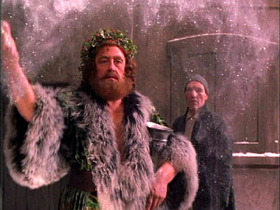
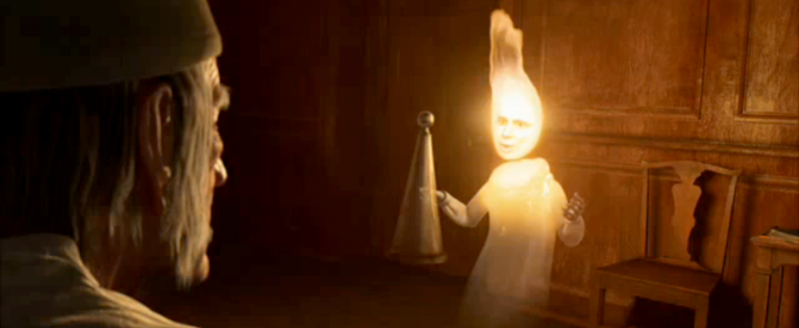
Society of Petroleum Engineers Gulf Coast
Section Breakfast
D. Nathan Meehan, Ph.D., P.E.
2016 SPE President
Senior Executive Advisor
Baker Hughes, Incorporated

Slide 3
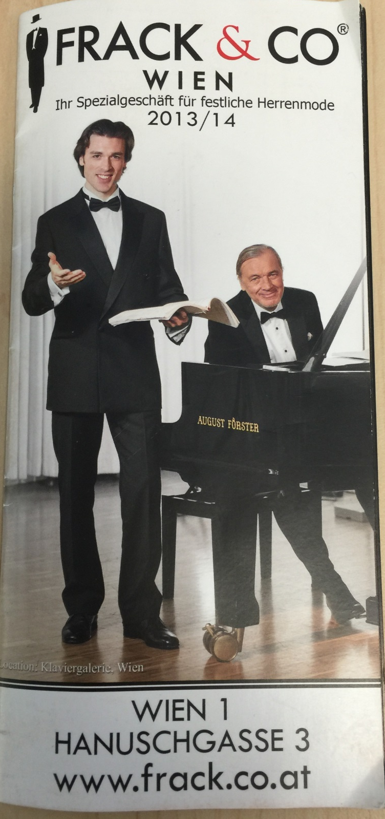
One of the joys of being Society of Petroleum Engineers President is the opportunity to travel around the world and see so many things through the eyes of a petroleum engineer. Imagine how happy I was while walking the streets of Vienna, Austria to see that hydraulic fracturing had been recognized as a brand of formal wear.
While the Society of Petroleum Engineers doesn’t do commercial endorsements, I am pretty sure that if we ever do one for men’s formal wear, this is it!

Slide 4
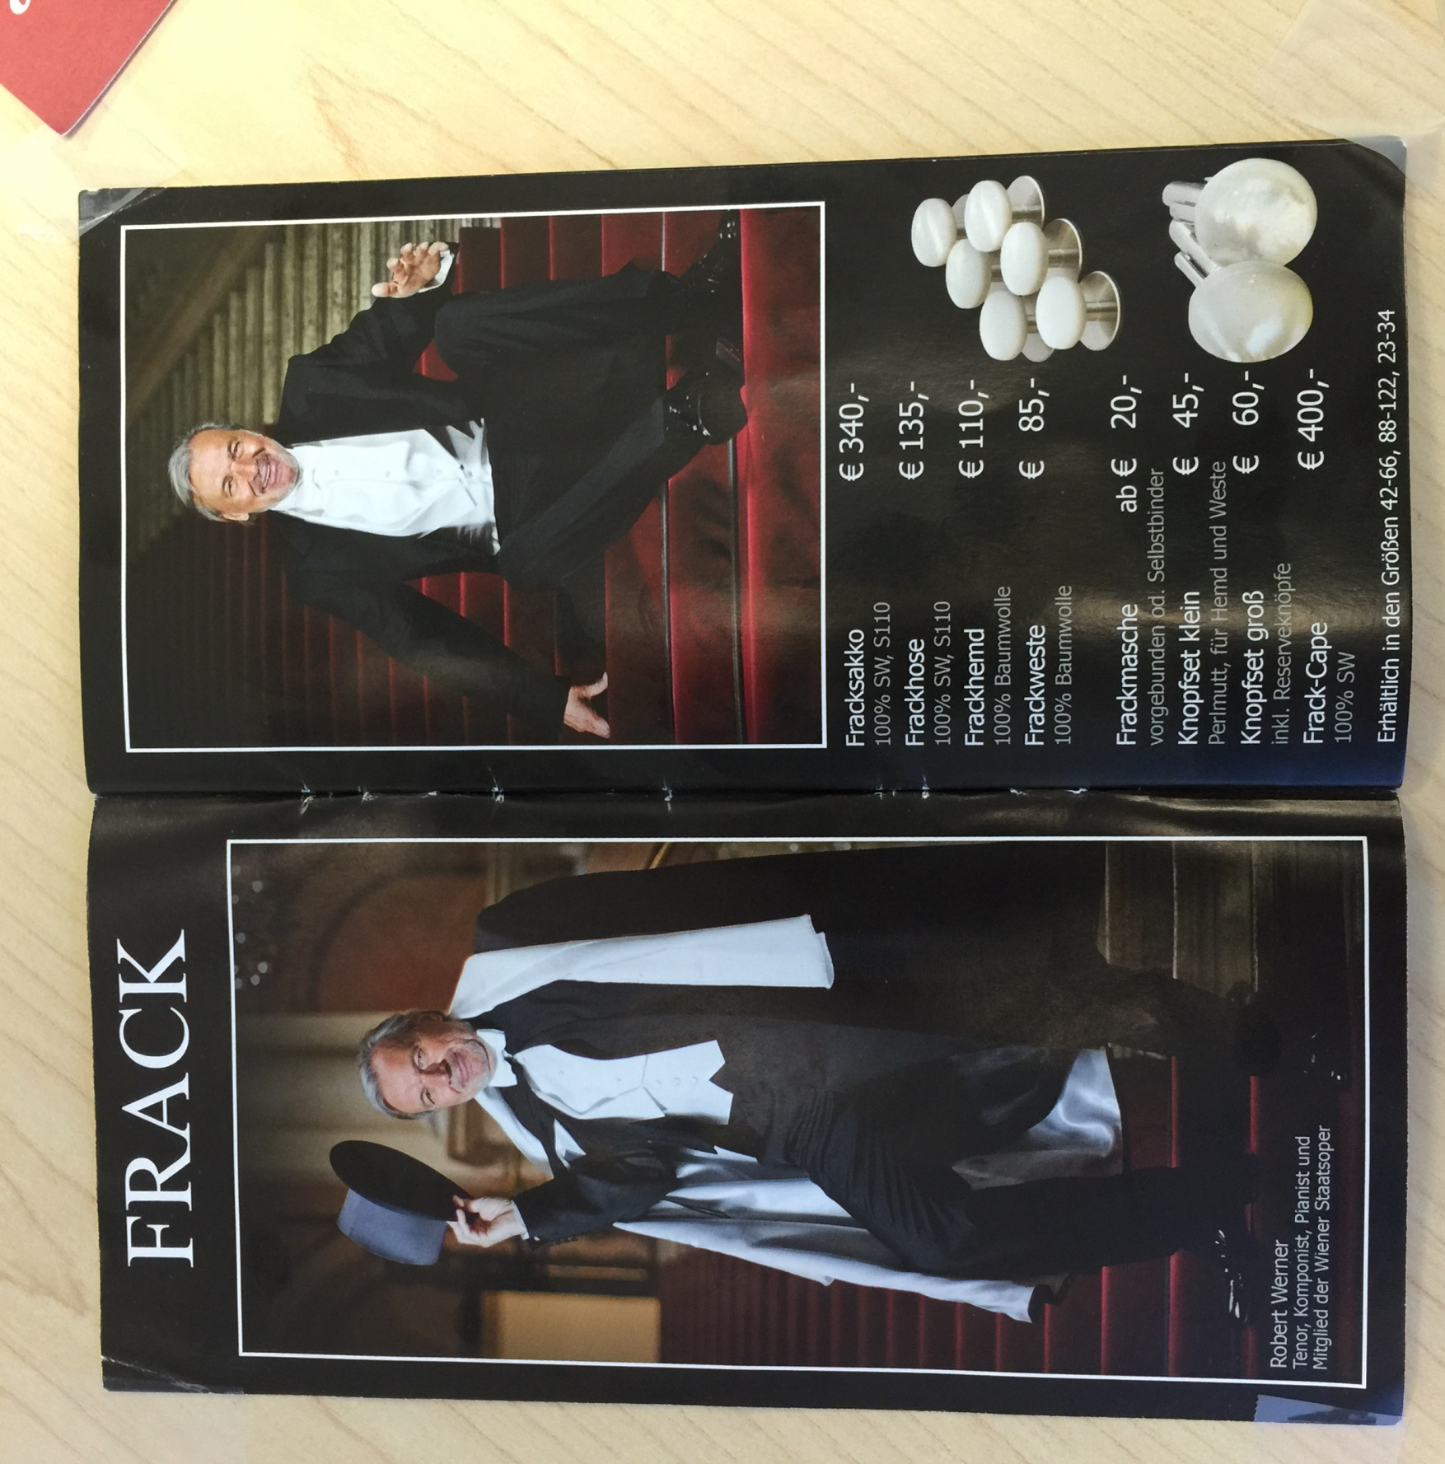
Can you name that famous petroleum engineer?

Slide 5
A story about a young man…
I asked him what he really wanted out of life.
He said “I want to be as rich as Bill Gates”
OK, why don’t you
  Program machine code at age 13
  Get perfect scores on college entrance exams and go to Harvard
  Drop out of Harvard and form a company that dominates the world’s software market

Slide 6
His response to me “I can’t do it like he did it”
We cannot succeed in the future just like we did in the past
That doesn’t mean this young man cannot learn many things from the actions of Bill Gates just as we can learn much from what has been done elsewhere
The Society of Petroleum Engineers plays an enormous role in our learning

Slide 7
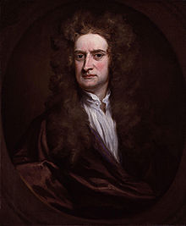
If I have seen further it is by standing on the shoulders of giants
Isaac Newton

Slide 8
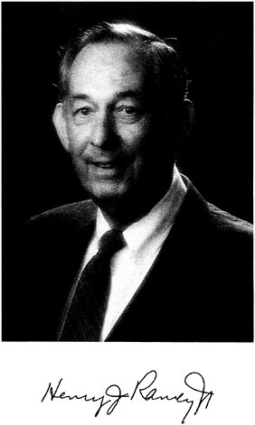
Six months in the lab can save two days in the library (loosely attributed to many)
Six months in the lab can save you thirty minutes on onepetro.org (Nathan Meehan)

Slide 9
Some things about the future
Energy is important to the world
Energy demand will continue to grow around the world
Fossil fuels will remain a big part of addressing energy demand
We will not be able to meet this demand without a social license to operate

Slide 10
Social License to Operate
You don’t get it by filling out an application
Community acceptance of a company and its operations
Community may be broadly defined

Slide 11
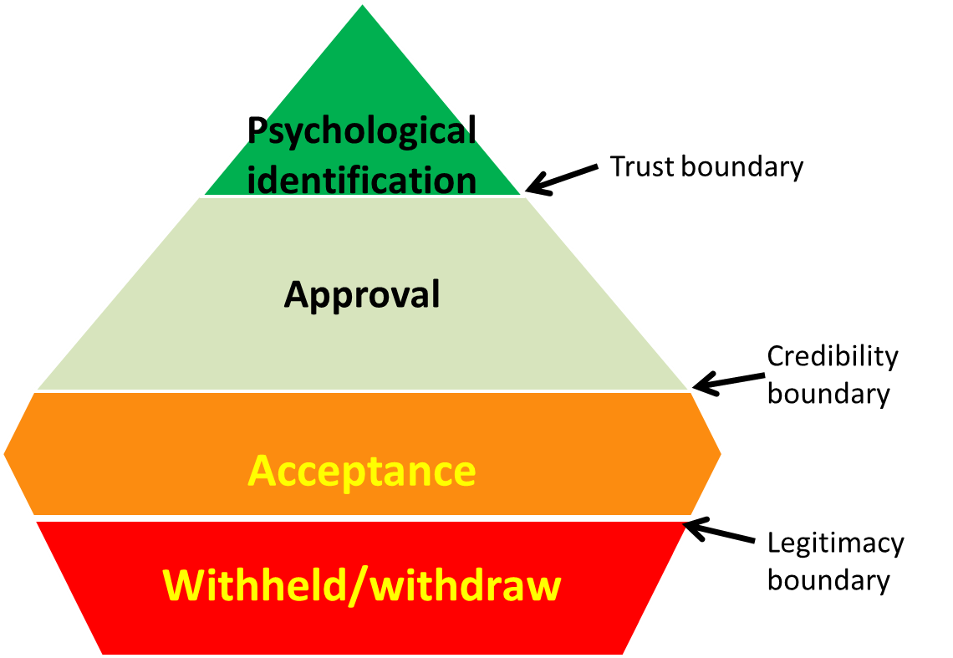

Slide 12
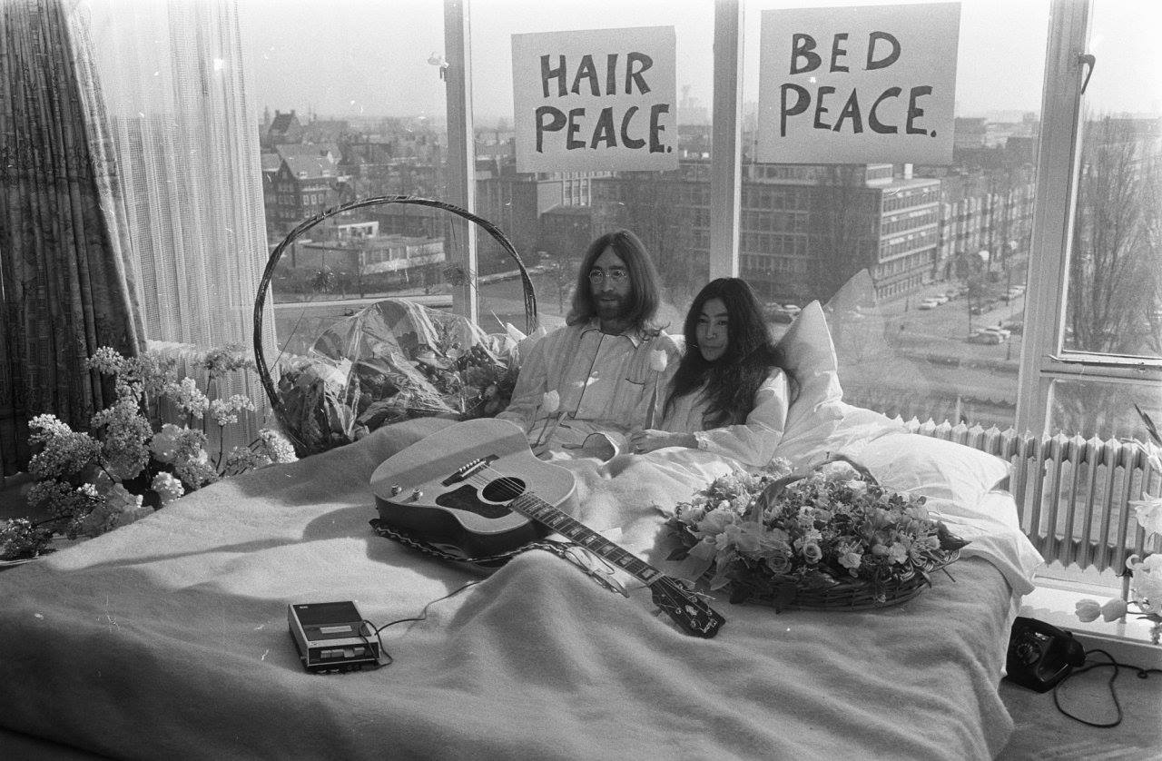

Slide 13
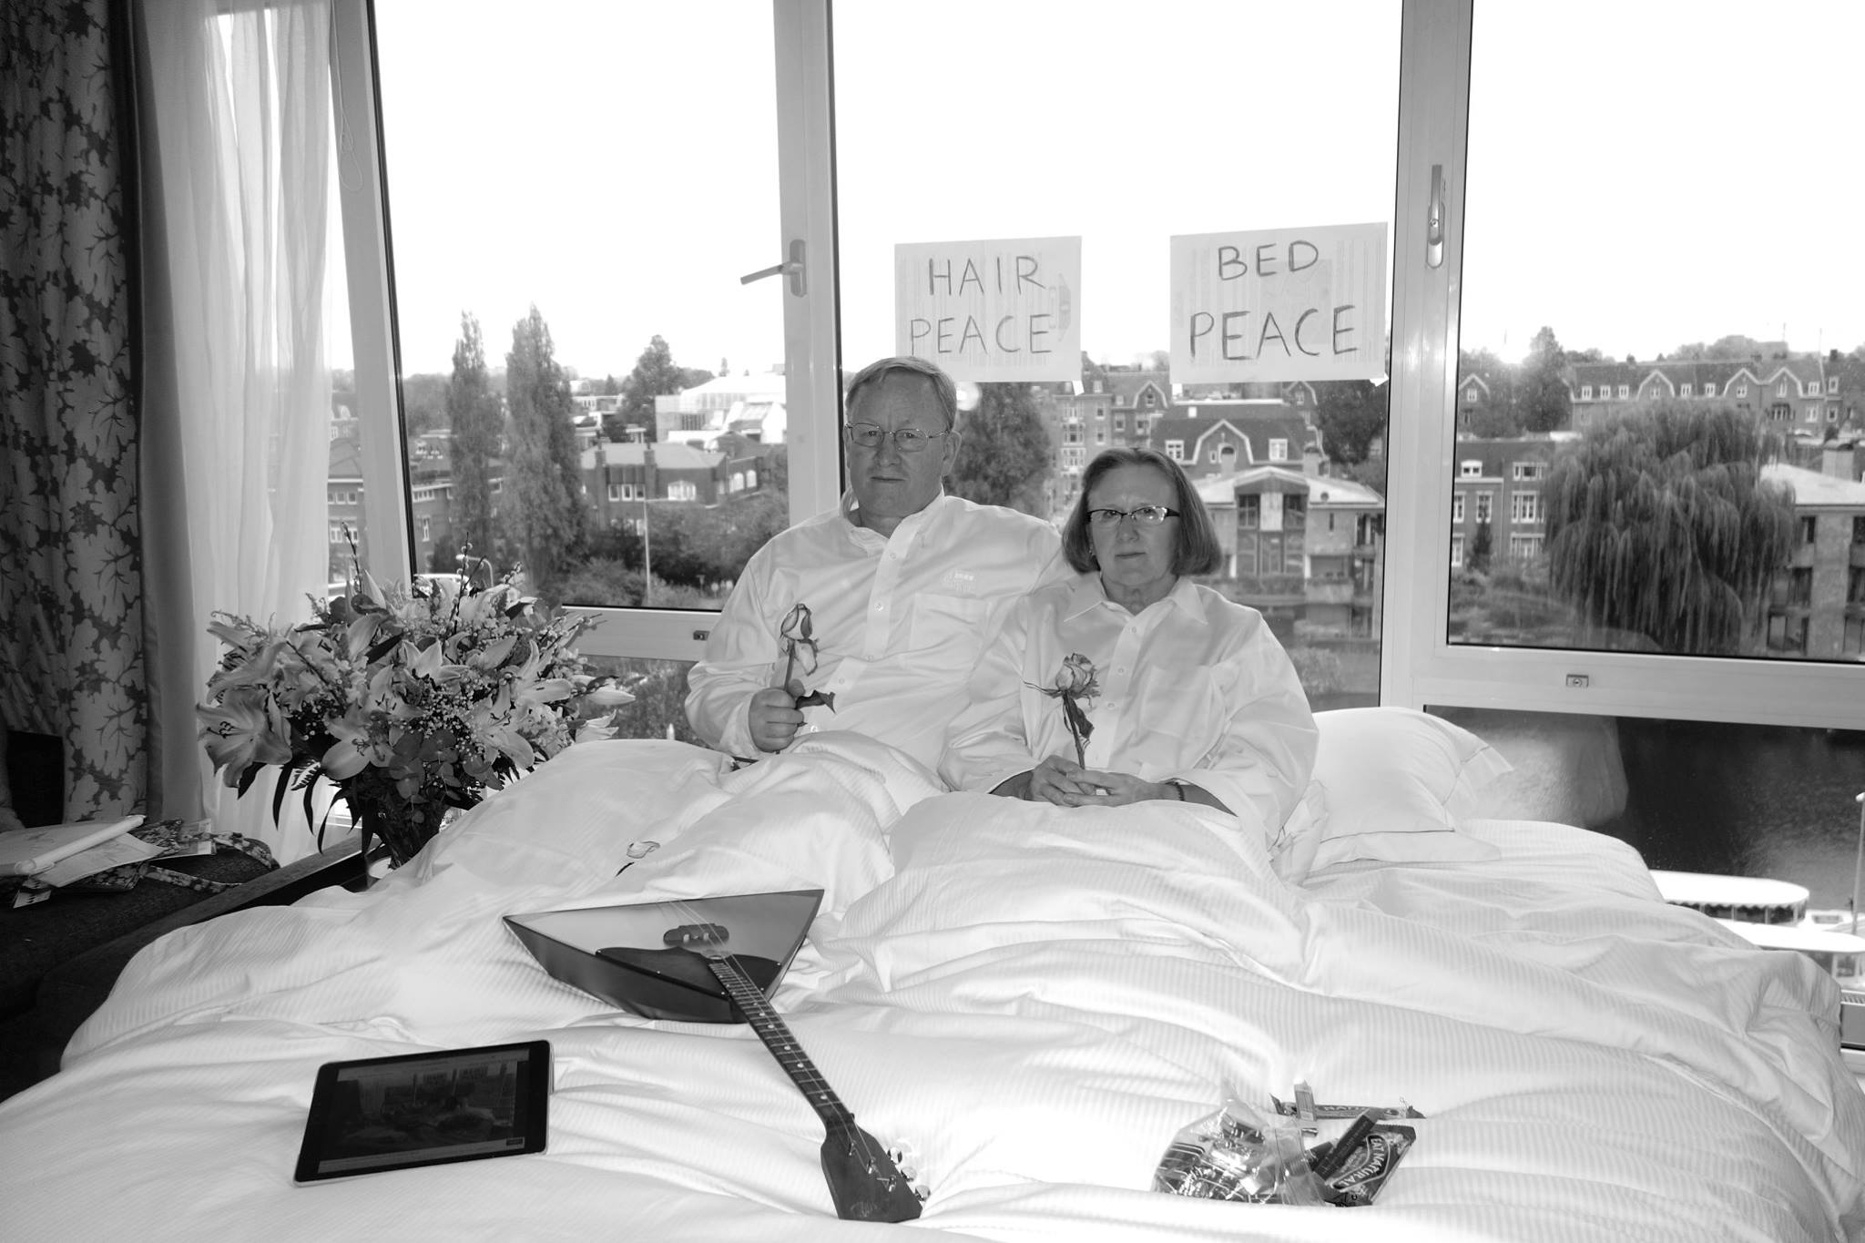

Slide 14
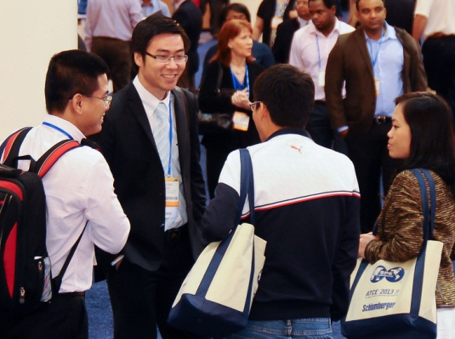
How Will We Measure Future Success?
Ability to meet demand for oil and gas
Operate safely in a cost effective and environmentally friendly manner
Obtain respect and acceptability by society
Ability to attract young, talented professionals to industry

Slide 15
Role of the Society of Petroleum Engineers in a down market
Role of SPE in public policy discussions
How do members contribute to the public policy debate?
Frac(k!)ing, climate change, carbon pricing/taxation, reserve definitions

Slide 16
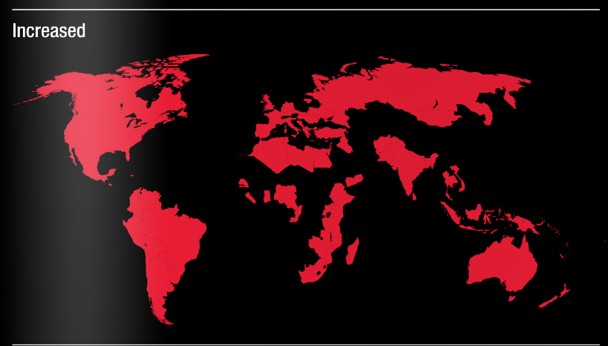
Do you think corruption in you country has increased, decreased or no change?

Slide 17
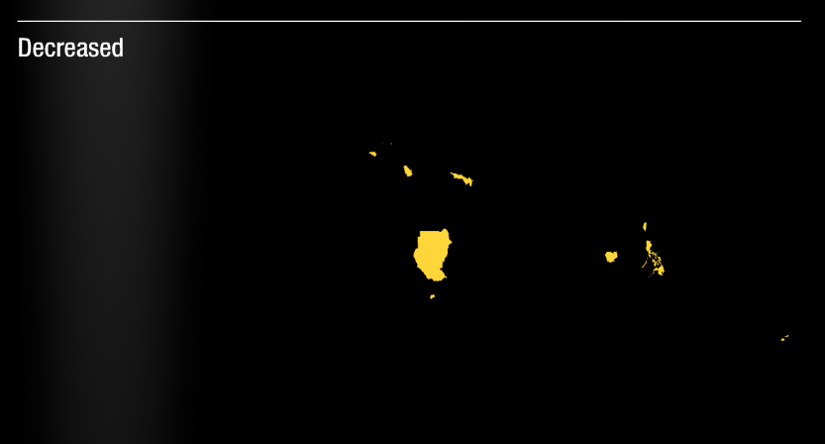
Do you think corruption in you country has increased, decreased or no change?

Slide 18
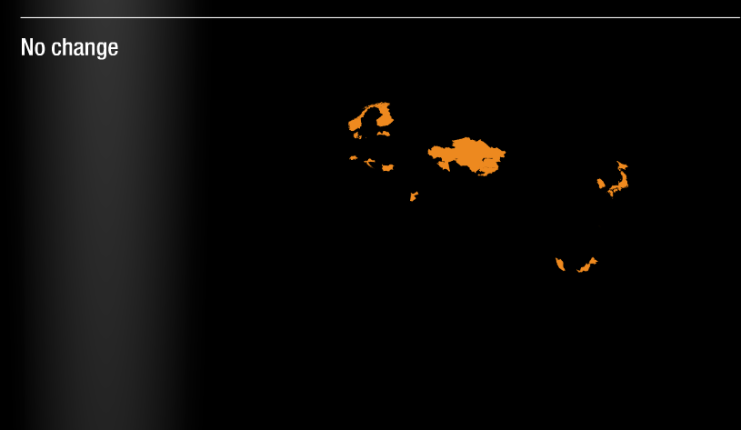
Do you think corruption in you country has increased, decreased or no change?

Slide 19
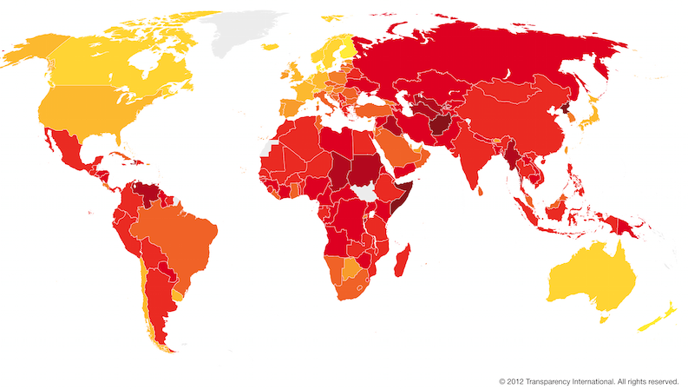
Corruption Perceptions Index 2012

