Slide 1

Society of Petroleum Engineers
Gulf Coast Section
February 10, 2015
Importance of SPE to the Industry
Dr. Ganesh Thakur
2012 SPE President, VP – Technology, Chevron (Retired),
Current Role: Global Advisor & Consultant
drganeshthakur38@gmail.com

Slide 2
Outline
Our mission and vision, $46/Bbl oil environment!
Growth in SPE, especially internationally
Globalization – half of SPE outside North America to serve global companies, ATCE rotation
OnePetro.org = treasure trove for companies to solve problems; learning and avoiding “reinventing the wheel”
Many thanks to execs – encourage volunteerism (share and gain)
Notes:
Last year we were 16.6 % of total membership

Slide 3
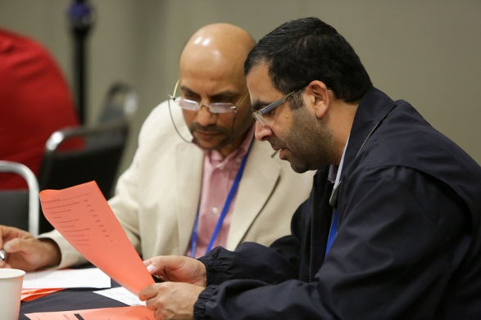
SPE Mission
To collect, disseminate, and exchange technical knowledge… and to provide opportunities for professionals to enhance their technical and professional competence

Slide 4

SPE Vision
Enable the global oil and gas E&P industry to share technical knowledge needed to meet the world’s energy needs in a safe and environmentally responsible manner

Slide 5
SPE Has Grown with the Industry
1871 American Institute of Mining Engineers (AIME) forms in
Pennsylvania, USA
1913 AIME creates oil and gas committee
1957 Officially founded as SPE
1985 SPE incorporates separately
2007 SPE celebrates 50-year anniversary
2011 SPE surpasses 100,000 members worldwide
2015 SPE membership grows to more than 143,000

Slide 6
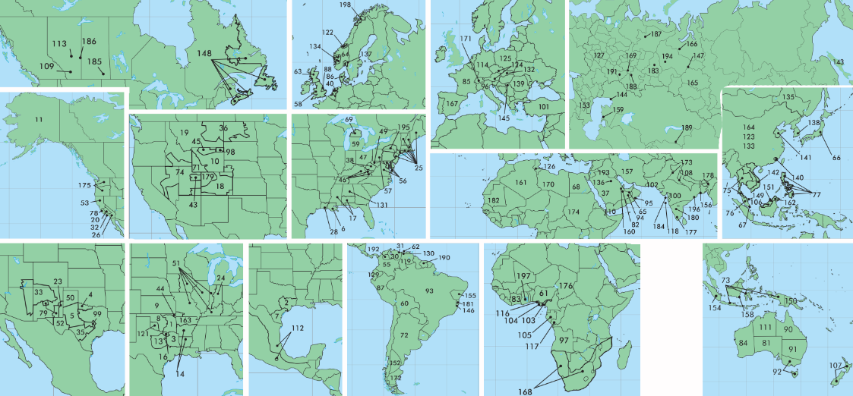
SPE’s Global Membership
143,000+ members in 137 countries
  199 professional sections
  337 student chapters

Slide 7
Membership
PROFESSIONAL
MEMBERSHIP
92,000+ members
in 137 countries
199 sections
48%  North America
16%  Middle East/
South Asia
14%  Europe
11%  Asia Pacific
5%  Africa
4%  South America/
Caribbean
2%  Russia and
Caspian
STUDENT
MEMBERSHIP
50,000+ members
in 124 countries
337 chapters
23%  North America
17%  Middle East/
South Asia
12%  Europe
17%  Asia Pacific
11%  Africa
14%  South America/
Caribbean
6%  Russia and
Caspian

Slide 8
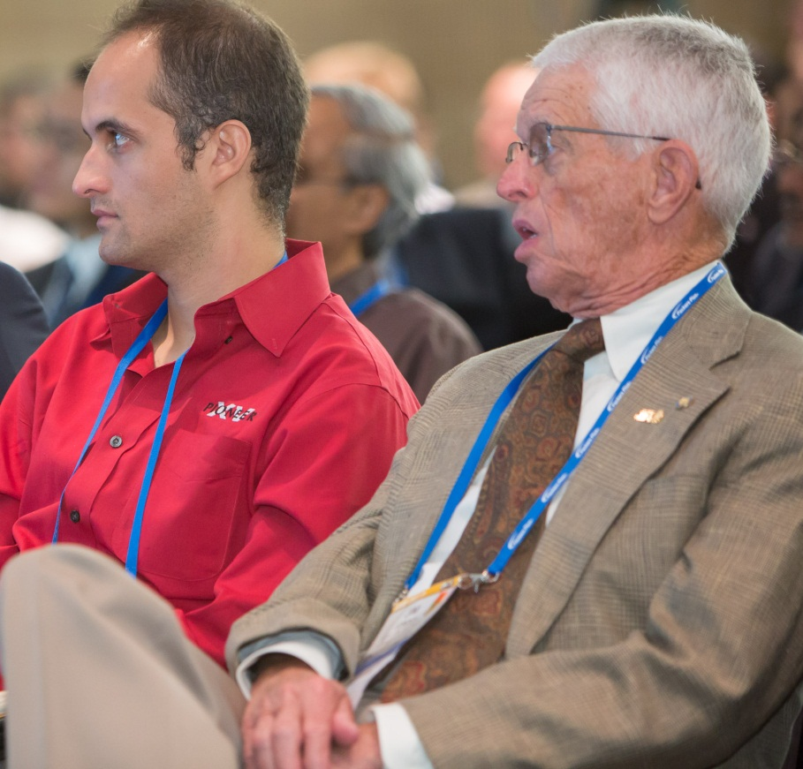
How SPE Disseminates Technology
Connecting members
  Conferences & other meetings held globally
  Online technical communities
Sharing technical knowledge
  Magazines
  OnePetro
  PetroWiki
  Peer-reviewed journals
Informing the public about our industry
  Energy4me teachers and students outreach
  Hydraulic fracturing website

Slide 9


SPE Technical Resources
SPE.org
Search and download papers
Join Technical Interest Groups
Access professional networks
Connect through eMentoring program
Read peer-reviewed journals
Technical Papers
65,000+ SPE technical papers in www.OnePetro.org multi-society library (130,000+ papers)
1,700 new papers annually
  Historical papers back to 1884
3 million+ downloads per year

Slide 10

Volunteerism
Volunteerism is key to SPE’s success
Volunteering helps members:
  Learn the industry
  Interact with industry professionals
  Give back to the industry
  Improve leadership skills

Slide 11
Summary
Our mission is even more important in $46 oil environment!
Continuous learning and improvement – innovation and ingenuity,
reduce costs effectively, increase recovery and production
Growth in SPE – making us truly an international organization
Globalization – half of SPE outside North America to serve global companies, ATCE rotation
OnePetro.org = treasure trove for companies to solve problems; learning and avoiding “reinventing the wheel”
Many thanks to execs – encourage volunteerism (share and gain)
Notes:
Last year we were 16.6 % of total membership

